Slide 1
The Dreaded Duo: Strictures and Fistulas
David A. Schwartz, MD, FACG, AGAF Director, McClain Family Directorship in Gastroenterology Director, Inflammatory Bowel Disease Center
Director, OHO Endoscopy Unit Professor of Medicine Vanderbilt University Medical Center

Slide 2
Program Disclosures
I, David Schwartz declare that I do not have any financial relationships that will impact my ability to present an unbiased presentation.

Slide 3
Perianal Fistulas

Slide 4
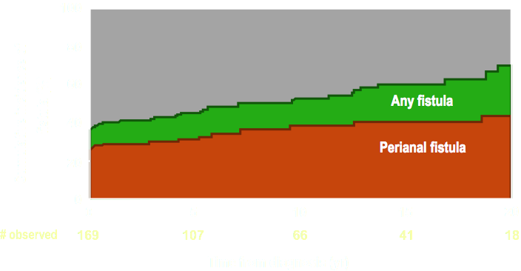
Cumulative Incidence of Crohn’s Fistulas
Rate of PCD decreased in recent cohort > 1998 to 14.5 %
Schwartz et al, Gastro 2002
Park et al., IBD 2019

Slide 5
Durable Fistula Healing Rates are Disappointing
Retrospective study from Leiden of 232 patients with CD fistulas - ~ 10 years followup
78% had complex fistulas
Long –term fistula healing was seen in only 37% of patients with complex fistulas
66.7 % of simple fistulas
53 % of patients required surgery (colectomy, etc)
Proctectomy Rate in recent Mayo cohort was largely unchanged at 19%
Molendijk et al. IBD 2014
Park et al., IBD 2019

Slide 6
PCD is Associated with Increased Costs
All-cause Healthcare Costs P < 0.0001 for all comparisons, PAF CD vs non-PAF CD
GI-related Healthcare Costs P < 0.0001 for all comparisons, PAF CD vs non-PAF CD
$85,233
$71,612
$40,526
$29,458
2,138
Schwartz et al, 2020

Slide 7
Classification System

Slide 8
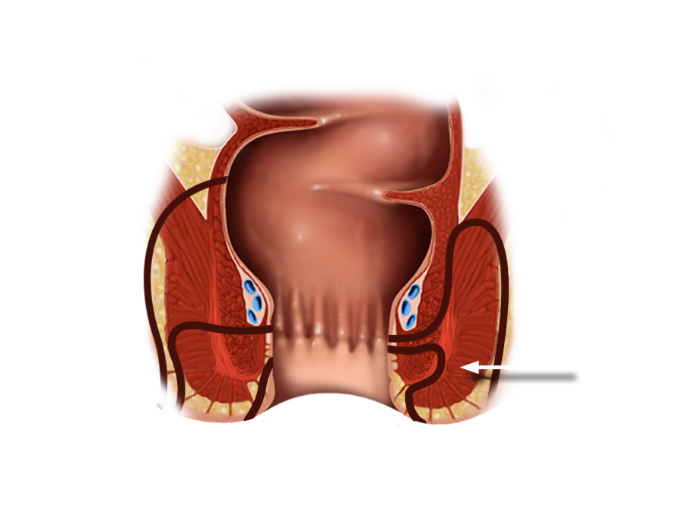
Park’s Classification of Perianal Fistulas
A: Superficial
B: Intersphincteric
C: Trans-sphincteric
D: Suprasphincteris
E: Extrasphincteric
External anal
sphincter
E
C
A
B
D

Slide 9
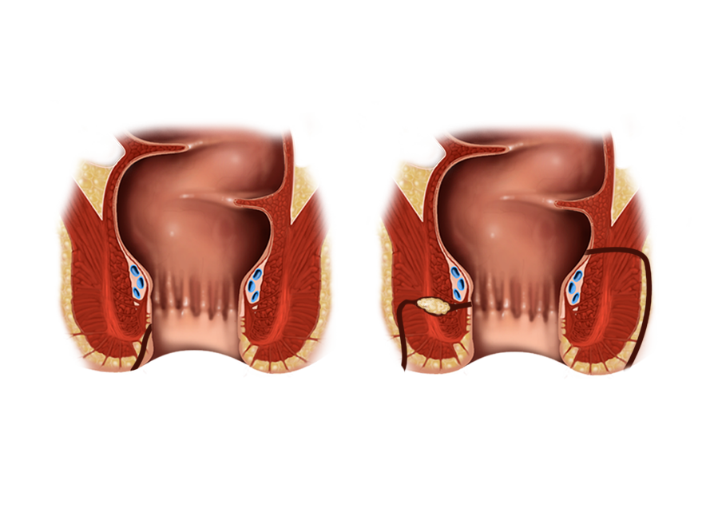
Simple vs. Complex Fistulas
Simple
Complex

Slide 10
Patient Focused Perianal Classification

Slide 11
Approach to Initial Diagnosis and Assessment

Slide 12
Why is a precise evaluation important?
The key to successful management is to establish adequate drainage of all abscesses and to control fistula healing. An imaging modality should provide a virtual road map for this purpose.

Slide 13
What Happens When Fistulas are Missed at Time of EUA?
-In 52% of patients needed repeat surgery in cases where surgery and MRI disagreed
-Fistula recurrence was always at site predicted by MRI
Buchanan et al, Lancet 2002

Slide 14
Study Results
A prospective triple blinded study compared EUS, MRI and EUA in 32 patients with suspect perianal Crohn’s disease.¹
All three methods showed excellent accuracy in assessing these patients
EUS – 91% (95% CI 75% - 98%)
EUA – 91% (95% CI 75% - 98%)
MRI – 87% (95% CI 69% - 96%)
Combining either of the imaging modalities with EUA increased the accuracy to 100%
1- Schwartz et al., Gastro 2001

Slide 15
Options for Therapy

Slide 16
Surgical Treatment

Slide 17
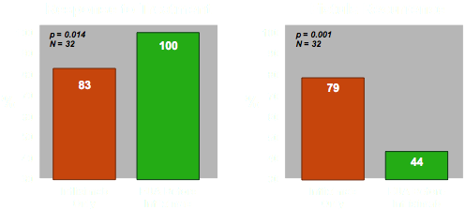
Does Controlling Fistula Healing Make a Difference?
Requeiro et al, IBD 2003

Slide 18
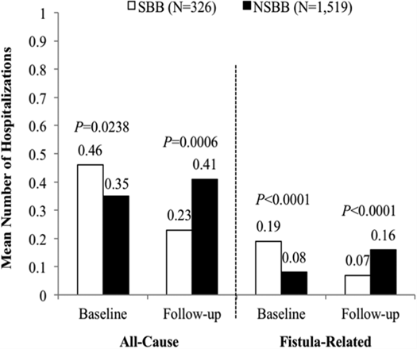
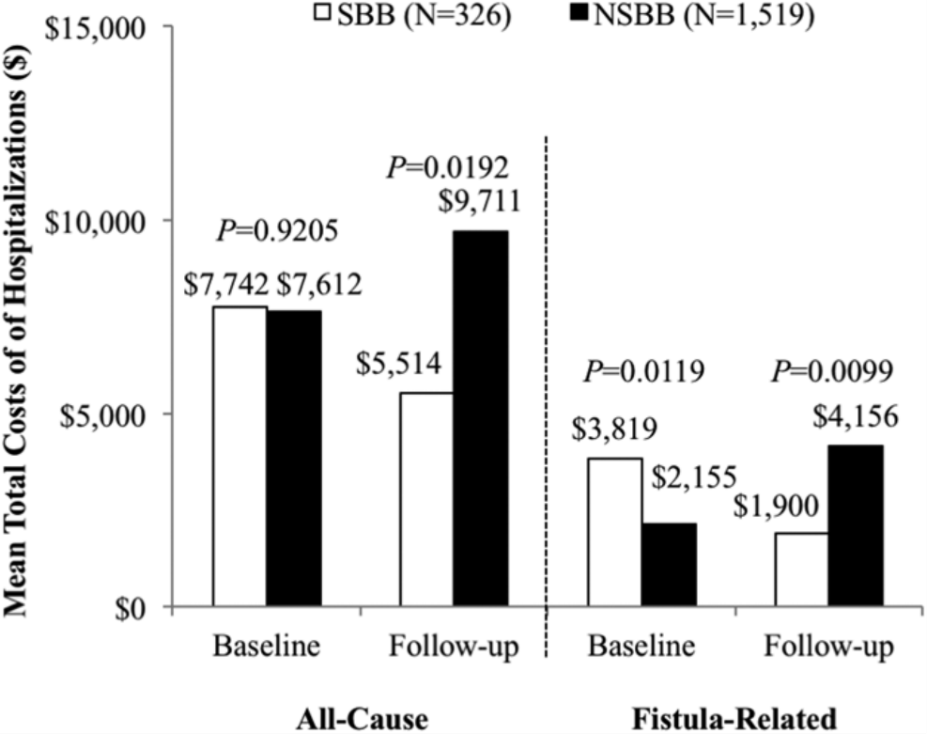
Comparison of Healthcare Utilization in Patients with CD Perianal Fistulas Treated with Biologics with or without Setons
Schwartz, IBD 2017

Slide 19
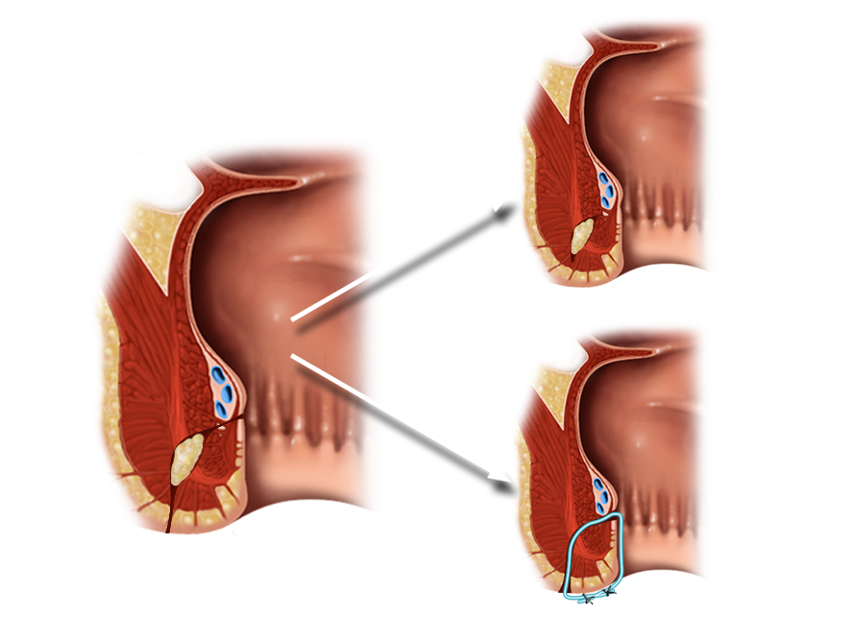
Setons Prevent Premature Closure of Fistula Openings
Without Seton
With Seton
Seton

Slide 20
Medical Therapies
Antibiotics (metronidazole, ciprofloxacin)
Immunosuppressives
Azathioprine
6-mercaptopurine
Cyclosporine
Tacrolimus
Biologic Agents
Infliximab
Adalimumab
Certolizumab
Vedolizumab ?
Ustekinumab?
JAK inhibitors
Novel Agents
Adipose Derive Stem Cells

Slide 21
Antibiotics

Slide 22
Antibiotics Improve Fistula healing in Combination with Anti-TNF Therapy
N=76
All patients received adalimumab 160 mg at wk 0, 80 mg at wk 2 and then 40 mg qow. Patients were then randomized to Ciprofloxacin 500 mg bid or placebo.
Dewint P, et al. Gut 2013.
Notes:
Dewint P, Hansen BE, Verhey E, Oldenburg B, Daniel W. Hommes, Marie J. Pierik, Cyriel Ponsioen, Hendrik M. van Dullemen, Maurice G. Russel, Adriaan A. van Bodegraven, Christien J. van der Woude et al. Adding Ciprofloxacin to Adalimumab Results in a Higher Fistula Closure Rate in Perianal Fistulizing Crohn's Disease. Gastroenterology 2012 Vol. 142, Issue 5, Supplement 1, Page S-212.
AddingCiprofloxacintoAdalimumabResultsinaHigherFistulaClosureRateinPerianalFistulizingCrohn'sDiseasePieterDewint,BettinaE.Hansen,ElkeVerhey,BasOldenburg,DanielW.Hommes,MarieJ.Pierik,CyrielPonsioen,HendrikM.vanDullemen,MauriceG.Russel,AdriaanA.vanBodegraven,ChristienJ.vanderWoudeBACKGROUND:Bothanti-TNFagentsandantibioticshaveshowntheirefficacyfortheclosureofperianalCrohn'sfistulas.Theexistenceofanadditiveeffectofcombinationtherapyforfistulaclosureremainstobedemonstrated.METHODS:Amulticenter,double-blind,placebocontrolledtrialwasconducted,evaluatingadalimumabincombinationwithcipro-floxacinorplacebointhetreatmentofactivefistulizing,perianaldiseaseinCrohn'sdiseasepatients(ADAFI).Seventy-sixpatientswereenrolledandreceivedinductiontherapywithadalimumabsubcutaneously(160mgonweek0,80mgonweek2),followedbymaintenancetherapy(40mgeveryotherweek)togetherwithplaceboorciprofloxacin500mgtwicedailyfor12weeks,dependingontherandomizationarm.Theanalyseswerebasedonthemodifiedintention-to-treatpopulationafterexclusionof4patientswithspontaneousfistulaclosurebeforestudystartand2patientsinwhomperianaldrainswereleftinsitu.Theprimaryendpointwasclinicalresponse,definedasareductionof≥50%ofthenumberofdrainingperianalfistulasfrombaselinetoweek12.Patientsnotevaluatedatthesheduledtimepointswerecodedasnon-responders.SecondaryendpointswerechangeinPerianalCrohn'sDiseaseActivityIndex(PDAI)frombaselineandinductionofremissionofCrohn'sdiseasebasedonCrohn'sDiseaseActivityIndex(CDAI).RESULTS:Seventeen(47,2%)of36patientsassignedtoadalimumabplusplaceboand24(70,6%)of34assignedtoadalimumabincombinationwithciprofloxacinshowedclinicalresponseatweek12(p=0.047).Atweek24,nosignificantdifferencebetweenthe2groups(17/36resp21/34)couldbewithheld(p=0.22).Theoverall,medianPDAIatweek12andweek24(medianPDAI=3resp3)wassignificantlylowerthanatbaseline(medianPDAI=7)(p<0.001).However,comparingthe2treatmentarms,nosignificantdifferenceinthechangeofPDAIfrombaselinecouldbedetectedatweek12noratweek24(p=0.16respp=0.32).CombinationtherapywithciprofloxacinwasmoresuccessfulthanadalimumabaloneatinducingremissionofCrohn'sdisease(CDAI<150)atweek12(68.8%vs26.7%,p=0.02).Intotal,24(34,3%)of70patientshadpreviouslyreceivedinfliximab.Thisdidnotinfluenceperianalfistularesponseratetotreatmentwithadalimumab,comparedtopatientsnaivetoinfliximab(62.5%resp56.5%(p=0.63)).CONCLUSION:FortheinductionofperianalfistulaclosureinCrohn'sDisease,combinationtherapyofadalimumabandciprofloxacinishighlyeffectiveandcanbeadvocatedoveradalimumabalone.Afterdiscontinuationofantibiotictherapy,theinitialbeneficialeffectofco-administrationonfistulaclosurerateisnotmaintained.Previoustreatmentwithinfliximabdoesnotinfluencethepotencyofadalimumabtoinduceperianalfistulaclosure.

Slide 23
Azathioprine / 6 - MP

Slide 24
Azathioprine / 6 - MP
The 5 Controlled trials were summarized in a meta-analysis¹
22 / 41 (54%) of patients who received AZA /6-MP responded vs. 6 / 29 (21%) who received placebo.
Pooled odds ratio was 4.44 in favor of fistula healing
1-Pearson et al. Ann Intern Med. 1995

Slide 25
Anti-TNF α Antibody

Slide 26
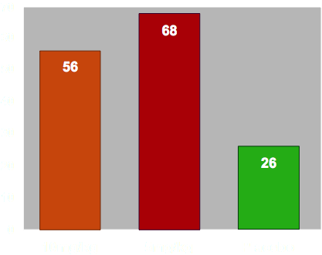
Infliximab for Crohn’s Perianal Fistulas
Primary endpoint; > 50% reduction in open fistulas
Initial Fistula Response to Infliximab
N=94
%
p = 0.041
p < 0.001
Present et al. , NEJM 1999

Slide 27
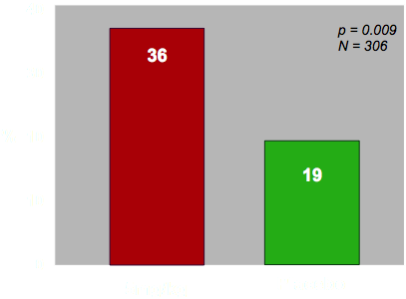
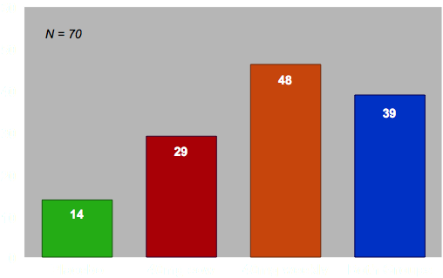
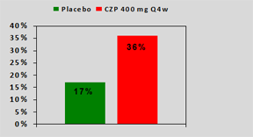
Anti-TNF Maintenance Therapy for CD Related Fistulas
Infliximab
Adalimumab
Certolizumab
N=28
1-Sands et al. , NEJM 2004
2-Colombel, Gut 2009
3- Schreiber S, et al. APT, 2011

Slide 28
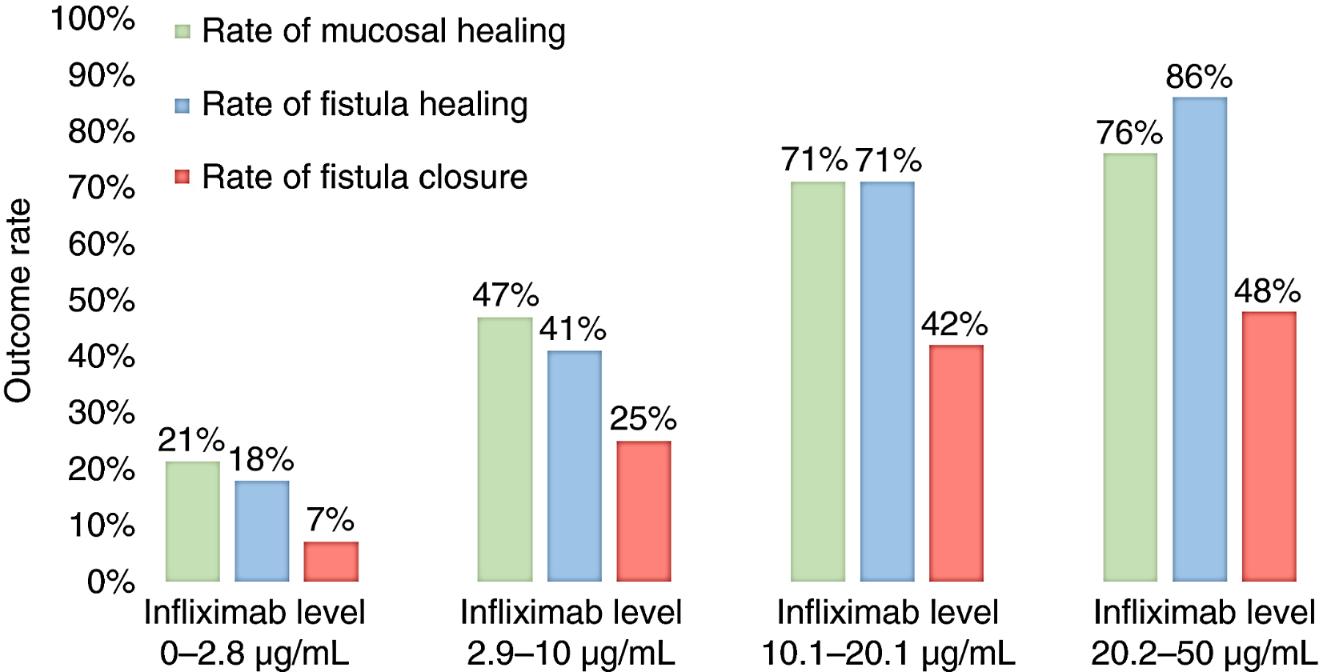
Higher Infliximab Trough Levels are Associated with a Higher Rate of Perianal Fistula Healing
Yarur A., APT 2017
Notes:
514
Higher Infliximab Trough Levels Are Associated With a Higher Rate of
Perianal Fistula Healing in Patients With Crohn's Disease
Andres Yarur, Vikram Kanagala, Daniel Stein, Frank Czul, Dilpesh Agrawal, Yelena
Zadvornova, Maria A. Quintero, Maria T. Abreu
BACKGROUND: Perianal complications are common in Crohn's disease (CD) and are usually
associated with a more aggressive disease behavior. While antibiotics and immunomodulators
had been used with some success, anti-tumor necrosis factor (anti-TNF) agents likely represent
the most efficacious medical therapy. Nevertheless, some patients with perianal fistulas
do not benefit from therapy, which could be explained by the lack of sufficient drug. The
aim of this study was to assess the correlation between perianal fistula healing (FH) and
serum infliximab (IFX) trough levels. METHODS: This was a multicenter cross sectional
study including patients with Crohn's disease (CD) with active perianal fistulas that were
started on IFX and had been on the drug for at least 24 weeks. We excluded patients that
underwent a fecal diversion procedure or proctectomy. Predictive variables included patient
demographics, disease phenotype, Harvey Bradshaw index, trough IFX levels, anti-IFX
antibodies (ATI), and medical therapy the patients were receiving at the time drug levels
was measured. The primary outcome was FH defined as the absence of drainage. The
secondary outcome was fistula closure. Rate of fistula healing was determined at each IFX
quartile level in order to assess optimal IFX threashold levels. Receiver operating characteristic
(ROC) analysis was also performed to evaluate how IFX levels predicted the primary and
secondary outcomes. RESULTS: 117 patients were included. Mean age was 39 (SD: 14.8)
and mean time between starting IFX and drug level measurement was 32 months (SD: 36).
63 patents (53.9 %) had fistula healing while 36 (31%) also had fistula closure. 17 patients
(14.5%) had setons placed. Patients with FH had significantly higher IFX level when compared
to those with active fistulas (18.5 vs. 6.5 μg/mL respectively [p<0.0001]). Other differences
between those patients with and without FH are shown in Table 1. There was an incremental
gain in FH with higher IFX levels (Figure 1). The AUC for the association between FH and
IFX levels was 0.82 (p<0.0001), while the AUC for the association of IFX levels and fistula
closure was 0.69 (p=0.014). Patients with ATIs had a lower chance of developing FH (OR:
0.04 [95%CI: 0.005-0.3], p<0.001) and fistula closure (OR: 0.038 [95%CI: 0.005-0.3],
p>0.0001) but combination therapy with an immunomodulator did not increase the odds of
achieving FH (OR: 1.7 [95%CI:0.8-3.7], p=0.157). CONCLUSIONS: We found a significant
association between serum IFX levels and rates of FH. This association was stronger with
FH (absence of drainage from the fistula) than with fistula closure. Notably, IFX levels
needed to achieve FH were higher than what was been described for mucosal healing.
Achieving higher IFX levels in patients with CD and perianal fistulas may improve outcomes
and should be considered in a treat-to-target strategy.
TABLE 1: Differences between patients with and without fistula healing
Figure 1: Incremental gain in fistula healing (FH) rates in relation to infliximab (IFX)
serum level
#### PLEASE DO NOT DELETE CONTENT BELOW THIS LINE ! ####
########### Presentation 'IFX_GLM_UST_DDW Abstracts of Interest_Final.pptx' created on May 22, 2016 ###########
Author: CEichelb Intended Use: Unsolicited Not for Dissemination Approval Date: 5/22/2016 Review By: 5/22/2017
*************** User Comments **************
*Developed by GI MSL team, lead by Nancy Rayhorn. Reviewed and approved by Jay Popp.
*
*******************************************
Presenter: MA Personnel Intended for: HCP
Slide #:81

Slide 29
How Can We Improve Outcomes for Patients with Crohn’s Perianal Fistulas?

Slide 30
The Use of Imaging to Guide Therapy

Slide 31
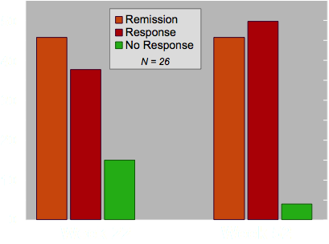
MRI to Guide Therapy with Infliximab or Adalimumab
Medical therapy was increased if no or partial response seen on MRI
Ng et al. Am J Gastro 2009

Slide 32
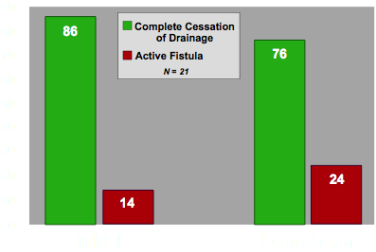
Utilizing EUS to Improve Fistula Healing
%
Schwartz et al, IBD 2005

Slide 33
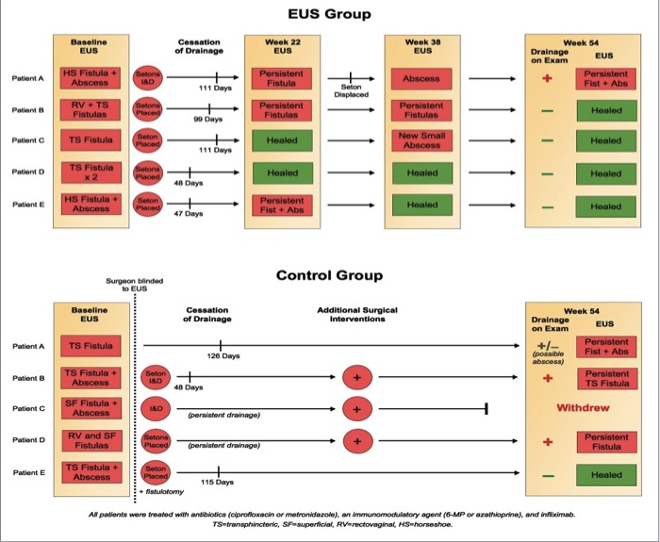
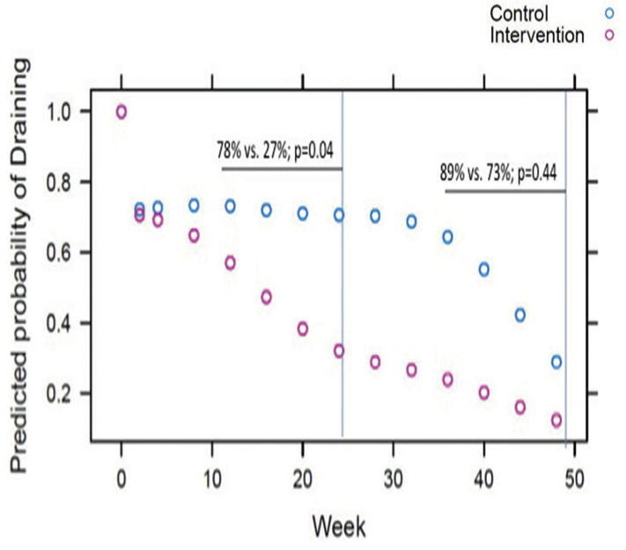
Two Randomized Prospective Studies Looking at EUS to Improve Outcomes
Initial Prospective Pilot Study
Follow-up Prospective Study
1-Spradlin, Schwartz Am J Gatro 2008
2- Wiese,Schwartz IBD 2015

Slide 34
Future Options ?

Slide 35
Post Hoc Analysis Suggests Ustekinumab Effective for Perianal Disease in Crohn’s
In large retrospective cohort (207 pts)- fistula healing was 39% at 6 months
Optimization to trough > 4.5 at week 26 was associated with better healing rates
Fistula Resolution at Week 8 - Pooled Data from CERTIFI, UNITI-1 and UNITI-2
Sands, DDW 2017
Battat R. Gastro 2017
Chapuis-Biron et al. Am J gastro 2020

Slide 36
Enterprise- Vedolizumab for CD Perianal Fistulas
Schwartz et al. DDW 2020

Slide 37
JAK Inhibitors for PCD
Filgotinib – Divergence 2
Upadacitinib – Secondary Analysis from Phase 3 Trials
1- Reinisch , Schwartz et al. ECCO 2022
2- Colombel, Schwartz et al. DDW 2023

Slide 38
Adipose Derived Stem Cells – Fistula Healing at Week 24 and Week 52
N =212
- Remission and Response rates higher in TNF/Immunomod pts - 67% v. 47%
- 75% of those who healed by wk 24 maintained remission out to week 52
Panes, Lancet 2016

Slide 39
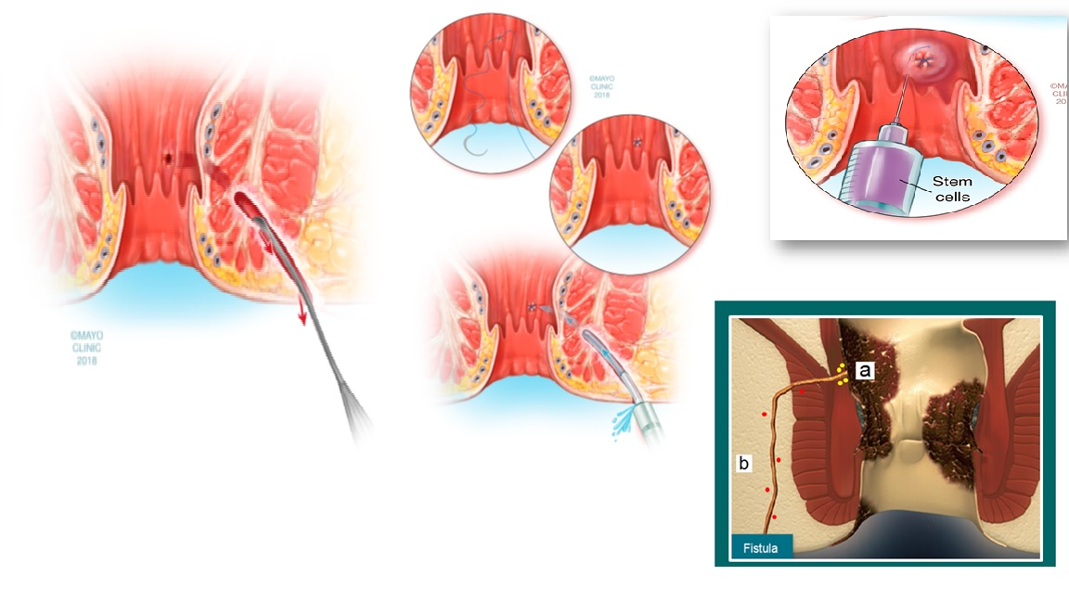
Steps for Administering Stem Cells
1
2
3
4
Georgiev-Hristov et al. J Gastro Surgery 2018

Slide 40
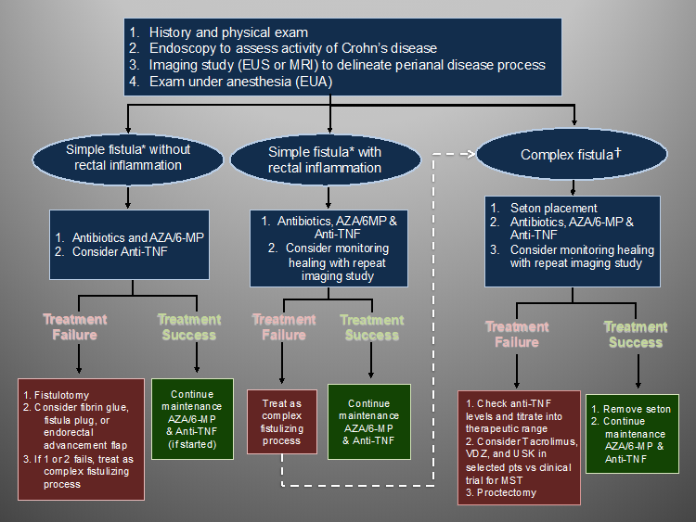

Slide 41
Strictures

Slide 42
Patient Example
32 yo male with 10 year h/o CD. S/p IC resection 5 years ago.
On IFX started 2 years post resection
Began experiencing post prandial abd pain about 6 months ago
CTE shows narrowing of distal ileum without pre-stenotic dilation
IFX levels checked about were 11 at trough
Colonoscopy

Slide 43
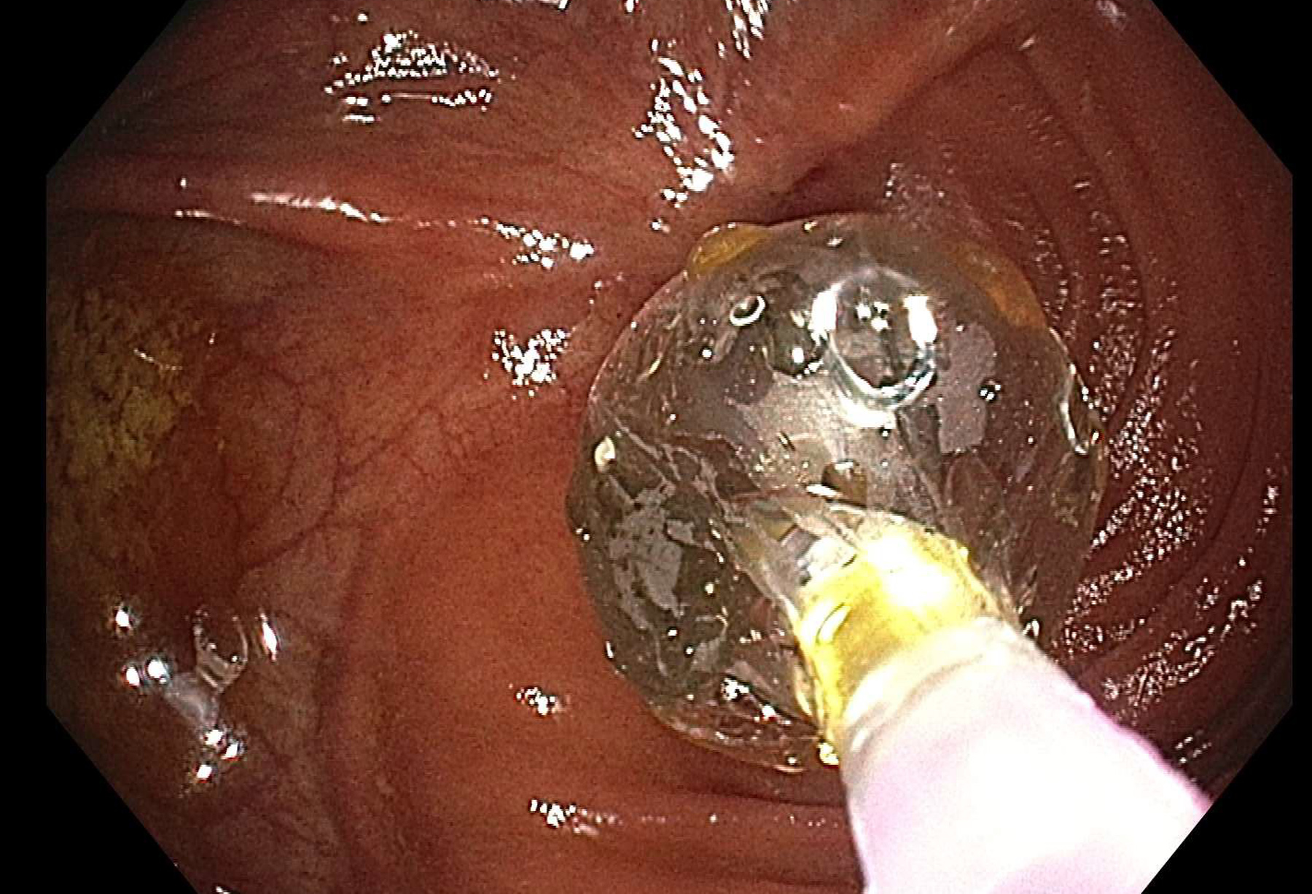
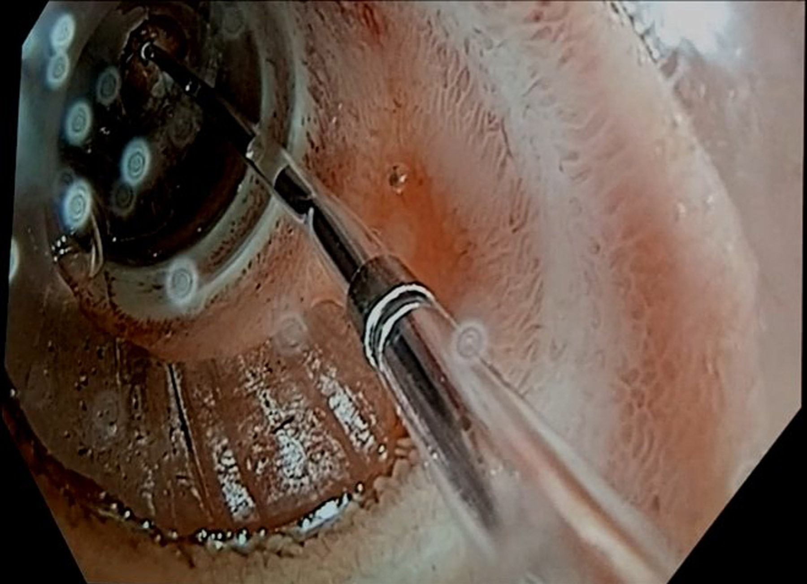
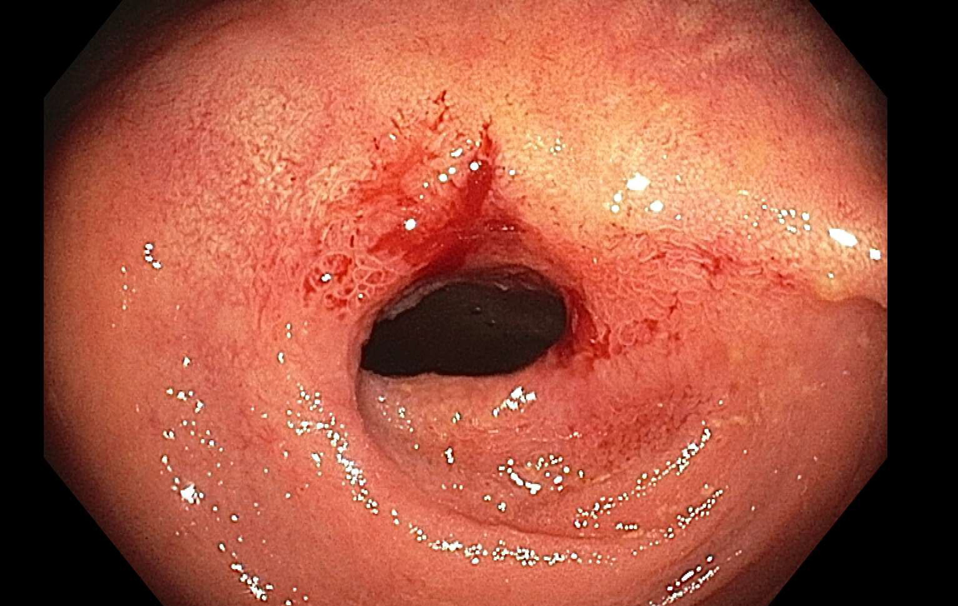
PT Case Continued

Slide 45
Strictures
Types of Stricture
5–24% patients, stricturing phenotype
no effective medical treatment
Surgery is gold standard
Chen M, IBD 2015;21:2222-40

Slide 47
Goals of Endoscopic Therapy for Strictures
Improve obstructive symptoms
Improve drainage symptoms
Reduce complications related to stricture and fistula
Adjunct to medical / surgical therapy
Space out need for surgery

Slide 48
Endoscopic Balloon Dilatation
Predominantly fibrotic stricture
Stricture length < 5 cm
Benign stricture
Preferably straight bowel lumen
No associated fistula or abscess
Shen B, Kochhar G et al. Lancet Gastro & Hepatol 2020;5(4):393-405

Slide 49
When to Avoid EBD
Deep ulcerations
Stricture length > 5-6 cm
Significant pre stenotic dilatation
Concurrent fistula, abscess, sinus
Angulated strictures
Shen B, Kochhar G et al. Lancet Gastro & Hepatol 2020;5(4):393-405

Slide 50
Endoscopic Balloon Dilatation
Author | No. Patients | Technical success (%) | Major Complication (%) | Surgical Intervention (%)
Couckuyt et al | 55 | 90 | 11 | 35
Thomas- Gibson et al | 59 | 74 | 3 | 61
Hagel et al | 77 | 65 | 10 | 35
Gustavsson et al | 178 | 89 | 11 | 36
Thienpont et al | 138 | 97 | 8 | 24
Mueller et al | 55 | 95 | 2 | 24
Atreja et al | 128 | 83 | 3 | 33
Andujar X et al | 187 | 79.5 | 1.3 | 23
Sivasailam B et al | 99 | 75 | 3.3 | 33
Tharian B et al. Inflmm Bow Dis 2016;22:1184-97
Andujar X et al. Surgical Endos 2020;34:1112-22
Sivasailam B et al. Inflmm Bow Dis 2021:27:1230-36

Slide 51
Procedure Considerations
Obtain CTE or MRE
Optimal bowel preparation
Consider fluoroscopy for complex strictures
No need to stop biological therapy, consider stopping or tapering corticosteroid therapy
MAC v/s. general anethesia, endoscopist preference & patients medical condition
Shen B, Kochhar G et al. Lancet Gastro & Hepatol 2020;5(4):393-405

Slide 52
Procedure Considerations
Biologics can be safely continued in patients undergoing endoscopic intervention
A follow-up endoscopy to assess the long-term response to therapy, and to repeat treatment within a year (if needed) is suggested
Complications like perforation can happen independent of the size of the balloon used for dilatation
Shen B, Kochhar G et al. Lancet Gastro & Hepatol 2020;5(4):393-405

Slide 53
Procedural Considerations
Asymptomatic of incidental strictures, dilate if benefits outweigh risk
Use graded dilatation in stepwise manner
Wire guided balloons are preferred
Retrograde dilatation preferred over antegrade
Biopsy the stricture
No use of intralesional steroids
Shen B, Kochhar G et al. Lancet Gastro & Hepatol 2020;5(4):393-405

Slide 54
Approach to a Patient with Stricture
Pre-procedure imaging (CTE/ MRE)
Size = < 5 cm
Inflammation
Pre stenotic dilatation and length > 5cm
Endoscopic balloon dilatation
Medical optimization
Consider surgery
Kochhar 2021

Slide 55
