Slide 1
Overview of Irritable Bowel Syndrome (IBS)
Brooks D. Cash, MD, AGAF, FACG, FACP, FASGE
Dan and Lillie Sterling Professor of Medicine
McGovern Medical School
Chief, Gastroenterology, Hepatology, and Nutrition
University of Texas Health Science Center
Houston, Texas

Slide 2
Faculty Disclosures
Dr. Cash: Consultant—AbbVie, Ardelyx, Salix; Speaker—AbbVie, Alnylam, Ardelyx, QOL, Salix, QOL

Slide 3
IBS Epidemiology and Costs
Estimated prevalence in the United States: 7% to 16%^{[a]}
35 million Americans impacted^{[b]}
More prevalent in women and people under 50 years of age^{[a,c]}
Direct medical costs exceed $1 billion^{[a]}
IBS, Irritable bowel syndrome.
a. Camilleri M. JAMA. 2021; 325:865-877; b. American Gastroenterological Association. IBS in America - Survey Summary Findings. 2015. Accessed August 30, 2022. https://www.multivu.com/players/English/7634451-aga-ibs-in-america-survey/docs/survey-findings-pdf-635473172.pdf; c. Lacy BE, et al. Gastroenterology 2016;150:1393-407.

Slide 4
IBS Symptom Burden Is Substantial
Impaired health status restricts an average of 73 days of activity per year^{[a]}
Up to 38% of patients report having contemplated suicide as a result of their symptoms^{[b]}
Average of 1.5 missed days of school/work and 8 days of lost productivity every month^{[b]}
a. Drossman DA, et al. J Clin Gastroenterol 2009;43:541-550; b. Ballou S, et al. Clin Gastroenterol Hepatol. 2019;17:2471-2478.e3.

Slide 5
IBS Remains Underdiagnosed
Seventh most common diagnosis by primary care physicians^{[a]}
4 years average time to IBS diagnosis from onset of symptoms^{[a]}
67% have symptoms for
≥ 1 year before seeing a healthcare provider^{[a]}
Up to 75% of patients estimated to remain undiagnosed^{[b]}
a. American Gastroenterological Association. IBS in America - Survey Summary Findings. 2015. Accessed August 30, 2022. https://www.multivu.com/players/English/7634451-aga-ibs-in-america-survey/docs/survey-findings-pdf-635473172.pdf; b. Sayuk GS, et al. Am J Gastroenterol. 2017;112:892-899.
Notes:
a. Shin A, et al. IBS in America. Survey Summary Findings. American Gastroenterological Association. 2015;1-45.
b. Sayuk GS, et al. Comparison of symptoms, healthcare utilization, and treatment in diagnosed and undiagnosed individuals with diarrhea-predominant irritable bowel syndrome. Am J Gastroenterol.2017;112:892-899.

Slide 6



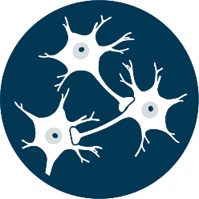


Pathophysiology of IBS Is Complex
Psychological stressors
Anxiety
Depression
Restricted diet
Disturbed brain-gut axis
Altered enteric nerves
Dysbiosis in
gut microbiota
Impaired gut barrier function
Visceral
hypersensitivity
and dysmotility
Antigens and bacterial toxins
Post-infectious IBS
Activated immune system
©Medscape, LLC
Spiller R, et al. Nat Rev Gastroenterol Hepatol. 2016;13:613-621.

Slide 7
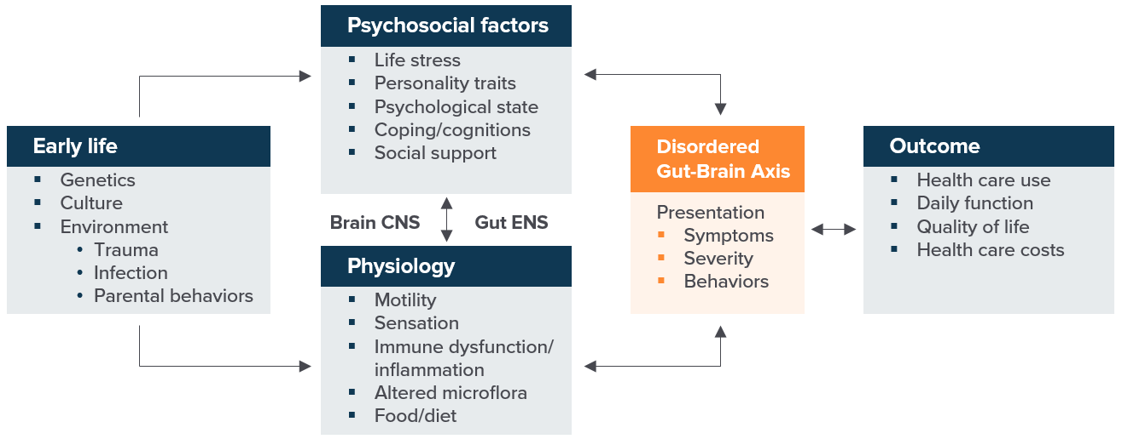
Biopsychosocial Conceptual Model of the IBS Journey
CNS, central nervous system; ENS, enteric nervous system.
Drossman DA. Gastroenterology. 2016;S0016-5085(16)00223-7.
Notes:
References
Drossman DA. Functional gastrointestinal disorders: history, pathophysiology, clinical features and Rome IV. Gastroenterology. 2016;S0016-5085(16)00223-7.

Slide 8
Rome IV Diagnostic Criteria for IBS
Recurrent abdominal pain on average at least 1 day/week in the past
3 months associated with at least 2 of the following criteria*
Related to
defecation
Associated
with a change in frequency of stool
Associated
with a change in
form of stool
*Criteria fulfilled for the past 3 months with symptom onset at least 6 months before diagnosis.
Lacy BE, et al. Gastroenterology. 2016;150:1393-1407.

Slide 9
Functional Bowel Disorders Exist on a Continuum
Type 1
Stool form
Type 2
Functional constipation
IBS-C
Type 3
Bloating
Bristol Stool Form Scale (BSFS)
IBS-M
IBS
Type 4
Type 5
Distension
Type 6
Functional diarrhea
IBS-D
Type 7
Pain
IBS-D, irritable bowel syndrome with diarrhea; IBS-M, irritable bowel syndrome, mixed bowel pattern.
Lacy BE, et al. Gastroenterology. 2016;150:1393-1407.
Notes:
Reference
Lacy BE, et al. Bowel disorders. Gastroenterology. 2016;150:1393-1407.

Slide 10





Making a Positive Diagnosis of IBS: 5 Key Features
IBS is not a diagnosis of exclusion
Take careful history
Perform a thorough physical exam
Apply symptom-based criteria
(ie, Rome IV)
Assess for alarm features
Classify appropriate subtype based on symptoms

Slide 11

History and Physical Examination for Lower GI Symptoms
  History
  Presenting symptoms and timeline
  Potential triggers (eg, infection, stress)
  Alarm signs
  Family history of organic GI disorders
  Diet
  Medications
  Co-morbid conditions
  Fibromyalgia
  Interstitial cystitis
  Migraine headaches
  Chronic pain syndrome
  Examination
  Signs of systemic and local diseases that might cause constipation
  Assess the anorectum and pelvic floor muscles
  Other relevant abnormalities
GI, gastrointestinal.
Lacy BE, et al. Gastroenterology. 2016;150:1393-1407; Heidelbaugh J, et al. J Clin Med. 2021;10:1092.

Slide 12








Alarm Features for Organic Disorders
New symptoms and age > 50 years
Family history of CRC, IBD, or celiac disease
Unintended weight loss
(> 10% in 3 months)
Acute or rapidly progressing symptoms
Blood in the stool (unrelated to hemorrhoids/anal fissures); iron-deficiency anemia
Fever
Symptoms that awaken the patient during the night
CRC, colorectal cancer; IBD, inflammatory bowel disease.
Lacy BE, et al. Gastroenterology. 2016;150:1393-1407; Lacy BE. Int J General Med. 2016;9:7-17.

Slide 13
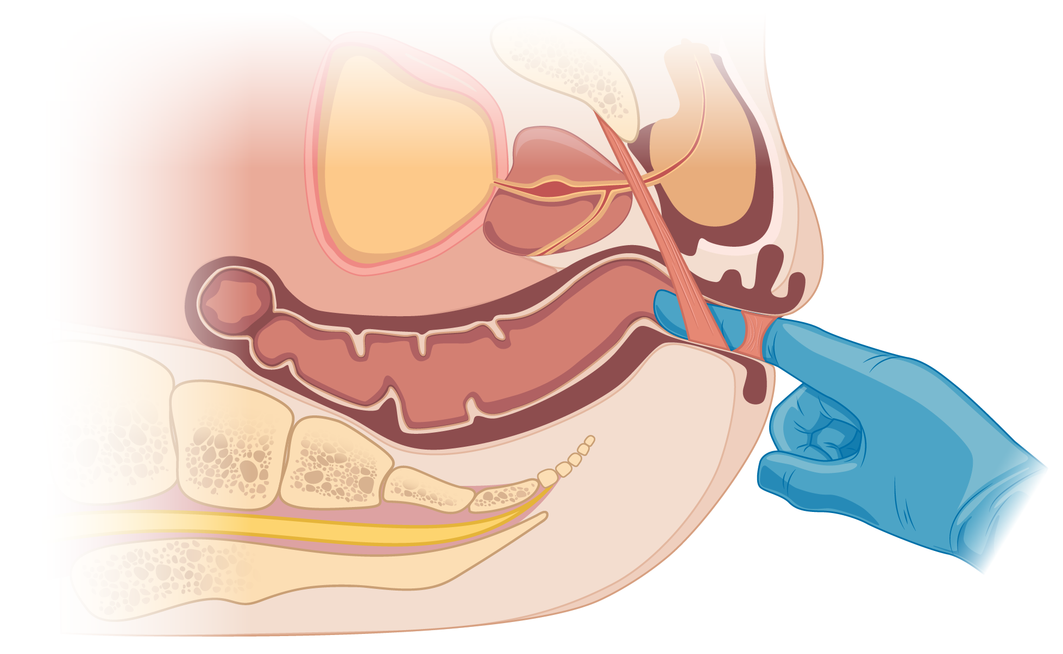
Digital Rectal Examination
Digital Examination
  Anocutaneous reflex
  Basal tone
  Squeeze pressure
  Stool in rectum
  Anorectal masses
  Puborectalis muscle tone
  Tenderness
  Simulated defecation
FRONT
Puborectalis
Rectum
©Medscape, LLC
Spine
Anal sphincter
BACK
Rao SS, et al. Am J Gastroenterol. 2018;113:635-638.
Notes:
Here, Kim could ask Brooks or Chuck if they have any pointers about doing a DRE.

Slide 14
Appropriate Use of Diagnostic Testing by IBS Subtypes
For All Patients With Suspected IBS: CBC and Age-Appropriate CRC Screening
IBS-M^{[a]}
IBS-D^{[b]}
IBS-C^{[a]}
  CRP; fecal calprotectin
  tTG-IgA ± serum IgA
  Stool diary
  Consider plain-film radiography to evaluate stool retention
  CRP; fecal calprotectin
  tTG-IgA ± serum IgA
  Giardia antigen assay
  Fecal bile acid testing (total bile acids in stool or FGF19, if available)
  No special testing
  If severe or medically refractory, refer to gastroenterology for physiologic testing
CRP, C-reactive protein; FGF19, fibroblast growth factor-19; tTG-IgA, tissue transglutaminase immunoglobin A.
a. Chey WD, et al. JAMA. 2015;313:949-958; b. Smalley W, et al. Gastroenterology. 2019;157:851-854.
Notes:
Abbreviations: C = complement; CBC = complete blood cell count; CRC = colorectal cancer; CRP = C-reactive protein; FGF19 = fibroblast growth factor 19; IBS = irritable bowel syndrome; IBS-C = irritable bowel syndrome with predominant constipation; IBS-D = irritable bowel syndrome with predominant diarrhea; IBS-M = irritable bowel syndrome with mixed bowel habits; Ig = immunoglobulin; tTG = tissue transglutaminase.

Slide 15
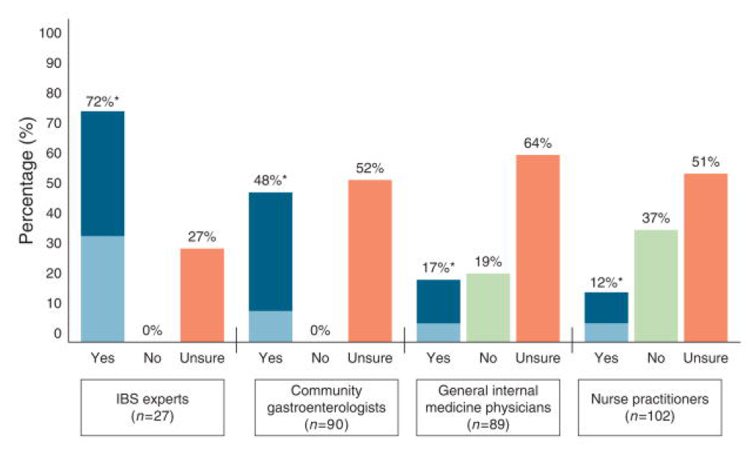
Clinicians’ Willingness to Diagnose IBS-C Based on History and Physical Findings Alone
*Light blue of “yes” bar indicates willingness to inform the patient of a positive diagnosis without further testing.
Spiegel BMR, et al. Am J Gastroenterol. 2010;105:848-858.

Slide 16
Natural History of IBS
A Systematic Review
IBS diagnoses are largely stable over time.
Fewer than 5% are diagnosed with an alternative organic GI disorder.
6 months to 6 years after original IBS diagnosis
N = 1099; 14 studies included
Patients diagnosed with IBS
Alternative diagnosis 2-5%
Worsened IBS symptoms 2-18%
Symptom free 12-38%
Unchanged IBS symptoms 30-50%
El-Serag HB, et al. Alim Pharmacol Ther. 2004;19;861.

Slide 17

Summary: Steps for Diagnosing IBS
  Take a careful symptom history
  Look for alarm signs
  Perform a thorough physical exam
  Classify into the appropriate subtype
  Consider limited diagnostic tests if appropriate

Slide 18
General Principles of IBS Management
Exclude organic GI disease
Make a positive diagnosis
Establish a rapport with the patient; educate and reassure
Categorize IBS subtype based on prevalent stool form (Bristol Stool Form Scale)
First-line treatments: lifestyle and dietary modifications, OTC therapies targeting abnormal stool form and most bothersome symptoms
Escalate to FDA-approved prescription therapies as needed
Consider off-label and/or psychological therapies as needed
OTC, over-the-counter.

Slide 19




Treatment Approaches for IBS-C
Physical activity^{[a]}
Simple recommendation is for patients to take a 20-minute walk (roughly 1 mile) each day
Constipating medications^{[b]}
Whenever possible, medications that impair GI transit should be stopped
Diet and fiber intake^{[c,d]}
Address food sensitivities and improve fiber intake; if using a fiber supplement, psyllium (soluble fiber) is recommended because bran fiber may worsen symptoms
Over-the-counter laxatives/prescription medications^{[d]}
May include osmotic or stimulant laxatives, prosecretory agents, and centrally acting interventions (eg, antidepressants) as appropriate for each individual patient
a. Chey WD, et al. JAMA. 2015;313:949-958; b. Lacy BE, et al. Gastroenterology. 2016;150:1393-1407; c. Patel A, et al. Aliment Pharmacol Ther. 2016;44:246-258; d. Ford AC, et al. Am J Gastroenterol. 2018;113:1-18.
Notes:
References
a. Lacy BE, et al. Bowel disorders. Gastroenterology. 2016;150:1393-1407
b. Patel A, et al. Effects of disturbed sleep on gastrointestinal and somatic pain symptoms in irritable bowel syndrome. Aliment Pharmacol Ther. 2016;44:246-258.
c. Ford AC, et al. American College of Gastroenterology monograph on management of irritable bowel syndrome. Am J Gastroenterol. 2018;113:1-18.
d. Chey WD, et al. Irritable bowel syndrome: a clinical review. JAMA. 2015;313:949-958.

Slide 20
Overview of OTC Treatments in IBS-C
Psyllium Fiber (Soluble)
Osmotic Laxatives
Stimulant Laxatives
Modest benefits for global IBS symptoms
Strongly recommended by the ACG for overall symptom improvement
Low cost, lack of significant side effects, and other health benefits make psyllium a reasonable
first-line therapy
Example: PEG
Improves stool frequency and consistency but does not reliably improve abdominal pain or bloating
ACG gives PEG a weak recommendation against use for overall symptom improvement in IBS
Examples: senna, cascara sagrada, castor oil, bisacodyl
ACG makes no recommendations regarding stimulant laxatives
No randomized controlled trials appear to have been conducted in IBS-C
ACG, American College of Gastroenterology; PEG, polyethylene glycol.
Lacy BE, et al. Am J Gastroenterol. 2021;116:17-44.

Slide 21
Using Fiber in the Clinic
  Benefits of soluble fiber in IBS-C:
  Improves stool consistency and frequency, and provides overall symptom relief^{[a]}
  Soluble viscous fiber (eg, psyllium) is minimally fermented and retains its gel-forming and water retention properties in the large bowel^{[a]}
  Dosing:
  Aim for 20 to 30 grams of total fiber per day^{[b]}
  Administration/Other Considerations:
  Start low, go slow^{[a]}
  Drink adequate water
  Most common AEs: bloating, gas, abdominal pain, and cramping^{[b,c]}
©Medscape, LLC
AE, adverse event.
a. Eswaran S et al. Am J Gastroenterol. 2013;108:718-727; b. Chey WD et al. JAMA. 2015;313:949-958; c. Suares NC, et al. Aliment Pharmacol Ther. 2011;33:895-901.

Slide 22


Polyethylene Glycol in IBS-C: ACG Guidelines 2021
Osmotic agent that promotes intestinal water secretion
Improves constipation, but not pain or other symptoms in IBS-C
Primary AEs: abdominal pain, diarrhea, nausea, and flatulence
RCTs
2
Patients treated
181
There is no evidence that PEG improves overall symptoms and pain in IBS-C
Conditional
recommendation against use
Low quality
of evidence
©Medscape, LLC
RCT, randomized controlled trial.
Lacy BE, et al. Am J Gastroenterol. 2021;116:17-44.

Slide 23
FDA-Approved Prescription Medications for IBS-C and Chronic Idiopathic Constipation
Agent | Mechanism of Action | Approved Indications | Common AEs
Lubiprostone | Type 2 chloride channel activator | IBS-C, CIC, OIC | Nausea, diarrhea, abdominal pain
Linaclotide | Guanylate cyclase-C receptor agonist | IBS-C, CIC | Diarrhea, abdominal pain, flatulence, abdominal distention
Plecanatide | Guanylate cyclase-C receptor agonist | IBS-C, CIC | Diarrhea
Prucalopride | Highly selective 5-HT₄ receptor agonist | CIC | Abdominal pain, diarrhea, headache, flatulence, fatigue, dizziness, vomiting
Tenapanor | Inhibitor of NHE3 | IBS-C | Diarrhea, abdominal distention, flatulence, dizziness
CIC, chronic idiopathic constipation; OIC, opioid-induced constipation.
Sharma A, et al. Aliment Pharmacol Ther. 2021;53:1250-1267; Lubiprostone [PI]. Approved 2006. Revised April 2018; Linaclotide [PI]. Approved 2012. Revised August 2021; Plecanatide [PI]. Approved 2017. Revised February 2021; Prucalopride [PI]. Approved 2018. Revised November 2020; Tenapanor [PI]. Approved 2019. Revised April 2022.

Slide 24

FDA-Approved Constipation Medications: Drug Targets
Linaclotide
Plecanatide
Lubiprostone
Tenapanor
Cl-
Cl-
Tight junction
Enteroendocrine cell
CIC-2
channel
GC-C
receptor
Lumen
NHE3
CFTR
GTP
cGMP
Mucosa
Intestinal epithelial cell
Serotonin
Submucosal plexus
5-HT4
Smooth muscle cell
Prucalopride
©Medscape, LLC
CFTR, cystic fibrosis transmembrane conductance regulator; CG-C, guanylate cyclase-C; cGMP, cyclic guanosine monophosphate; GTP, guanosine triphosphate.
Sharma A, et al. Aliment Pharmacol Ther. 2021;53:1250-1267.
Notes:
2:34
Mechanism of action of agents used for the treatment of constipation. This figure has been modified from Simrén et al Nature Reviews Gastroenterology & Hepatology 2018 with permission from Springer Nature Customer Service GmBH: Wiley.171 ACh, acetylcholine;
CFTR, cystic fibrosis transmembrane conductance regulator; ClC-2, type-2 chloride channel; GC-C, guanylate cyclase-C; IBAT, ileal bile acid transporter; NHE3, sodium/hydrogen exchanger 3; VIP, vasoactive intestinal polypeptide

Slide 25
Lubiprostone for IBS-C
Results From Phase 3 Trials and Extension Study
Overall Responders at 12 Weeks
in Phase 3 Trials^{[a]}*
Monthly Responder Rates in Randomized Withdrawal/Extension Studies^{[b]}
Phase 3 Studies
Randomized Withdrawal/Extension Studies
P = .001
*Defined as monthly responder for ≥ 2 of 3 months. Monthly responder defined as having at least moderate relief for 4 of 4 weeks or significant relief for 2 of 4 weeks.
a. Drossman DA, et al. Aliment Pharmacol Ther. 2009;29:329-341; b. Chey WD, et al. Aliment Pharmacol Ther. 2012;35:587-599.
Notes:
needs permissions, euro journal

Slide 26
Lubiprostone in the Clinic
  Indications:
  IBS-C: women ≥ 18 years of age
  CIC: adults
  OIC: adults with chronic noncancer pain
  Dosing:
  IBS-C: 8 µg twice daily
  CIC and OIC: 24 µg twice daily
  Take with food and water
Most Common Reported AEs in IBS-C and CIC Trials*
 | IBS-C |  | CIC
AE | Placebo (n = 435) | Lubiprostone 8 µg twice daily (n = 1011) | Placebo (n = 316) | Lubiprostone 24 µg twice daily (n = 1113)
Nausea | 4 | 8 | 3 | 29
Diarrhea | 4 | 7 | 1 | 12
Abdominal pain | 5 | 5 | 3 | 8
Abdominal distention | 2 | 3 | 2 | 6
*Includes only those AEs associated with treatment (possibly or probably related, as assessed by investigator).
CIC, chronic idiopathic constipation; OIC, opioid-induced constipation.
Lubiprostone [PI]. Approved 2006. Revised March 2018.
Notes:
OIC = opioid-induced constipation

Slide 27
Linaclotide
Phase 3 Trial in IBS-C
Efficacy in IBS-C established in 2 phase 3 RCTs
  N=1604
FDA Primary Endpoint:
≥ 30% reduction in WAP and increase ≥ 1 CSBM, both for
≥ 6 of 12 weeks
P < .0001*
%
%
CSBM, complete spontaneous bowel movement; WAP, worst abdominal pain.
*P < .0001 for all analyses of linaclotide vs placebo groups, using Cochran-Mantel-Haenszel test.
Chey WD, et al. Am J Gastroenterol. 2012;107:1702-171; Linaclotide [PI]. Approved 2012. Revised August 2021.

Slide 28
Linaclotide in the Clinic
  Indications and Dosing:
  Adults ≥ 18 years of age
  IBS-C: 290 mcg once daily
  CIC: 145 mcg or 72 mcg once daily
  Take on empty stomach at least 30 minutes before first meal of day
  Contraindicated in patients aged under
  2 years
  Safety and effectiveness not established in patients aged under 18 years
Common GI AEs in IBS-C and CIC Trials*
 | IBS-C |  | CIC
AE | Placebo, % (n = 798) | Linaclotide 290 µg, % (n = 807) | Placebo, % (n = 423) | Linaclotide 145 µg, % (n = 430)
Diarrhea | 3 | 20 | 5 | 16
Abdominal pain† | 5 | 7 | 6 | 7
Flatulence | 2 | 4 | 5 | 6
Abdominal distention | 1 | 2 | 2 | 3
*Occurring in ≥ 2% of patients treated with linaclotide and at an incidence greater than placebo.
†Includes abdominal pain, upper abdominal pain, and lower abdominal pain.
Linaclotide [PI]. Approved 2012. Revised August 2021.

Slide 29
Plecanatide
Phase 3 Trial Results in IBS-C
*Overall responder defined as ≥ 30% reduction in abdominal pain plus an increase of ≥ 1 CSBM from baseline same week 6 of 12 weeks.
Brenner DM, et al. Am J Gastroenterol. 2018;113:735-745.
Notes:
<<Reference not in folder, abstract at: https://www.ncbi.nlm.nih.gov/pubmed/29545635>>

Slide 30
Plecanatide in the Clinic
  Indications and Dosing
  IBS-C and CIC in adults aged ≥ 18 years of age
  3 mg once daily
  Contraindicated in pediatric patients under 6 years of age
  Avoid use in children aged 6 through 17 years
  Take with or without food
  Most Common AEs in IBS-C Trials*
AE | Placebo, % (n = 726) | Plecanatide 3 mg, % (n = 723)
Diarrhea | 1.0 | 4.3
*Occurring in ≥ 2% of plecanatide-treated patients and at an incidence greater than placebo.
Plecanatide [PI]. Approved 2017. Revised February 2021.

Slide 31
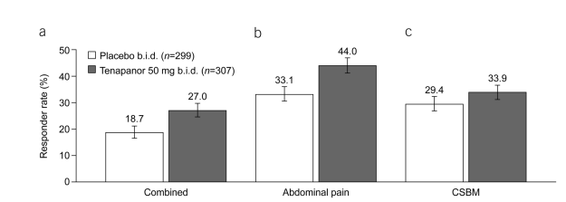
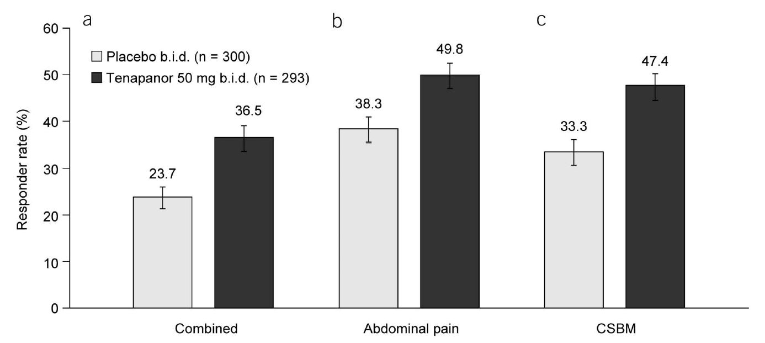
Tenapanor in IBS-C
  Small molecule inhibitor of NHE3^{[a,b]}
  FDA approved in 2019 for IBS-C in adults aged ≥ 18 years^{[a]}
  Approval based on data from the 16-week T3MPO-1 and the
  26-week T3MPO-2 clinical trials^{[b,c]}
  T3MPO-3, an open-label safety study, found tenapanor to be safe and well tolerated when taken for up to 52 consecutive weeks^{[d]}
P = .020
P = .008
P = .270
T3MPO-1
Responder Rates^{[b]}
Proportion of Patients With Response in At Least 6 of the First 12 Weeks
P < .001
P = .004
P < .001
T3MPO-2
Responder Rates^{[c]}
Proportion of Patients With Response in At Least 6 of the First 12 Weeks
b.i.d., twice daily.
a. Tenapanor [PI]. Approved 2019. Revised April 2022; b. Chey WD, et al. Am J Gastroenterol. 2020;115:281-293; c. Chey WD, et al. Am J Gastroenterol. 2021;116:1294-1303; d. Lembo A, et al. Am J Gastroenterol. 2018;113:S252.
Notes:
Abbreviations
References
Tenapanor [PI]. Approved 2019. Revised May 2021.
Chey WD, et al. Efficacy of tenapanor in treating patients with irritable bowel syndrome with constipation: a 12-week, placebo-controlled phase 3 trial (T3MPO-1). Am J Gastroenterol. 2020;115:281-293.
Chey WD, et al. Efficacy of tenapanor in treating patients with irritable bowel syndrome with constipation: a 26-week, placebo-controlled phase 3 trial (T3MPO-2). Am J Gastroenterol. 2021;116:1294-1303.
Lembo A, et al. An open-label long-term safety trial (T3MPO-3) of tenapanor in patients with irritable bowel syndrome with constipation (IBS-C): presidential poster award. Am J Gastroenterol. 2018;113:S252. Poster 430.

Slide 32
Tenapanor in the Clinic
  Indications and Dosing:
  IBS-C in adults aged
  ≥ 18 years
  50 mg orally twice daily
  Contraindicated in pediatric patients aged under 6 years
  Avoid use in children aged 6 through 11 years
  Take immediately prior to first meal of the day and dinner
  Most Common AEs in IBS-C Trial 1 (26 weeks)*
AE | Placebo, % (n = 300) | Tenapanor 50 mg BID, % (n = 293)
Diarrhea | 4 | 16
Abdominal Distention | < 1 | 3
Flatulence | 1 | 3
Dizziness | < 1 | 2
*Occurring in ≥ 2% of tenapanor-treated patients and at an incidence greater than placebo.
Tenapanor [PI]. Approved 2019. Revised April 2022.

Slide 33
Categories of IBS-D Therapies by MOA
Modulation of
Gut Flora
Bile Acid Binding Agents
Antispasmodics
Rifaximin*
Probiotics
Low FODMAP diet
  Cholestyramine/ Colestid/Colesevelam
Peppermint oil
Dicyclomine/ hyoscyamine
5-HT₃ Antagonists
Opioid Receptor Modulators
Neuromodulation
Alosetron†
Ondanestron
Diphenoxylate
Eluxadoline*
Loperamide
Antidepressants
Gut-directed behavioral therapy
*FDA approved for IBS-D.
†FDA approved for women with severe IBS-D who do not respond to conventional therapies.
MOA, mechanism of action.

Slide 34
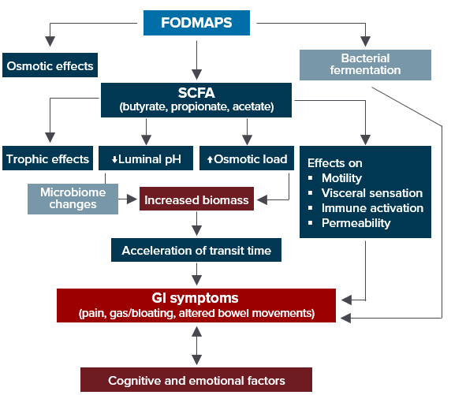




FODMAPs in IBS
(Fermentable Oligosaccharides, Disaccharides, Monosaccharides, and Polyols)
Excess fructose
Honey, apples, pears,
peaches, mangos,
fruit juice, dried fruit
Raffinose
Lentils, cabbage, brussels sprouts, asparagus,
green beans, legumes
Fructans
Wheat (large amounts)
Rye (large amounts)
Onions, leeks, zucchini
Sorbitol
Apricots, peaches, artificial sweeteners, artificially sweetened gums
© Medscape, LLC
SCFA, short chain fatty acids.
Barrett JS, et al. Ther Adv Gastroenterol. 2012;5:261-268; Spencer M, et al. Curr Treat Options Gastroenterol. 2014;12:424-440.
Notes:
SCFA = short-chain fatty acid

Slide 35
Applying the Low-FODMAP Diet in Practice
No
Motivated patient
GI dietitian or high-quality teaching materials
Willing and able to follow-up
Consider LFD
Yes
No
benefit
Alternative treatment
Restrict 4-6 weeks
“Diagnostic test” to identify FODMAP sensitive patients
Consider daily multivitamin
Benefit
Foods containing individual FODMAPs
Increasing dose over 3 days
Wheat, milk, garlic common culprits
Re-introduce 6-10 weeks
Personalize
Use re-introduction data to liberalize diet
> 80% of patients can liberalize
LFD, low FODMAP diet.
Chey WD, et al. Gastroenterology 2022;162:1737-1745.
Notes:
References

Slide 36
Possible Complications/Drawbacks of Low FODMAP
  Alterations in gut microbiome
      Decreased Bifidobacteria
  Disordered eating
  Vitamin and micronutrient deficiency (not proven)
  Requires time-intensive counseling – referral to a GI-registered dietitian is advised
Milk
© Medscape, LLC
Chey WD, et al. Gastroenterology. 2022;162:1737-1745; Hill P, et al. Gastroenterol Hepatol. 2017;13:36-45.

Slide 37
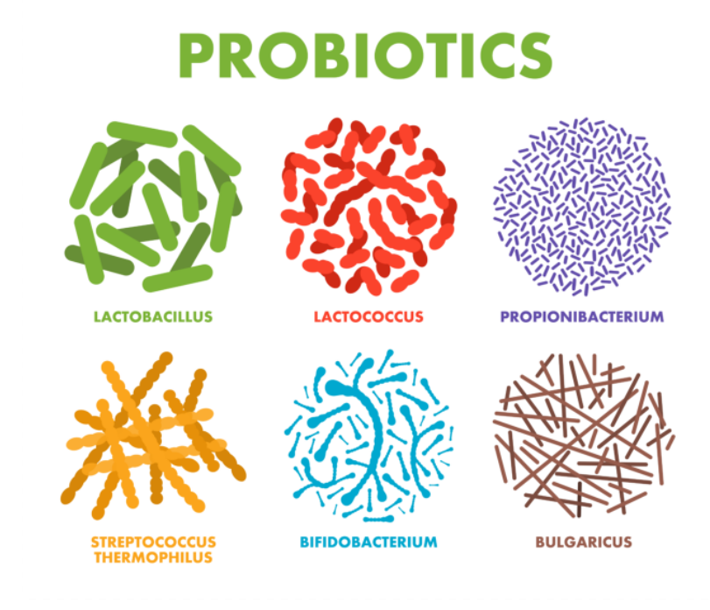
Probiotics in IBS: Yay or Nay?
AGA recommends using probiotics only in the setting of clinical trials^{[a]}
The ACG recommends against the use of probiotics^{[b]}
AGA, American Gastroenterological Association.
a. Su GL, et al. Gastroenterology. 2020;159:697-705; b. Lacy BE, et al. Am J Gastroenterol. 2021;116:17-44.
Notes:
Brooks to ask Kim and Chuck for their input on this slide.

Slide 38

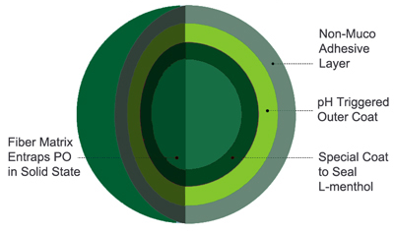
Antispasmodic: Peppermint Oil
Primary active component: l-menthol
Antispasmodic, anti-inflammatory, antibacterial, anesthetic properties
  Meta-analyses of 12 RCTs involving 835 IBS patients^{[a]}
    Reduced global IBS symptoms and abdominal pain
    NNT = 3 for global symptoms, 4 for abdominal pain
    AEs similar to placebo
  RCT of triple-coated peppermint oil (microspheres)^{[b]}
    40% improvement in TISS from baseline
    Reduced frequency and intensity of symptoms
    Improvements in abdominal pain, bloating or distention,
    pain at evacuation
NNT, number needed to treat; PO, peppermint oil; TISS, Total IBS Symptom Score.
a. Alammar N, et al. BMC Complement Alt Med. 2019;19:21; b. Cash BD, et al. Dig Dis Sci. 2016;61:560-571.
Notes:
RCT = randomized controlled trial
TISS = Total IBS Symptom Score

Slide 39
Rifaximin in IBS-D
TARGET 1 and TARGET 2 Trials
  Poorly absorbed antibiotic; inhibits bacterial protein synthesis
  Indicated for the treatment of IBS-D in adults
  3 RCTs; 3837 patients
  AEs similar to placebo
Adequate Relief
of Global IBS Symptoms
Adequate Relief
of Bloating
P = .01
P = .03
P < 0.001
P = .005
P=.02
P < .001
Patients, %
n =309 | n=314 |  | n=315 | n=320 |  | n=624 | n=634
n=309 | n=314 |  | n=315 | n=320 |  | n=624 | n=634
TARGET 1 |  | TARGET 2 | Combined
TARGET 1 |  | TARGET 2 | Combined
Rifaximin
Placebo
Rifaximin [PI]. Approved 2004. Revised October 2020; Pimentel M, et al. N Engl J Med. 2011;364:22-32.

Slide 40
Rifaximin for IBS-D
TARGET 3 Trial
Retreatment Efficacy
Responder defined as
Responding to IBS-related abdominal pain and stool consistency for at least 2 of 4 weeks
Recurrence defined as
Loss of response for at least 3 of 4 weeks
First Repeat Treatment
Data for last observation carried forward
P = .03
Patients, %
Urgency and bloating improved significantly with both repeat treatments
Abdominal pain and stool consistency improved significantly
with first retreatment
n=328 | n=308
Rifaximin
Placebo
Lembo A, et al. Gastroenterology. 2016;151:1113-1121.

Slide 41
Rifaximin in the Clinic
Pooled safety analysis demonstrated no difference between rifaximin and placebo for any AE^{[b]}
  Dosage for IBS-D^{[a]}
  550 mg 3 times daily for 14 days
  For recurrence, up to 2 retreatments with the same regimen
Most Common Reported AEs (≥ 2%)*^{[b]}
 | Rifaximin 550 mg (n = 1008) | Placebo (n = 829)
AEs, n (%)
Headache | 55 (5.5) | 51 (6.2)
URT infection | 45 (4.5) | 47 (5.7)
Nausea | 41 (4.1) | 31 (3.7)
Abdominal pain | 40 (4.0) | 39 (4.7)
Diarrhea | 35 (3.5) | 26 (3.1)
Urinary tract infection | 32 (3.2) | 18 (2.2)
*Pooled analysis of phase 2b and phase 3 trials of rifaximin in non-IBS-C.
a. Rifaximin [PI]. Approved 2004. Revised October 2020; b. Schoenfeld P, et al. Aliment Pharmacol Ther. 2014;39:1161-1168.
Notes:
AE = adverse event

Slide 42
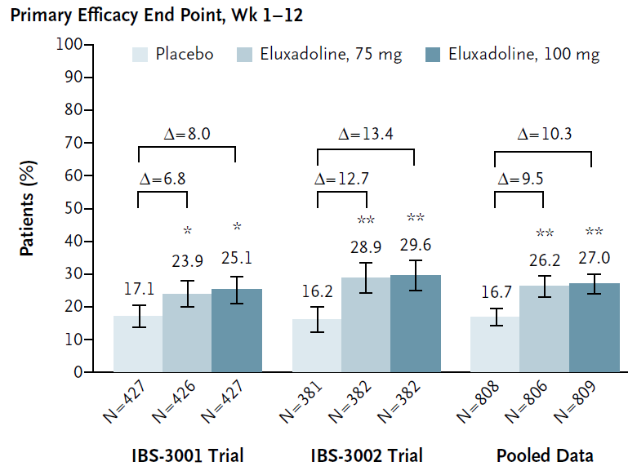
Eluxadoline in IBS-D
Mixed opioid receptor modulator
  μ/κ-opioid receptor agonist/δ-opioid receptor antagonist
2 RCTs; 2426 patients
AEs: constipation, abdominal pain, SO spasm, pancreatitis
  Contraindicated if no gall bladder or h/o pancreatitis, heavy ETOH users
*P < .05 vs. placebo; **P < .001 vs. placebo.
ETOH, ethyl alcohol; SO, sphincter of Oddi.
Eluxadoline [PI]. Approved 2015. Revised June 2020; Lembo AJ et al. N Engl J Med. 2016;374:242-253.

Slide 43
Eluxadoline in Patients Who Failed Loperamide: RELIEF Trial
Phase 4 multicenter double-blind RCT evaluating eluxadoline in patients subjectively reporting failure of loperamide to adequately control IBS-D symptoms in prior 12 months.
P = .02
Responders, % (ITT)
P = .01
P = .002
Primary composite: ≥ 40% improvement in WAP compared with baseline and Bristol Stool Score of < 5 or absence of a bowel movement if accompanied by ≥ 40% improvement in WAP.
WAP, worst abdominal pain.
Brenner DM, et al. Am J Gastroenterol. 2019;114:1502-1511.

Slide 44


Eluxadoline in the Clinic
Dosage for IBS-D^{[a]}
  100 mg twice daily taken with food
  75 mg twice daily with food in patients who:
    Are unable to tolerate the 100-mg dose
    Are receiving concomitant OATP1B1 inhibitors
    Have mild or moderate hepatic impairment
    Have end-stage renal disease and are not yet on dialysis
Contraindications^{[b]}
  Cholecystectomy
  Bile duct obstruction
  Sphincter of Oddi disease or dysfunction
  Pancreatitis
  Severe liver impairment (Child-Pugh class C)
  Severe constipation
  Patients who consume > 3 alcoholic drinks per day
a. Eluxadoline [PI]. Approved 2015. Revised June 2020; b. Lembo AJ, et al. N Engl J Med. 2016;374:242-253.

Slide 45
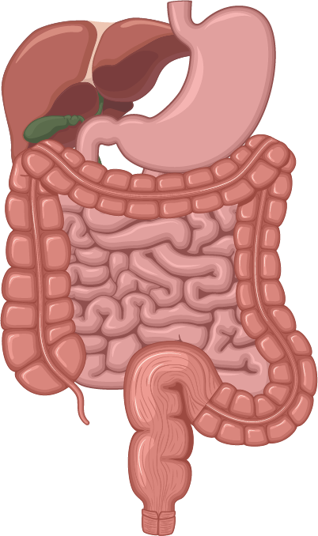

Bile Acid Sequestrants
25% to 50% of patients with IBS-D may have bile acid malabsorption (unproven)
  Excess bile acids in the colon stimulate colonic motility and increase visceral sensation and fluid secretion
  Testing for bile acid diarrhea can be challenging
  Uncontrolled studies of bile acid sequestrants suggest benefit in subset of IBS-D patients
Enterohepatic circulation of bile acids
IBS with bile acid diarrhea
Colonic motility and transit
Visceral sensation
Fluid secretion
Mucosal permeability
Hepatocytes
↓Bile acid synthesis
↑Bile acid synthesis
FGFR4
β-klotho
FGFR4
gene variant
β-klotho
gene variant
FGF-19
FGF-19
Bile acids
Adenyl cyclase
FGF-19
↑FGF-19 synthesis
FGF-19
Feedback
loop
↑Portal venous blood
↓FGF-19 in portal venous blood
©Medscape, LLC
GPBAR1 gene variant
FXR
Ileal enterocytes
FXR
↑Bile acid absorption
↓Bile acids (impaired absorption)
↑Bile acids in colon
IBAT receptor
IBAT receptor
IBAT, ileal bile acid transporter.
Camilleri M. Gut Liver. 2015;9:332-339.
Notes:
AE = adverse event

Slide 46

Antidepressants in IBS
  Meta-analysis: tricyclics and SSRIs are effective in reducing IBS symptoms^{[a]}
    Significant heterogeneity between SSRI studies^{[a]}
  Tricyclics most rigorously studied in IBS^{[b,c]}
    Reduce pain sensitivity in chronic neuropathic animal models more effectively than SSRIs^{[b]}
  SSRIs may be preferred in IBS-C^{[c]}
  SNRIs not yet studied in large RCTs^{[c]}
Potential Antidepressant Actions in IBS^{[c]}
Antidepressant action
Visceral analgesia
Changes in motility
Smooth muscle relaxation
©Medscape, LLC
SNRI, serotonin noradrenaline reuptake inhibitor; SSRI, selective serotonin reuptake inhibitor.
a. Ford AC, et al. Am J Gastroenterol. 2014;109:1350-1365; b. Grover M, et al. Gastroenterol Clin N Am. 2011;40:183-206; c. Chey WD, et al. Gut Liver. 2011;5:253-266.
Notes:
RCT = randomized controlled trial
TCA = tricyclic antidepressant
SSRI = selective serotonin reuptake inhibitor
SNRI = serotonin norepinephrine reuptake inhibitor

Slide 47
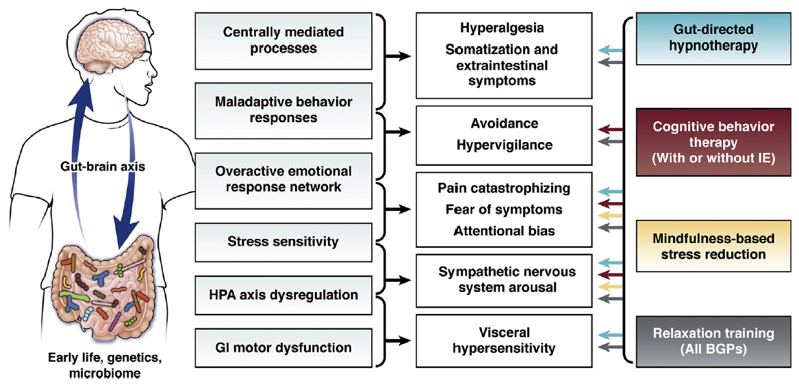
The Gut-Brain Axis as the Mechanistic Basis for Behavioral Therapies in IBS
Notes:
Chey WD, et al. Gastroenterology. 2021;160:47-62.

Slide 48
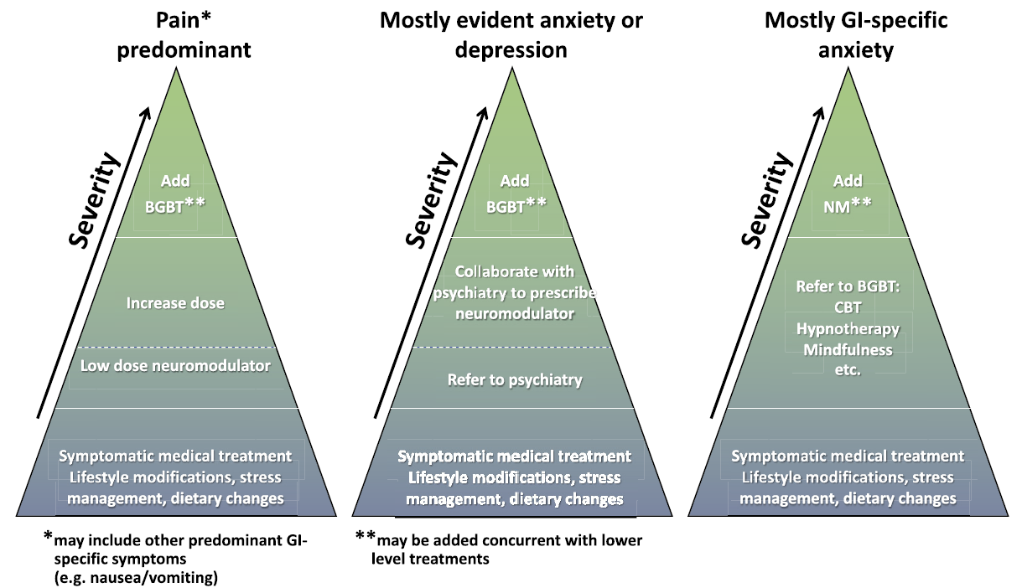
Integrating BGBT Into Care of Disorders of Gut-Brain Interaction
Notes:
Keefer L, et al. Gastroenterology. 2022;162:300-315.

Slide 49
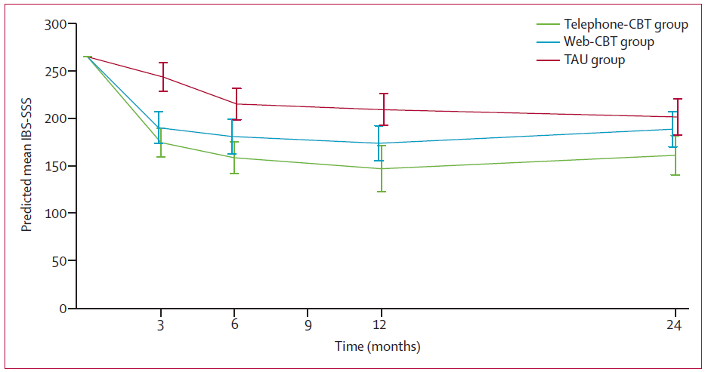
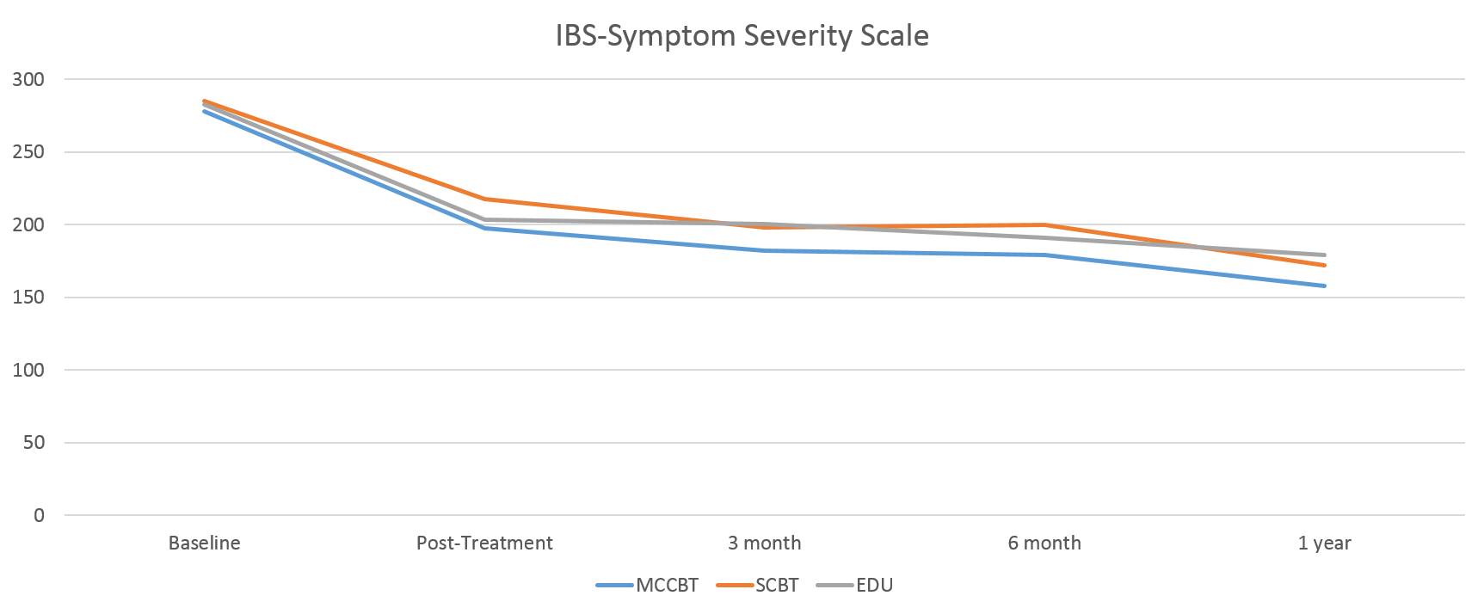
Impact of CBT on IBS Symptom Severity
Predicted Mean IBS-SSS by Trial Arm[a]
IBS Symptom Severity Scale[b]
Lackner, J. M., et al. (2018). "Improvement in Gastrointestinal Symptoms After Cognitive Behavior Therapy for Refractory Irritable Bowel Syndrome." Gastroenterology 155(1): 47-57.
IBS-SSS, Irritable Bowel Syndrome Symptom Severity Score
a. Everitt HA et al. Gut. 2019;68:613-1623;b. Lackner JM, et al. Gastroenterology. 2018;155:47-57..
Notes:
Lackner, J. M., et al. (2018). "Improvement in Gastrointestinal Symptoms After Cognitive Behavior Therapy for Refractory Irritable Bowel Syndrome." Gastroenterology 155(1): 47-57.
BACKGROUND & AIMS: There is an urgent need for safe treatments for irritable bowel syndrome (IBS) that relieve treatment-refractory symptoms and their societal and economic burden. Cognitive behavior therapy (CBT) is an effective treatment that has not been broadly adopted into routine clinical practice. We performed a randomized controlled trial to assess clinical responses to home-based CBT compared with clinic-based CBT and patient education. METHODS: We performed a prospective study of 436 patients with IBS, based on Rome III criteria, at 2 tertiary centers from August 23, 2010, through October 21, 2016. Subjects (41.4 +/- 14.8 years old; 80% women) were randomly assigned to groups that received the following: standard-CBT (S-CBT, n = 146, comprising 10 weekly, 60-minute sessions that emphasized the provision of information about brain-gut interactions; self-monitoring of symptoms, their triggers, and consequences; muscle relaxation; worry control; flexible problem solving; and relapse prevention training), or 4 sessions of primarily home-based CBT requiring minimal therapist contact (MC-CBT, n = 145), in which patients received home-study materials covering the same procedures as S-CBT), or 4 sessions of IBS education (EDU, n = 145) that provided support and information about IBS and the role of lifestyle factors such as stress, diet, and exercise. The primary outcome was global improvement of IBS symptoms, based on the IBS-version of the Clinical Global Impressions-Improvement Scale. Ratings were performed by patients and board-certified gastroenterologists blinded to treatment allocation. Efficacy data were collected 2 weeks, 3 months, and 6 months after treatment completion. RESULTS: A higher proportion of patients receiving MC-CBT reported moderate to substantial improvement in gastrointestinal symptoms 2 weeks after treatment (61.0% based on ratings by patients and 55.7% based on ratings by gastroenterologists) than those receiving EDU (43.5% based on ratings patients and 40.4% based on ratings by gastroenterologists) (P < .05). Gastrointestinal symptom improvement, rated by gastroenterologists, 6 months after the end of treatment also differed significantly between the MC-CBT (58.4%) and EDU groups (44.8%) (P = .05). Formal equivalence testing applied across multiple contrasts indicated that MC-CBT is at least as effective as S-CBT in improving IBS symptoms. Patients tended to be more satisfied with CBT vs EDU (P < .05) based on immediate posttreatment responses to the Client Satisfaction Questionnaire. Symptom improvement was not significantly related to concomitant use of medications. CONCLUSIONS: In a randomized controlled trial, we found that a primarily home-based version of CBT produced significant and sustained gastrointestinal symptom improvement for patients with IBS compared with education. Clinicaltrials.gov no.: NCT00738920.
IBS-SSS means by trial arm. IBS-SSS, IBS Symptom Severity Score; TAU, treatment as usual; TCBT, telephone-delivered CBT; WCBT, web-based CBT.
Assessing telephone-delivered cognitive–behavioural therapy (CBT) and web-delivered CBT versus treatment as usual in irritable bowel syndrome (ACTIB): a multicentre randomised trial
Hazel Anne Everitt1,
Sabine Landau2,
Gilly O’Reilly1,
Alice Sibelli3,
Stephanie Hughes1,
Sula Windgassen3,
Rachel Holland2,
Paul Little1,
Paul McCrone4,
Felicity Bishop5,
Kimberley Goldsmith2,
Nicholas Coleman6,
Robert Logan7,
Trudie Chalder8,
Rona Moss-Morris3
on behalf of ACTIB trial group
Author affiliations
Abstract
Objective To evaluate the clinical effectiveness of two modes of cognitive–behavioural therapy (CBT) for IBS compared with treatment as usual (TAU) in refractory IBS.
Design A three-arm randomised controlled trial assessing telephone-delivered CBT (TCBT), web-based CBT (WCBT) with minimal therapist support, and TAU. Blinding participants and therapists was not possible. Chief investigator, assessors and statisticians were blinded. Participants were adults with refractory IBS (clinically significant symptoms for ≥12 months despite first-line therapies), recruited by letter and opportunistically from 74 general practices and three gastroenterology centres in London and South of England between May 2014 to March 2016. Co-primary outcomes were IBS Symptom Severity Score (IBS-SSS) and Work and Social Adjustment Scale (WSAS) at 12 months.
Results 558/1452 (38.4%) patients screened for eligibility were randomised: 76% female: 91% white: mean age 43 years. (391/558) 70.1% completed 12 months of follow-up. Primary outcomes: Compared with TAU (IBS-SSS 205.6 at 12 months), IBS-SSS was 61.6 (95% CI 33.8 to 89.5) points lower (p<0.001) in TCBT and 35.2 (95% CI 12.6 to 57.8) points lower (p=0.002) in WCBT at 12 months. Compared with TAU (WSAS score 10.8 at 12 months) WSAS was 3.5 (95% CI 1.9 to 5.1) points lower (p<0.001) in TCBT and 3.0 (95% CI 1.3 to 4.6) points lower (p=0.001) in WCBT. All secondary outcomes showed significantly greater improvement (p≤0.002) in CBT arms compared with TAU. There were no serious adverse reactions to treatment.
Conclusion Both CBT interventions were superior to TAU up to 12 months of follow-up.
Trial registration number ISRCTN44427879.

Slide 50
Who are Candidates for CBT (and Who Aren’t)?
Good Candidate for CBT
Poor Candidate for CBT
Moderate to severe IBS symptoms (including pain) that have not responded to medical or diet therapy
Belief that stress/anxiety are driving/exacerbating IBS symptoms
Motivated to try CBT
Belief that they can control (or learn ways to control) IBS symptoms
Unstable medical condition that needs immediate attention
Unstable psychiatric comorbidity or current, severe psychiatric symptoms
Uninterested and/or refuses to engage in behavioral medicine treatment
https://www.mirecc.va.gov/VISN16/docs/ibs-referral-toolkit.pdf
Notes:
https://www.mirecc.va.gov/VISN16/docs/ibs-referral-toolkit.pdf

Slide 51
CBT Digital Products for IBS Patients
Mahana IBS (Mahana Therapeutics)
CBT: 6 nodules over 6 weeks
FDA approved: No
Randomized crossover trial
  Significant improvement in IBS QoL, GI symptom rating scale-IBS, fear of food questionnaire, visceral sensitivity index, depression anxiety stress scale, PHQ-9
Cost: 19.49/mo or $154.99/yr
CBT: 10 sessions over 12 weeks
FDA approved: Yes
Based on a RCT comparing efficacy of CBT (phone-based, web-based CBT) to TAU
  Significant improvement in IBS-SSS, WSAS vs TAU alone in both CBT groups
Prescription; max out-of-pocket = $90
Zemedy (Bold Health)
TAU, treatment as usual; IBS-SSS, Irritable Bowel Syndrome Symptoms Severe score; PHQ-9, Patient Health Questionnaire-9; QoL, quality of life.
Zaleh ZM, et al. Am J Gastroenterol. 2023;11:1-3. Published online March 20, 2023.

Slide 52
Where are Some Good Places to Find Therapists?
Resource | Website
Rome GastroPsych | https://romegipsych.org
Psychology Today Therapist Finder | https://www.psychologytoday.com/us/therapists
American Psychological Association | https://locator.apa.org
National Register of Health Service Psychologists | https://www.findapsychologist.org
Association for Behavioral & Cognitive Therapies | http://www.findcbt.org
National Eating Disorders Association | https://map.nationaleatingdisorders.org
Notes:
It’s not necessary to find someone with GI-specific experience
Look for specific language in the profile about chronic illness
Look for specific training in behavioral medicine, health psychology, or medical social work
Look for Cognitive Behavioral Therapy, Mindfulness Based Therapy, Solutions-Focused Therapy, Acceptance & Commitment Therapy
Consider inviting the therapist(s) to your practice to meet your team
Connect the therapist with Rome GastroPsych for ongoing training and consultation

Slide 53
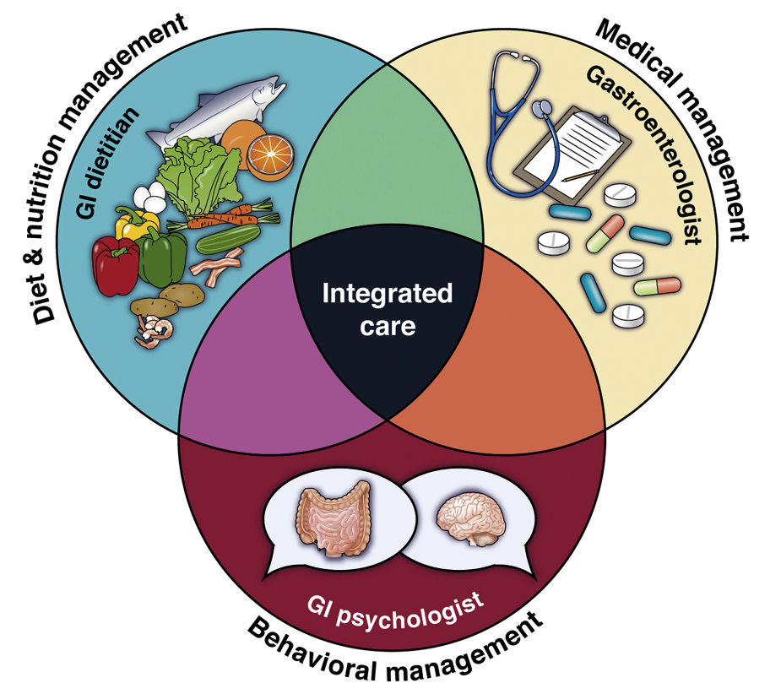
Interprofessional Care in IBS
Consulting With a Dietitian and Mental Health Professional
Source: AGA. https://patient.gastro.org/irritable-bowel-syndrome-ibs/. Accessed on 8/31/2022.

Slide 54
Standard GI vs Multidisciplinary Treatment for DGBIs (MANTRA): Open-label, Single-center RCT
*p=0.044
*p=0.017
percent
ITT: intention to treat
IBS-SSS responder: 50-point reduction in IBS-SSS
from baseline
Basnayake C et al. Lancet Gastroenterol Hepatol. 2020;5:890-899.
Notes:
Background: Functional gastrointestinal disorders are common and costly to the health-care system. Most specialist care is provided by a gastroenterologist, but only a minority of patients have improvement in symptoms. Although they have proven to be effective, psychological, behavioural, and dietary therapies are not provided routinely. We aimed to compare the outcome of gastroenterologist-only standard care with multidisciplinary care.
Methods: In an open-label, single-centre, pragmatic trial, consecutive new referrals of eligible patients aged 18-80 years with Rome IV criteria-defined functional gastrointestinal disorders were randomly assigned (1:2) to receive gastroenterologist-only standard care or multidisciplinary clinic care. The multidisciplinary clinic included gastroenterologists, dietitians, gut-focused hypnotherapists, psychiatrists, and behavioural (biofeedback) physiotherapists. Randomisation was stratified by Rome IV disorder and whether referred from gastroenterology or colorectal clinic. Outcomes were assessed at clinic discharge or 9 months after the initial visit. The primary outcome was a score of 4 (slightly better) or 5 (much better) on a 5-point Likert scale assessing global symptom improvement. Modified intention-to-treat analysis included all patients who attended at least one clinic visit and who had answered the primary outcome question. This study is registered with ClinicalTrials.gov, NCT03078634.
Findings: Between March 16, 2017, and May 10, 2018, 1632 patients referred to the hospital gastrointestinal clinics were screened, of whom 442 were eligible for a screening telephone call and 188 were randomly assigned to receive either standard care (n=65) or multidisciplinary care (n=123). 144 patients formed the modified intention-to-treat analysis (n=46 in the standard-care group and n=98 in the multidisciplinary-care group), 90 (63%) of whom were women. 61 (62%) of 98 patients in the multidisciplinary-care group patients saw allied clinicians. 26 (57%) patients in the standard-care group and 82 (84%) patients in the multidisciplinary-care group had global symptom improvement (risk ratio 1·50 [95% CI 1·13-1·93]; p=0·00045). 29 (63%) patients in the standard-care group and 81 (83%) patients in the multidisciplinary-care group had adequate relief of symptoms in the past 7 days (p=0·010). Patients in the multidisciplinary-care group were more likely to experience a 50% or higher reduction in all Gastrointestinal Symptom Severity Index symptom clusters than were patients in the standard-care group. Of the patients with irritable bowel syndrome, a 50-point or higher reduction in IBS-SSS occurred in 10 (38%) of 26 patients in the standard care group compared with 39 (66%) of 59 patients in the multidisciplinary-care group (p=0·017). Of the patients with functional dyspepsia, a 50% reduction in the Nepean Dyspepsia Index was noted in three (11%) of 11 patients in the standard-care group and in 13 (46%) of 28 in the multidisciplinary-care group (p=0·47). After treatment, the median HADS scores were higher in the standard-care group than in the multidisciplinary-care group (13 [8-20] vs 10 [6-16]; p=0·096) and the median EQ-5D-5L quality of life visual analogue scale was lower in the standard-care group compared with the multidisciplinary-care group (70 [IQR 50-80] vs 75 [65-85]; p=0·0087). The eight SF-36 scales did not differ between the groups at discharge. After treatment, median Somatic Symptom Scale-8 score was higher in the standard-care group than in the multidisciplinary-care group (10 [IQR 7-7] vs 9 [5-13]; p=0·082). Cost per successful outcome was higher in the standard-care group than the multidisciplinary-care group.
Interpretation: Integrated multidisciplinary clinical care appears to be superior to gastroenterologist-only care in relation to symptoms, specific functional disorders, psychological state, quality of life, and cost of care for the treatment of functional gastrointestinal disorders. Consideration should be given to providing multidisciplinary care for patients with a functional gastrointestinal disorder.

Slide 55
Conclusions
  IBS is a chronic disorder if gut-brain interaction with no known cure
    Syndrome of symptoms with diverse etiologies
  Diagnose using a positive diagnostic strategy incorporating the Rome criteria, thorough history and physical exam, limited testing
  Treatments for IBS include diet and lifestyle modifications, OTC and prescription medications, psychological therapy
    Important to set realistic expectations with the patient
    Best treated with an interdisciplinary approach
    Employ shared decision-making
    Referral to specialist for severe and/or refractory symptoms

