Slide 1
Advances in Liver Transplantation
Robert Cannon
October 1, 2023

Slide 2
Disclosures
Transmedics, Inc
UAB receives research funding for the post approval registry for the Liver OCS device
NIDDK
I receive research funding including partial salary support.

Slide 3
Advances in Liver Transplantation
Patient Selection
Early Transplant for Severe Alcohol Related Liver Disease
New Preservation Technology
Normothermic Machine Perfusion

Slide 4
Case Presentation
50 year old with recently diagnosed alcohol related cirrhosis
PCP noted elevated LFTs a month prior to presentation. He stopped drinking at that time. Drank 2-8 beers per day prior to that
2 weeks prior to presentation to UAB presented to local ED with jaundice and ascites, MELD score 40
Treated for SBP
Admitting team initially considering hospice given continued clinical deterioration

Slide 5
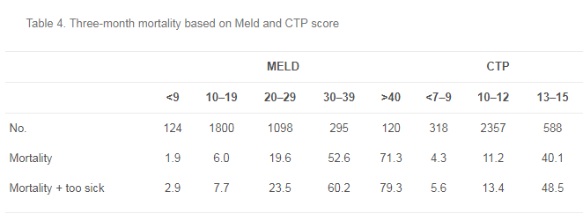
Case Presentation

Slide 6
Case Presentation
NIAAA Definition of Alcohol Related Hepatitis
Onset of jaundice within 60 days of heavy alcohol consumption (>50g per day, ~3-4 Coors for example)
Bilirubin > 3mg/dl
AST 50-400 U/L
AST:ALT ratio >1.5
Absence of other causes of acute hepatitis
Acute Binge is a Common Trigger in Patients with Chronic Use

Slide 7
Case Presentation
Severe AH:
MELD >20
Discriminant Function > 32
Severe AH considered for short course of prednisolong (40mg/day for 28 days)
Those with lack of improvement (Lille score > 0.45) within a week should have steroids discontinued
STOP-AH trial demonstrated short term mortality improvements without difference in 6-month or 1-year mortality

Slide 8
Case Presentation
Consulting GI called UAB to inquire about liver transplantation
Transferred to UAB for emergent liver transplant evaluation
Evaluated by addiction social work upon admission
Moderate insight into nature of disease
Open to treatment for alcohol use disorder
Good social support

Slide 9
Case Presentation
Listed for liver transplant 48 hours after admission to UAB
Developed acute variceal bleed and taken for emergent banding.
Transferred to SICU for initiation of CRRT and pressor suppor
Orthotopic liver transplant on HD 5
Discharged on POD 18. No further dialysis requirement
Currently 2 years after his transplant. Has returned to work full time and regularly speaks to church groups about his story

Slide 10
Prior Landscape for Transplant Related to AH In the US
“6-Month Rule”
Few if any centers would consider liver transplantation in the absence of a minimum of 6 months of demonstrated sobriety
Meant to minimize risk of recidivism post-transplant and allow for potential hepatic recovery
Patients with severe disease and short sobriety duration left to die of their disease

Slide 11
Problems with the 6-Month Rule
There is no good evidence that 6-months of abstinence distinguishes those who will relapse from those who will not
The cumulative risk of problem drinking has previously been estimated at 10-13%

Slide 12
Problems with the 6-Month Rule
University of Pittsburgh prospective study of all patients transplanted for alcohol related liver disease (DiMartini, et al. Liver Transplantation. 2001)
42% of patients had at least 1 drink by 4.5 years post-discharge
Longer sobriety predicted less risk of alcohol use, but there was no significant cut-point.
6 months of sobriety was only 40% specific in predicting post-liver transplant abstinence from alcohol

Slide 13
Problems with the 6-Month Rule
Patients with severe AH not responding to therapy usually don’t have 6 months
In the initial paper reporting the Lille model for treatment response (Louvet, et al. Hepatology. 2007), 75% of patients with a score >0.45 at 7 days died within 6-months

Slide 14
Early Experience with Early LT for Severe AH
Philippe Mathurin, et al. New England Journal of Medicine, 2012
7 centers in France and Belgium agreed to participate beginning in 2005
Inclusion Criteria
Severe AH defined by MDF > 32
Non-response to medical therapy (Lille score of >0.45 or continuous increase in MELD score)

Slide 15
Early Experience with Early LT for Severe AH
Inclusion Criteria (continued)
No prior episodes of liver decompensation
Strong social support
Absence of coexisting psychiatric disorders
Commitment to lifelong abstinence from alcohol
Entire medical team required to reach consensus on listing

Slide 16
Early Experience with Early LT for Severe AH
26 patients enrolled
24 were treated initially with steroids
Median Lille Score at day 7: 0.880
Median MELD on first day of treatment: 30.1
Median MELD at day 7: 28.5
Median MELD at listing: 34
Median time to transplant after listing: 9 days

Slide 17
Early Experience with Early LT for Severe AH
6-month Survival Outcomes
77% survival for transplanted patients vs. 23% in matched controls with severe AH not listed for transplant
5 of 6 post-transplant deaths were related to infection
No alcohol relapse was observed in the initial 6-month followup period
These 26 patients represented <2% of patients with severe AH evaluated a the two largest participating centers

Slide 18
Early US Experience with Early LT for Severe AH
G.Y Im, et al. American Journal of Transplantation. 2016
Patients evaluated at Mount Sinai Medical Center for severe AH from 2012-2015
Candidate Inclusion Criteria
Severe AH as first decompensating event
Good social support
Signed agreement to lifelong abstinence
No other chronic liver disease (ie HCV, HCC)

Slide 19
Early US Experience with Early LT for Severe AH
111 consecutive patients enrolled
15% responded to medical therapy with 82% 6-month survival
85% were non-responders or ineligible for AH-specific therapy (94 patients)

Slide 20
Early US Experience with Early LT for Severe AH
9 underwent transplant
(9.6%)
94 non-responders
15 survived to listing
20 provisionally accepted for listing

Slide 21
Early US Experience with Early LT for Severe AH
Presentation
Listing
Transplant
10.5 Days
5 Days

Slide 22
Early US Experience with Early LT for Severe AH
Median MELD at transplant – 39
78% required perioperative hemodialysis
66% developed bacterial infecitons

Slide 23
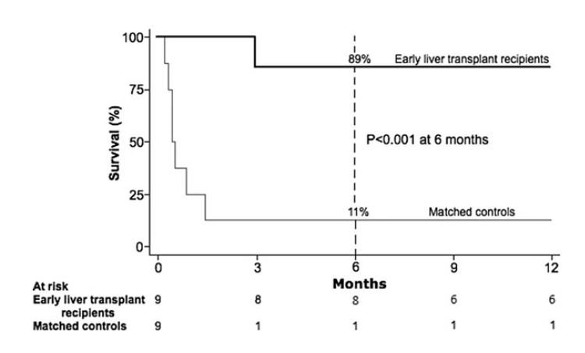
Early US Experience with Early LT for Severe AH
89% 6-month survival

Slide 24
Early US Experience with Early LT for Severe AH
1 patient with self limited “slip”
1 patient with relapse
All patients alive with good graft function at a median of 735 days

Slide 25
What Constitutes a Favorable Psychosocial Profile?
First Liver Decompensating Event
Fewer Drinks per Day
Longer Interval Since Last Drink
Good Insight into Alcohol Use Disorder
Good Social Support
Presence of Life Partner
Children
Stable Employment

Slide 26
Favorable Psychosocial Factors

Slide 27
SALT
95% negative predictive value for sustained drinking at a cutoff score of 5
Only 25% positive predictive value
Overall, only 10% of patients have sustained return to alcohol use post-transplant
Lee, et al. Hepatology 2019

Slide 28
ACCELERATE-AH Cohort
12 US Transplant Centers Across the United States
Published results on 147 patients transplanted between 2006 and 2017
94% of transplants after 2011
35% of patients with severe AH evaluated for LT were listed
29.5% were ultimately transplanted

Slide 29
ACCELERATE-AH Cohort
Presentation
Listing
Transplant
Median MELD at hospitalization – 35
Median MELD at transplant – 39
13 Days
7 Days

Slide 30
ACCELERATE-AH Cohort
Lee, et al. Gastroenterology. 2018

Slide 31
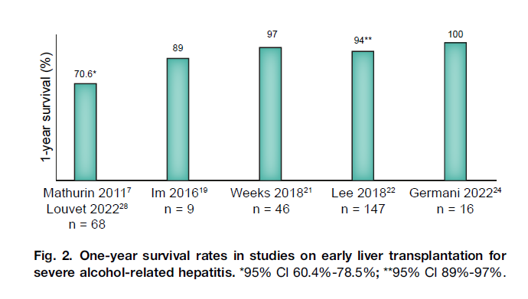
Improving Outcomes
Germani, et al. J Hep. 2023

Slide 32
Improving Outcomes
Germani, et al. J Hep. 2023

Slide 33
Increasing Acceptance
0%
25%
85%
2005
2015
2022

Slide 34
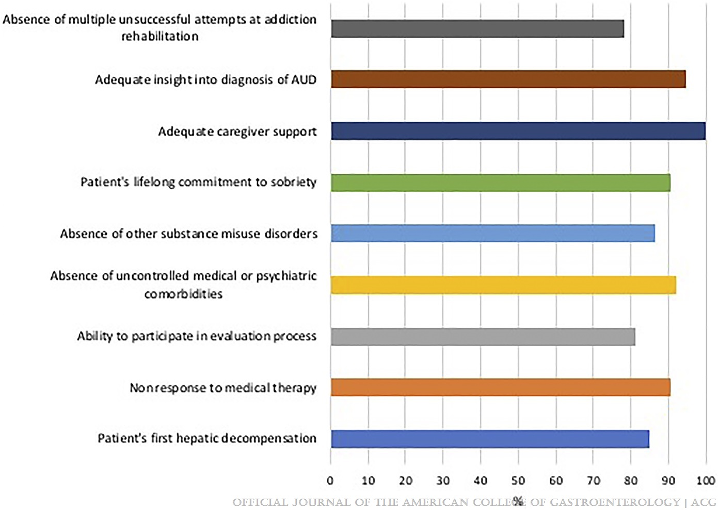
Common Selection Criteria
Heterogeneity in Center Practices in Liver Transplantation for Alcohol-Associated Liver Disease in the United States
Lim, Nicholas; Kwong, Allison J.; Jafri, Syed-Mohammed; Jesse, Michelle T.; Kriss, Michael; Nair, Kavitha; Pillai, Anjana; Shingina, Alexandra; Tang, Qing; Desai, Archita P.
Official journal of the American College of Gastroenterology | ACG117(9):1530-1535, September 2022.
doi: 10.14309/ajg.0000000000001863

Slide 35
Significant Variability Remains
The number of AH transplants varies 8-fold between regions
Three transplant centers account for 50-90% of AH transplants within each region
Overall outcomes remain excellent
1 year survival 91.7%
5 year survival 81.9%
Cotter, et al. Am J Transplant 2021

Slide 36
Expansion to Alcohol Related Cirrhosis
Toronto Pilot initiated in 2018
6-months abstinence not required for patients with alcohol related cirrhosis meeting selection criteria
Severity of alcohol use disorder
Insufficient insight into disease that would make relapse prevention therapy ineffective
Continued heavy alcohol use despite decompensated liver disease and understanding that ongoing drinking would result in death

Slide 37
Toronto Pilot in Alcohol Related Cirrhosis
Inclusion Criteria (Continued)
Willing to participate in relapse prevention therapy
No more than 1 failed treatment attempt
No treatment refractory comorbid psychiatric disease
No active substance abuse (excluding THC)
No history of recurrent noncompliance with medical recommendations
Adequate Social Support
Stable Housing

Slide 38
Toronto Pilot in Alcohol Related Cirrhosis
44 Transplanted (6.3%)
703 Referred
101 Listed (14.3%)
164 Evaluated

Slide 39
Reasons for Decline In Toronto Pilot
290 (41.3%) ruled out based on alcohol related criteria
37 (5.3%) ruled out based on medical criteria
78 (11%) diverted to routine pathway
72 (10%) died

Slide 40
Alcohol Related Reasons for Decline
19.1% not willing to participate in treatment
19.1% Not committed to abstinence
82.6% for severe AUD
16.4% for inadequate social support

Slide 41
Outcomes In Toronto Pilot
6.8% Return to Alcohol use (vs. 16.2% in patients with 6 months abstinence)
88.6% 1 and 2-year graft survival

Slide 42
Our Approach
Introduced Early Liver Transplant for Severe AH in 2019
Similar Criteria to ACCELERATE-AH and Franco-Belgian Study
Severe AH as first decompensating Event
Failure of Response to medical therapy
Lille Score >0.45 at 7 days
Commitment to Lifelong Abstinence
Low Risk for Sustained Relapse as Defined by SALT Score < 5
Consensus Approval of All Committee Members

Slide 43
Our Approach
Formally expanded to newly diagnosed alcohol related cirrhosis in 2021
Such patients evaluated under same guidelines as severe AH protocol
Now considering selected patients with a brief period of continued use after diagnosis with liver disease
Relapse prevention counseling required

Slide 44
Our Results
139 patients transplanted with alcohol related liver disease since institution of severe AH policy
1-year survival – 99.3%
2 deaths related to recurrent drinking
1 year, 3 months post-txp
1 year, 1 month post-transplant

Slide 45
Deaths Due to Recurrent Drinking
Patient 1: Quit using alcohol 2 years prior to transplant, completed relapse prevention program, and was active in AA. Resumed drinking 3 months after transplant
Patient 2: Stopped drinking > 1 year prior to listing for transplant. No prior treatment history. Resumed drinking 3 months after transplant.

Slide 46
Early Transplant for Severe AH
20 patients
No death or graft loss
4 (20%) total recurrent drinking
3 with sustained drinking, all currently abstinent

Slide 47
Normothermic Machine Perfusion

Slide 48
A Brief History of Organ Preservation
Collins solution introduced in 1969 ushered in the era of static cold storage
Belzer introduced University of Wisconsin (US) solution in the 1908s, which remains the standard
Meant to mimic intracellular conditions

Slide 49
Limitations of SCS
Time limited
Outcomes start to decline after 8 hours cold ischemia time
Less than 6 hours CIT desirable for more marginal grafts
Maximum of 12-16 hours depending on organ quality

Slide 50
Principles of Normothermic Machine Perfusion
Maintain the liver under physiologic conditions
Separate flow to hepatic artery and portal vein
Normal body temperature
Oxygen and nutrients provided via circuit
Extends the allowable preservation period
Allows for ex-vivo assessment of marginal donor organs
Lactate clearance
Bile production

Slide 51
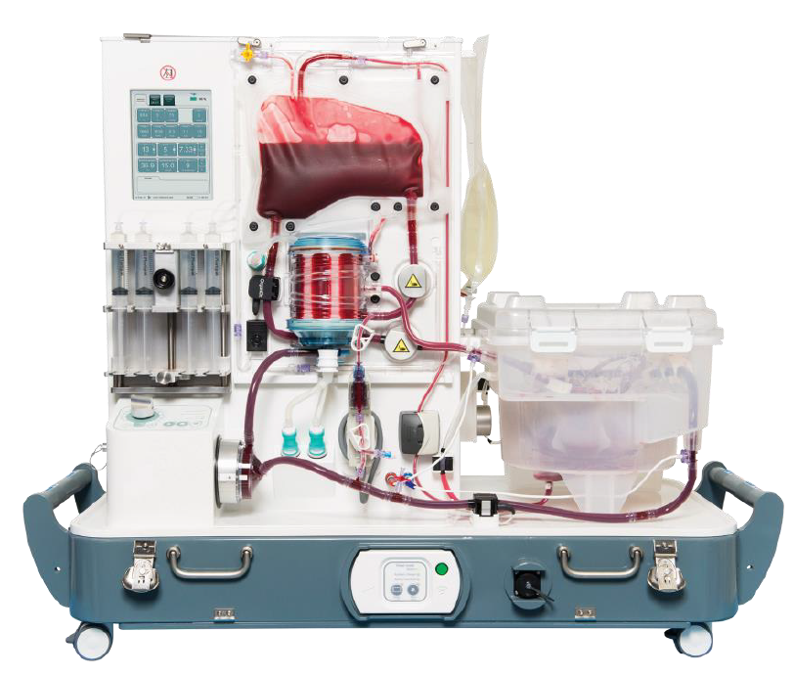
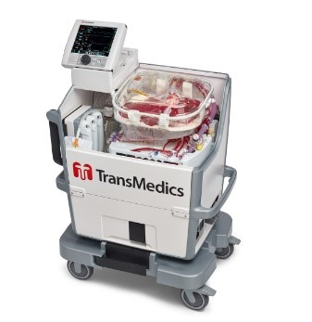
FDA Approved Devices in the United States

Slide 52
FDA Approved Devices in the United States
Organox Metra
Transmedics Organ Care System (OCS)
Both approved in 2021

Slide 53
Organox Randomized Controlled Trial
136 livers underwent NMP, 130 underwent SCS
No difference in incidence of early allograft dysfunction on intention to treat analysis (20.6% NMP vs. 23.7% SCS)
EAD definition: Bili >10 or INR >1.6 on POD 7, AST or ALT > 2,000 within first 7 days
Post-reperfusion syndrome decreased in the NMP arm in as-treated analysis (5.9% vs. 14.6%)
Greater effect size regarding EAD in higher risk organs on intention to treat analysis
Chapman, et al. Ann Surg 2023

Slide 54
Transmedics OCS Randomized controlled Trial
153 livers using NMP, 147 underwent SCS
18% EAD in NMP cohort vs. 31% in the SCS cohort
Lower rate of ischemic biliary complications with NMP
2.6% vs. 9.9% at 12 months

Slide 55
Expanding the Donor Pool
Donor History:
71 year old male, died of CVA
Located in Neenah, Wisconsin
Declined by all centers within 500 nautical miles

Slide 56
Expanding the Donor Pool
650 nautical
miles

Slide 57
Expanding the Donor Pool
Accepted at Sequence 149 and placed on OCS
68 year old recipient, MELD 15
14 hours total preservation time
Cold ischemia time 1 hour, 33 minutes
Uneventful postoperative course, discharged postoperative day 8

Slide 58
Stretching Our Reach

Slide 59
Increasing Our Capacity

Slide 60
Thank you!
My cell: 404-405-9329

