Slide 1
Metabolic-associated fatty liver disease (MAFLD)
George Therapondos
MBChB, FRCP (Edin), MPH
Hepatology
Ochsner Multiorgan Transplant Institute
Sep 30 2023

Slide 2
Disclosures
Research support from Madrigal/Intercept/Gilead
Consulting/speaker for Intercept
Advisory Board/Speaker for Mallinckrodt/Astra Zeneca
Consulting for Novo Nordisk

Slide 3
Outline
Epidemiology
Care Pathways- how to identify high risk individuals
Treatment

Slide 4
Commonest cause of liver disease
Spectrum of disease
Annual ecomonic burden – 35 billion in direct costs + 200 billion societal costs

Slide 5
Affects 1 in 4 people
Most common cause of chronic liver disease/cirrhosis
Associated with significant cardiovascular risk
Associated with malignancies
Strongly linked with obesity, insulin resistance, dyslipidemia and hypertension

Slide 6
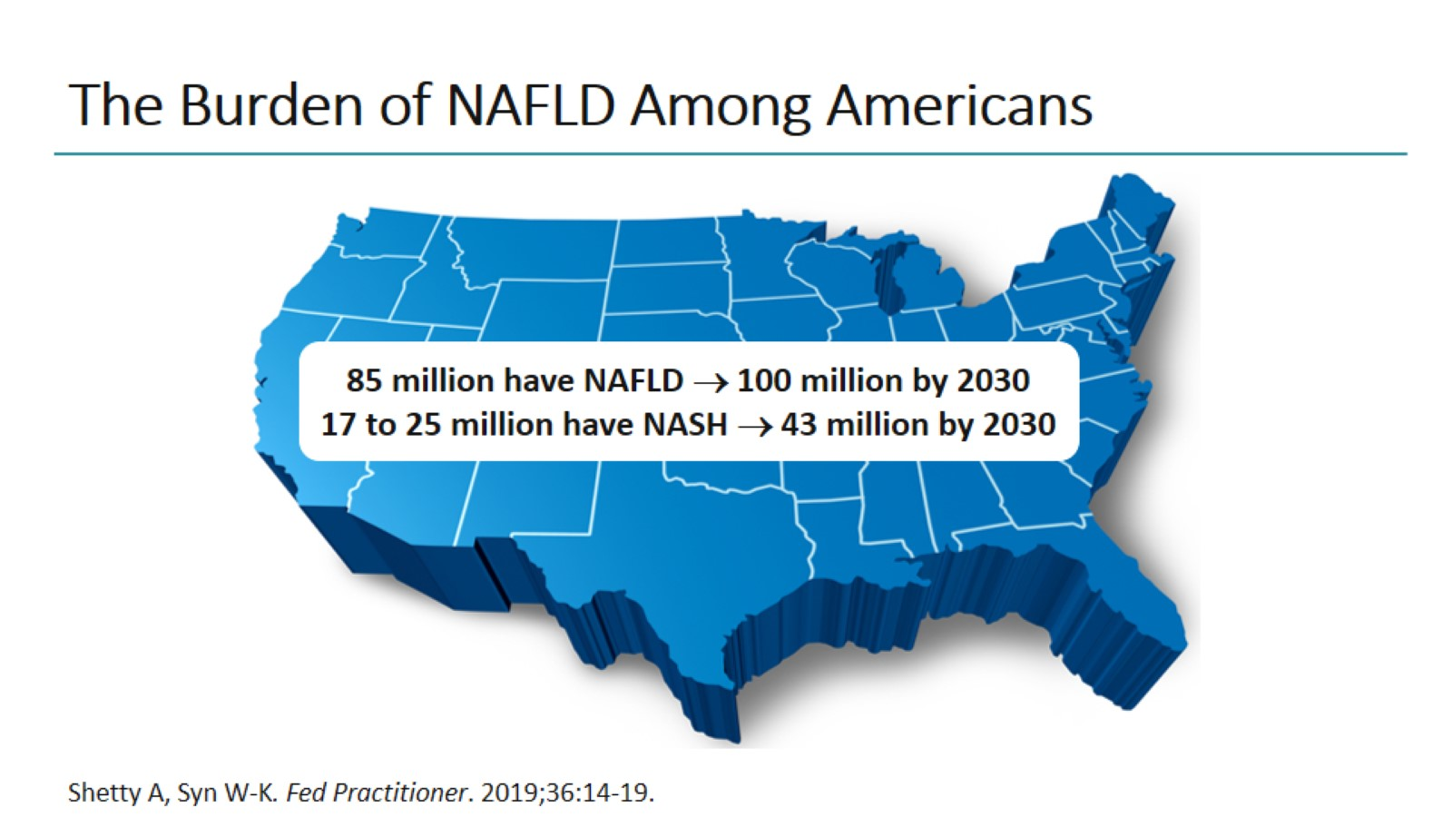
The Burden of NAFLD Among Americans

Slide 7
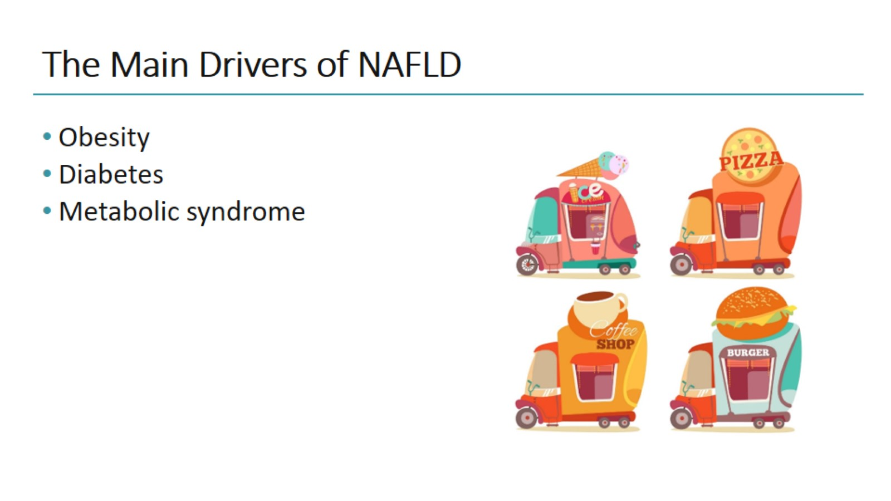
The Main Drivers of NAFLD

Slide 8
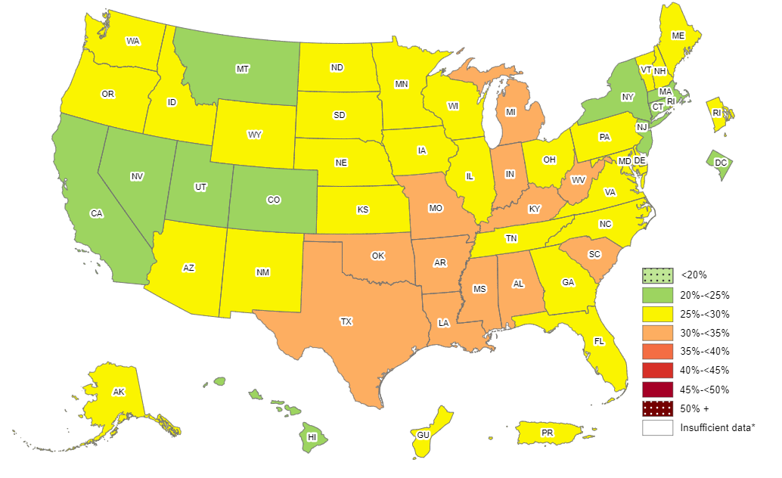

Prevalence¶ of Self-Reported Obesity Among U.S. Adults by State and Territory, BRFSS, 2011
¶ Prevalence estimates reflect BRFSS methodological changes started in 2011. These estimates should not be
compared to prevalence estimates before 2011.
*Sample size <50, the relative standard error (dividing the standard error by the prevalence) ≥30%, or no data in a specific year.

Slide 9
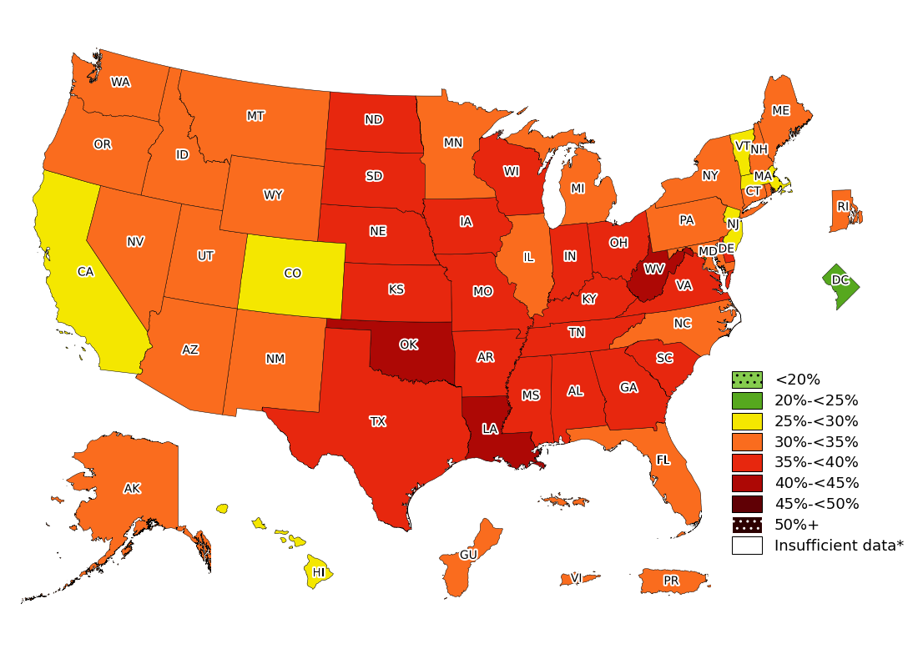
Prevalence¶ of Obesity Based on Self-Reported Weight and Height Among US Adults by State and Territory, BRFSS, 2022
¶ Prevalence estimates reflect BRFSS methodological changes started in 2011. These estimates should not be
compared to prevalence estimates before 2011.
*Sample size <50, the relative standard error (dividing the standard error by the prevalence) ≥30%, or no data in a specific year.

Slide 10
Prevalence¶ of Self-Reported Obesity Among U.S. Adults by State and Territory, BRFSS, 2022
Summary
No state or territory had a prevalence of obesity less than 20%.
The District of Columbia had a prevalence of obesity between 20% and <25%.
6 states had a prevalence of obesity between 25% and <30%.
22 states, Guam, Puerto Rico and Virgin Islands had a prevalence of obesity between 30% and <35%.
19 states (Alabama, Arkansas, Delaware, Georgia, Indiana, Iowa, Kansas, Kentucky, Mississippi, Missouri, Nebraska, North Dakota, Ohio, South Carolina, South Dakota, Tennessee, Texas, Virginia, and Wisconsin) had a prevalence of obesity between 35% and <40%.
3 states (Louisiana, Oklahoma, and West Virginia) had a prevalence of obesity 40% or greater.
¶ Prevalence estimates reflect BRFSS methodological changes started in 2011. These estimates should not be compared to prevalence estimates before 2011.
http://www.cdc.gov/obesity/data/prevalence-maps.html

Slide 11
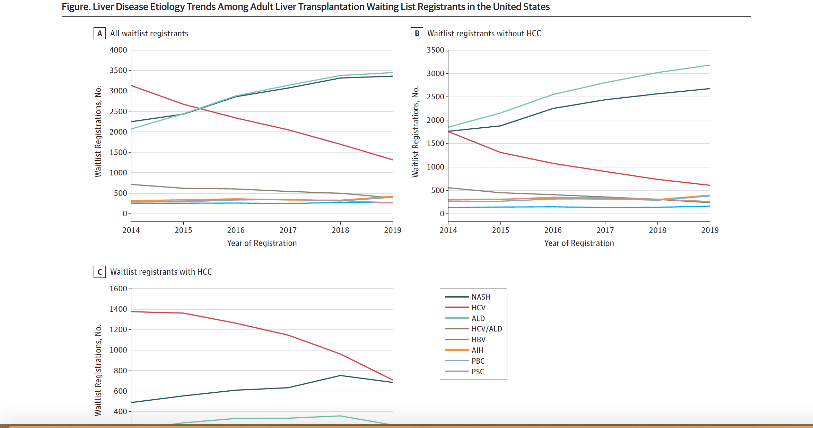
Liver Transplantation in the US
Wong et al 2020 JAMA Netw Open 2020;3(2)

Slide 12
Definitions of NAFLD, NAFL and NASH
NAFLD
Excessive hepatic fat accumulation with IR
Steatosis in >5% of hepatocytes*
Exclusion of secondary causes and AFLD†
NAFL
Pure steatosis
Steatosis and mild lobular inflammation
NASH
HCC
Early
F0/F1 fibrosis
Fibrotic
≥F2 to ≥F3 fibrosis
Cirrhotic
F4 fibrosis
Definitive diagnosis of NASH requires a liver biopsy
*According to histological analysis or proton density fat fraction or >5.6% by proton MRS or quantitative fat/water-selective MRI;
†Daily alcohol consumption of ≥30 g for men and ≥20 g for women
EASL–EASD–EASO CPG NAFLD. J Hepatol 2016;64:1388–402
Notes:
AFLD, alcoholic fatty liver disease; HCC, hepatocellular carcinoma; IR, insulin resistance; MRI, magnetic resonance imaging; MRS, magnetic resonance spectroscopy; NAFL, non-alcoholic fatty liver; NASH, non-alcoholic steatohepatitis

Slide 13
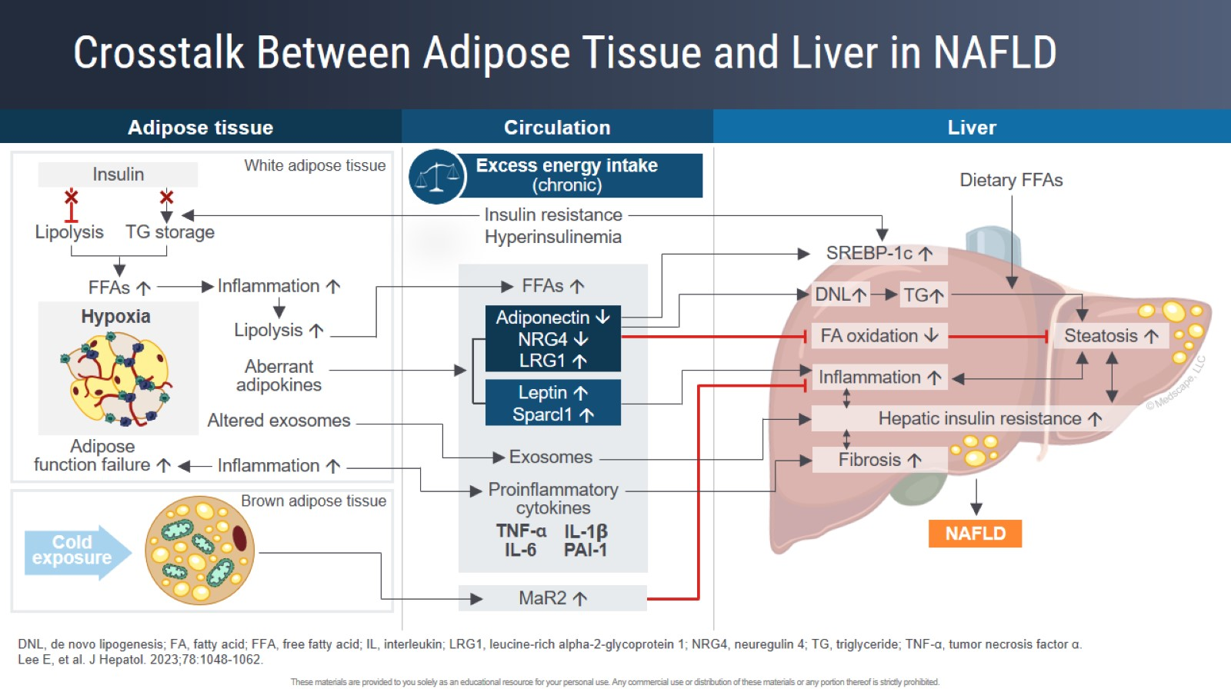
Crosstalk Between Adipose Tissue and Liver in NAFLD

Slide 14
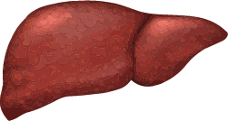
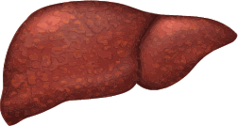
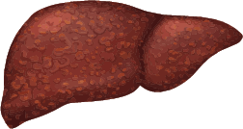
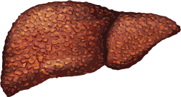
In NASH, disease progression activates an inflammatory cascade fibrogenesis¹⁻⁴
NORMAL LIVER
STEATOSIS
NASH
FIBROSIS
FFA
Factors such as metabolic syndrome and genetic factors
Hepatocytes are less responsive to insulin
Increased fat storage
Decreased fatty acid oxidation, fat droplets form in cells
Steatosis
Oxidative stress and ER stress
Mitochondrial dysfunction
Lipotoxicity (apoptosis)
Inflammation; hepatic apoptosis
Hepatic stellate cells lay down ECM deposits (fibrosis)
ECM, extracellular matrix; ER, endoplasmic reticulum; FFA, free fatty acid
1. Schuppan D, Schattenberg JM. J Gastroenterol Hepatol 2013;28(Suppl 1):68–76; 2. Cusi K. Gastroenterology 2012;142(4):711–725.e6; 3. Machado MV, Diehl AM. Gastroenterology 2016;150(8):1769–1777; 4. Ramos-Lopez O, et al. World J Gastroenterol 2015;21(41):11552–11566.

Slide 15

Natural history of NAFLD over 8–13 years
Steatosis
8%
12−40%
NASH ±
F1−F2
fibrosis
13%
5−10%
Advanced
F3
fibrosis
14%
0−50%
Death/
LTx
25%
Cirrhosis
25−50%
7%
HCC
de Alwis NMW, Day CP. J Hepatol 2008;48:S104–12
Copyright © 2008 European Association for the Study of the Liver Terms and Conditions
Notes:
HCC, hepatocellular carcinoma; NASH, non-alcoholic steatohepatitis; LTx, liver transplantation

Slide 16
Screening, prevalence and incidence
NAFLD is the most common liver disorder in Western countries, affecting 17–46% of adults¹
  NAFLD is also present in 7% of normal-weight (lean) individuals²
Recommendations
Patients with IR and/or metabolic risk factors (i.e. obesity or MetS) should undergo procedures for the diagnosis of NAFLD
Screen individuals with steatosis for secondary causes of NAFLD, including a careful assessment of alcohol intake. Always consider the interaction between moderate amounts of alcohol and metabolic factors in fatty liver
Identify other chronic liver diseases that may coexist with NAFLD as these might result in more severe liver injury
1. Vernon G, et al. Aliment Pharmacol Ther 2011;34:274−85; 2. Younossi ZM, et al. Medicine 2012;91:319−27;
EASL–EASD–EASO CPG NAFLD. J Hepatol 2016;64:1388–402
Notes:
IR, insulin resistance

Slide 17
Pathogenesis: lifestyle and genes
A Western diet/lifestyle has been associated with weight gain and obesity, and NAFLD¹
High calorie intake
Excess (saturated) fat
Obesity
NAFLD
High fructose intake
Sedentary behaviour
Several genetic modifiers of NAFLD have been identified
  A minority have been robustly validated
PNPLA3 I148M and TM6SF2 E167K carriers have a higher liver fat content/Increased risk of NASH

Slide 18
Pathogenesis: genetics
Several genetic modifiers of NAFLD have been identified¹
  A minority have been robustly validated
PNPLA3 I148M and TM6SF2 E167K carriers have a higher liver fat content*
  Increased risk of NASH
Recommendation
Genotyping may be considered in selected patients and clinical studies but is not recommended routinely | B | 2
Grade of evidence
Grade of recommendation
*Grade of evidence B, grade of recommendation 2
1. Anstee QM, et al. Nat Rev Gastroenterol Hepatol 2013;10:330–44;
EASL–EASD–EASO CPG NAFLD. J Hepatol 2016;64:1388–402
Notes:
IR, insulin resistance; NASH, non-alcoholic steatohepatitis

Slide 19
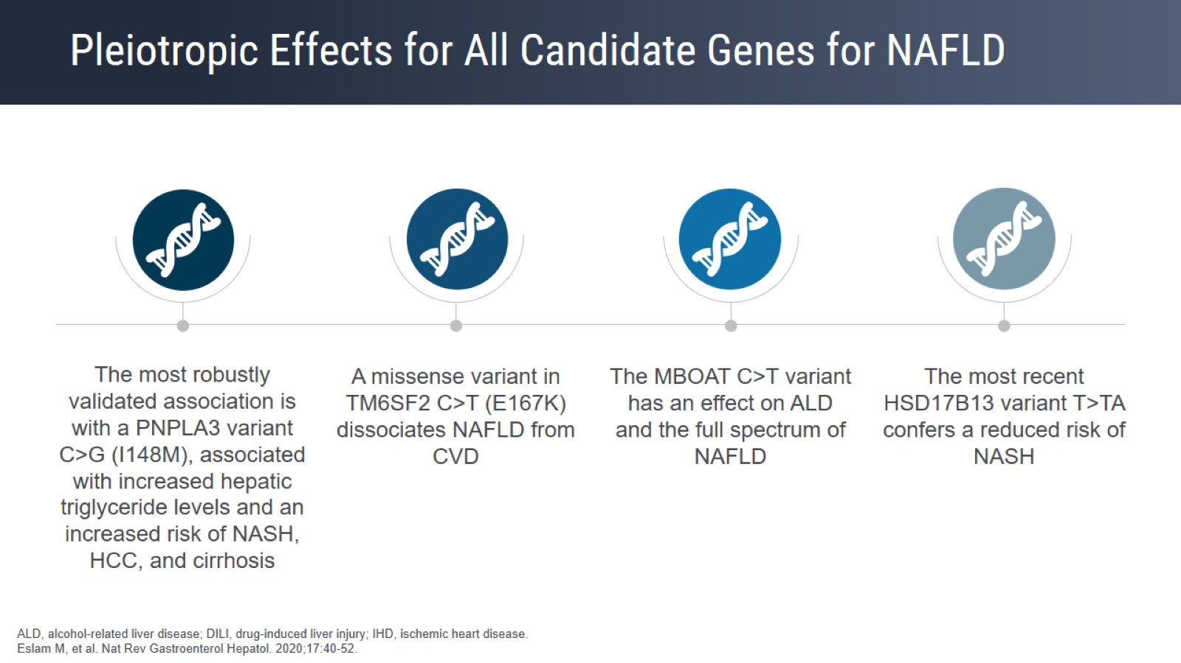
Pleiotropic Effects for All Candidate Genes for NAFLD

Slide 20
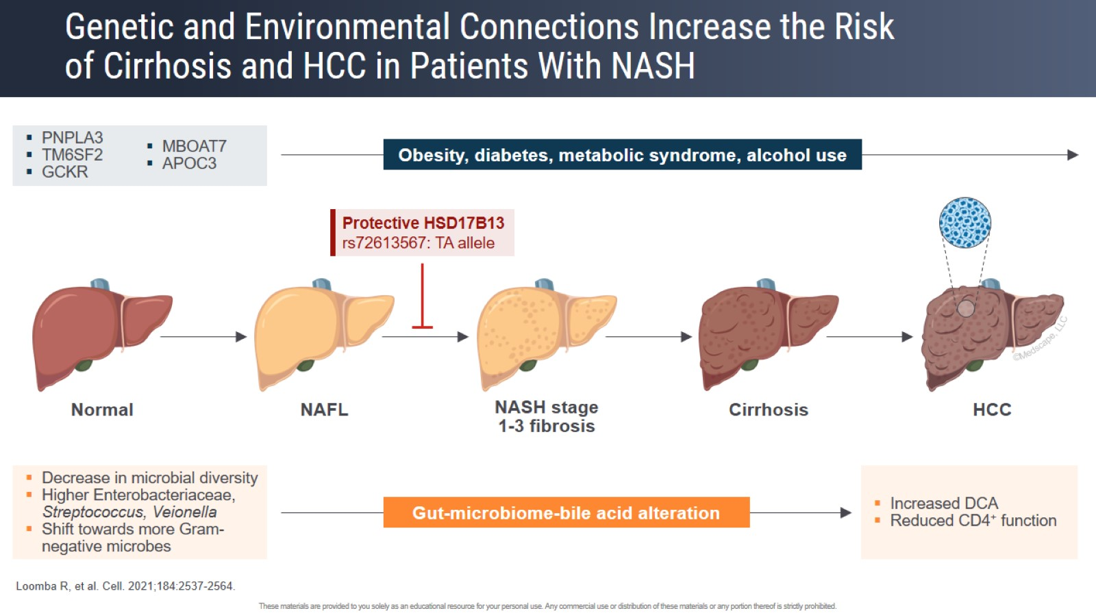
Genetic and Environmental Connections Increase the Risk of Cirrhosis and HCC in Patients With NASH

Slide 21
Prognosis
Fibrosis is the most important prognostic factor in NAFLD
  Correlates with liver-related outcomes and mortality
  Advanced fibrosis indicates thorough investigation
EASL–EASD–EASO CPG NAFLD. J Hepatol 2016;64:1388–402

Slide 22
Common related metabolic disorders: T2DM
Irrespective of liver enzymes, diabetes risk and T2DM are closely associated with:
  Severity of NAFLD
  Progression to NASH
  Presence of advanced fibrosis
  Development of HCC
In individuals with NAFLD, screening for diabetes is mandatory, by fasting or random blood glucose or HbA1c…
Look for NAFLD in patients with T2DM, irrespective of liver enzyme levels, due to high risk of disease progression
EASL–EASD–EASO CPG NAFLD. J Hepatol 2016;64:1388–402
Notes:
HbA1c, glycated haemoglobin; HCC, hepatocellular carcinoma; NASH, non-alcoholic steatohepatitis; OGTT, oral glucose tolerance test; T2DM, type 2 diabetes mellitus

Slide 23
Natural history and complications: progression
In general, NAFLD is a slowly progressive disease, both in adults and in children
  Rate of progression corresponds to 1 fibrosis stage every 14 years in NAFL and every 7 years in NASH
  Rate of progression is doubled by arterial hypertension¹
  Progression of fibrosis is more rapid in about 20% of cases¹
Paediatric NAFLD is of concern
  Potential for severe liver-related complications later in life
  NASH-related cirrhosis has been reported as early as 8 years of age
1. Sing S et al. Clin Gastroenterol Hepatol 2015;13:643–54;
EASL–EASD–EASO CPG NAFLD. J Hepatol 2016;64:1388–402
Notes:
NAFL, non-alcoholic fatty liver; NASH, non-alcoholic steatohepatitis

Slide 24
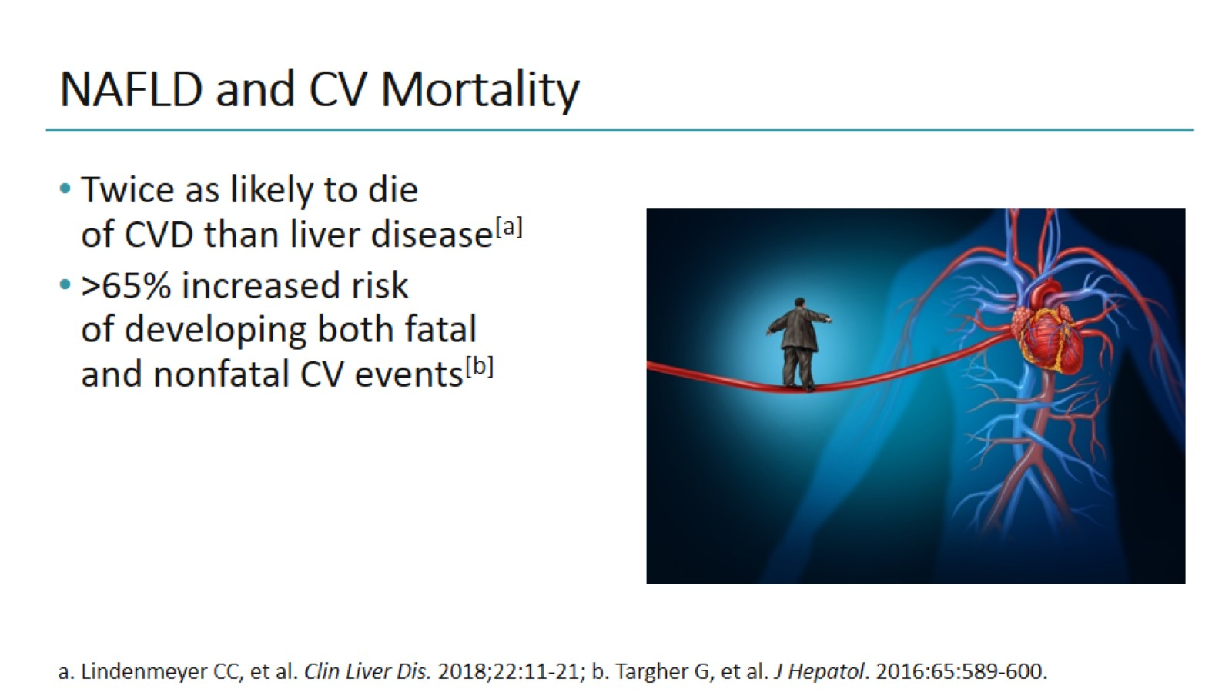
NAFLD and CV Mortality

Slide 25


Some patients with Advanced Fibrosis due to NASH will progress to cirrhosis quickly
Rapid progression of patients with
F3 to cirrhosis¹
After approximately
2.5 years
1 in 5 progressed to cirrhosis
The natural history of Advanced Fibrosis due to NASH may be more rapid than previously thought¹
NASH, nonalcoholic steatohepatitis
1. Sanyal AJ et al. Hepatology 2019; doi: 10.1002/hep.30664.
Notes:
And in some patients, advanced fibrosis due to NASH will progress very quickly. In this study (Sanyal et al, 2019), 20% of patients with F3 advanced fibrosis had progressed to cirrhosis in just 2.5 years.¹
Reference
1. Sanyal AJ et al. Hepatology 2019; doi: 10.1002/hep.30664.

Slide 26
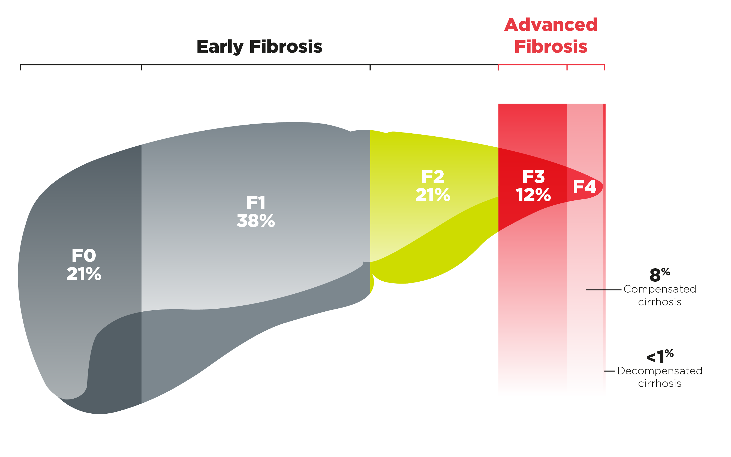
Advanced Fibrosis due to NASH represents a subset of the NASH population
Distribution of NASH population by fibrosis stage in the US using a population model¹
Patients with advanced fibrosis are at greater risk for serious liver-related consequences¹
NASH, nonalcoholic steatohepatitis; US, United States
1. Estes C et al. Hepatology 2018;67(1):123–133.
26
May or may not be reversible
Notes:
Advanced Fibrosis due to NASH represents a subset of the NASH population. These patients are at greater risk for serious liver-related consequences as we will see in the coming slides.¹
Reference
1. Estes C et al. Hepatology 2018;67(1):123–133.

Slide 27
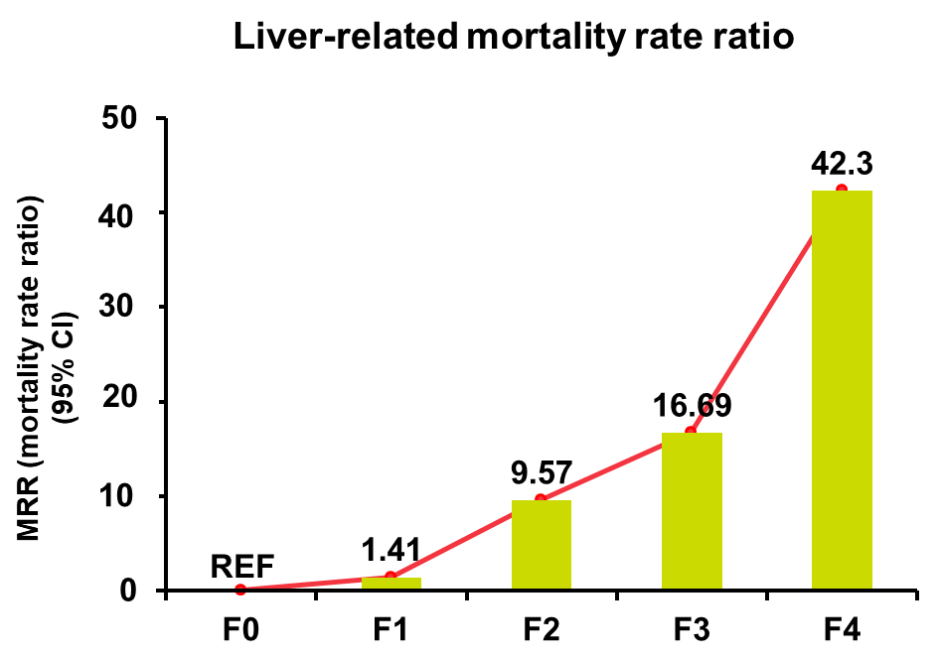
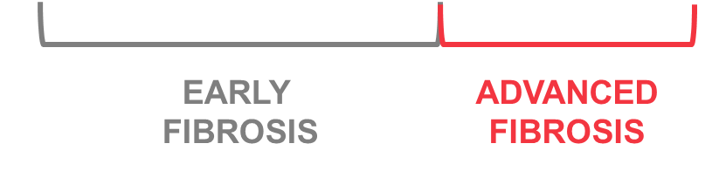
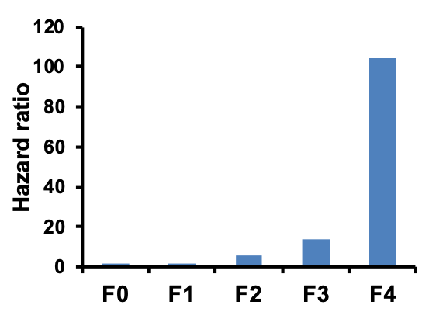
Advanced Fibrosis exponentially increases the risk of liver-related morbidity and mortality
Risk of severe liver disease
compared to controls*¹
Liver-related mortality rate ratio^{†2}
104.5
5.5
14.3
1.9
1.7
95% confidence intervals
(0.90–4.10) (0.84–3.24) (3.10–9.70) (7.90–25.8) (57.2–191.1)
95% confidence intervals
(0.17–11.95) (1.67–54.93) (2.92–95.36) (3.51–510.34)
Adapted from Hagström H et al. J Hepatol 2017;67:1265 –1273
Adapted from Dulai PS et al. Hepatology 2017;65(5):1557–1565
^{1,*}From a retrospective cohort study of 646 biopsy-proven NAFLD patients, each matched to 10 controls
^{2, †}From a meta-analysis of 5 multinational cohorts (17,452 PYF)
Hagström H et al. J Hepatol 2017;67:1265 –1273;
2. Dulai PS et al. Hepatology 2017;65(5):1557–1565.
Notes:
Advanced fibrosis exponentially increases the risk of liver-related morbidity and mortality. Both of these graphs illustrate that the risk of liver-related morbidity (Hagström et al, 2017) and mortality (Dulai et al, 2017) increase as fibrosis stage increases and patients with advanced fibrosis are at the greatest risk.^{1,2}
Severe liver disease was defined in the study as an ICD-code for liver failure, cirrhosis, hepatocellular carcinoma, or decompensated liver disease. Decompensated liver disease was defined by an ICD-code for esophageal varices (bleeding or not bleeding), ascites, or hepatic encephalopathy).¹
References
Hagström H et al. J Hepatol 2017;67:1265 –1273.
Dulai PS et al. Hepatology 2017;65(5):1557–1565.

Slide 28
Identifying
Advanced Fibrosis
Notes:
There is a great deal of discussion around how best to identify these patients,^{1–3} so let’s take a closer look at this topic…
References
Alkhouri N et al. Gastroenterol Hepatol (NY) 2012;8(10): 661–668.
Grandison GA and Angulo P. Clin Liver Dis 2012;16(3):567–585.
Alkhouri N et al. Hepatology 2019; doi: 10.1002/hep4.1342.

Slide 29
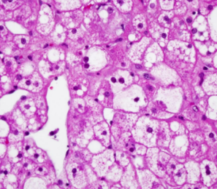
Liver biopsy
Liver biopsy is essential for the diagnosis of NASH
  Clinical, biochemical or imaging measures cannot distinguish NASH from steatosis
NAFL encompasses
  Steatosis alone plus ONE of lobular or portal inflammation OR ballooning
NASH requires
  Steatosis AND
  Lobular or portal inflammation AND
  Ballooning
NAS scoring indicates disease severity*
Recommendations
NASH has to be diagnosed by a liver biopsy showing steatosis, hepatocyte ballooning and lobular inflammation | A | 1
Grade of evidence
Grade of recommendation
*Should not be used for initial diagnosis
EASL–EASD–EASO CPG NAFLD. J Hepatol 2016;64:1388–402
Notes:
NAFL, non-alcoholic fatty liver; NASH, non-alcoholic steatohepatitis; NAS, NAFLD Activity Score
Image from Journal of Hepatology 2013 vol. 59 :131–137

Slide 30
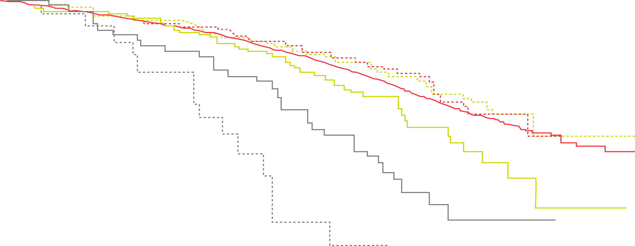
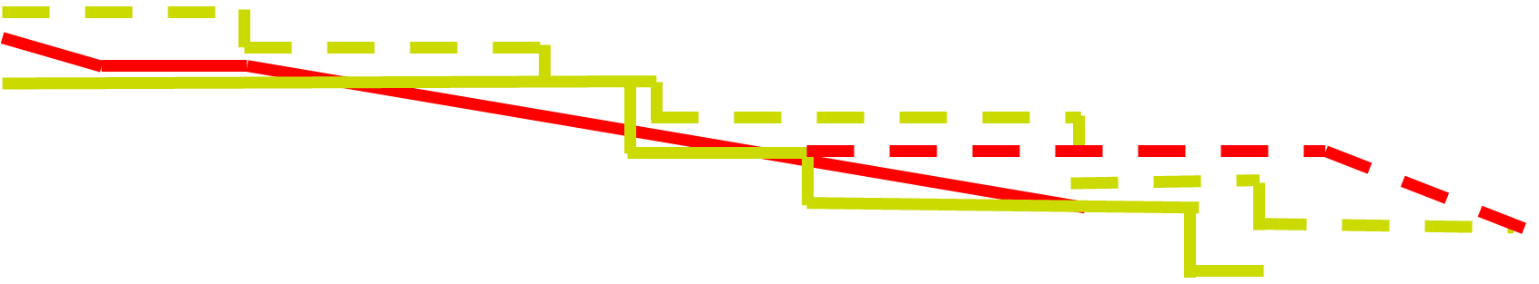
Despite limitations, liver biopsy results have been shown to be effective at predicting patient outcomes*¹
Kaplan-Meier survival estimates and fibrosis stage¹
1.00
Controls
F1
F3
F0
F2
F4
Fibrosis stage determined by liver biopsy predicts risk of all-cause mortality in NAFLD patients¹
0.75
Proportion alive
0.50
0.25
Log-rank <0.001
0.00
0
10
20
30
40
*From a retrospective cohort study of 646 biopsy-proven NAFLD patients, each matched to 10 controls
Years of follow-up
Adapted from Hagström H et al. J Hepatol 2017;67:1265 –1273
NAFLD, nonalcoholic fatty liver disease
1. Hagström H et al. J Hepatol 2017;67:1265 –1273.
Notes:
Liver biopsy is valuable for its ability to stage fibrosis, which can predict patient outcomes.¹
Reference
Hagström H et al. J Hepatol 2017;67:1265 –1273.

Slide 31

Non-invasive tests (NITs) offer alternative ways to diagnose and stage the degree of fibrosis
NITs are reproducible, widely available and relatively low cost^{1–3}
Safe and simple way to support disease monitoring over time¹
Identify patients with advanced fibrosis while excluding patients in early stages of fibrosis²
Use of multiple NITs are likely to be more predictive³
NIT, non-invasive test
1. Tapper EB et al. Am J Gastroenterol 2015; doi: 10.1038/ajg.2015.241; 2. Lucero C et al. Gastroenterol Hepatol (N Y). 2016;12(1):33–40; 3. Leoni S et al. World J Gastroenterol 2018; 24(30):3361–3373.
Notes:
Non-invasive tests are increasingly being looked to as alternatives to biopsy. They offer many positive attributes^{1–3} [...]; and as we’ll see the fibrosis stage determined by NITs is also predictive of mortality.^{4,5}
References
Tapper EB et al. Am J Gastroenterol 2015; doi: 10.1038/ajg.2015.241.
Lucero C et al. Gastroenterol Hepatol (N Y). 2016;12(1):33–40.
Leoni S et al. World J Gastroenterol 2018; 24(30):3361–3373.
Angulo P et al. Gastroenterology 2013;145:782–789.
Boursier J et al. J Hepatol 2016;65(3):570–578.

Slide 32
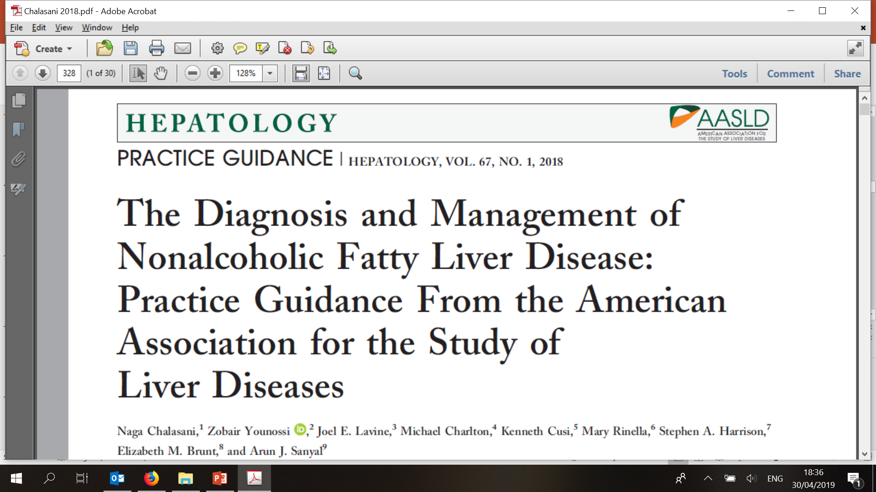


Recent guidelines recognize the value of NITs
“There has been significant interest in developing clinical prediction rules and noninvasive biomarkers for identifying SH [steatohepatitis]”¹
“There is increasing evidence for the prognostic value of non-invasive tests”²
NITs have prognostic value in predicting both mortality and liver-related
complications in patients with NAFLD/NASH and other chronic liver diseases²
NAFLD, nonalcoholic fatty liver disease; NASH, nonalcoholic steatohepatitis; NIT, non-invasive test
1. Chalasani N et al. Hepatology 2018;67(1):328–357; 2. EASL-ALEH. J Hepatol 2015;63:237–264.
Notes:
The potential and prognostic value of NITs has further been recognized by the guidelines as well.^{1–3}
References
Chalasani N et al. Hepatology 2018;67(1):328–357.
EASL-EASD-EASO. J Hepatol 2016;64:1388–1402.
EASL-ALEH. J Hepatol 2015;63:237–264.

Slide 33
Commonly used NITs
NITs use different approaches to determine liver fibrosis:¹
  Simple and proprietary predictive scores quantify biomarkers in serum samples that have been shown to be associated with fibrosis stage
  Imaging techniques measure liver stiffness
Simple scores
Proprietary predictive scores
Imaging
NAFLD fibrosis score²
Fibrosis-4 (FIB-4)²
Aspartate aminotransferase/platelet ratio index (APRI)³
FibroSure®
Enhanced Liver Fibrosis (ELFTM)^{2 –} (not commercially available in the US)
Transient elastography (e.g. FibroScan®)²
Magnetic resonance elastography (MRE)⁴
NAFLD, nonalcoholic fatty liver disease; NIT, non-invasive test
1. EASL. J Hepatol 2015;63:237–264; 2. Alkhouri N et al. Gastroenterol Hepatol (NY) 2012;8(10): 661–668; 3. Atay K et al. Biomedical Research 2017;28(2):565–570; 4. Chalasani N et al. Hepatology 2018;67(1):328–357.
ELFTM is a trademark of Siemens Healthineers
FibroScan® is a registered trademark of EchoSensTM, Paris
FibroSure® is distributed by LabCorp in the US
List of NITs provided above is not exhaustive
Notes:
These are a few of the more common NITs in use today. We’re going to go into a deeper discussion on a few of them…

Slide 34
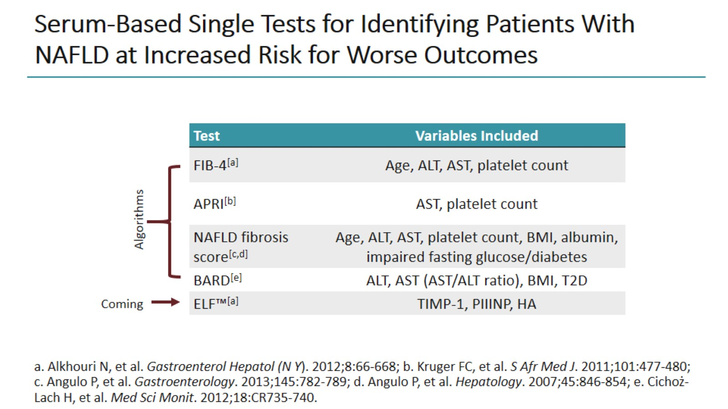
Serum-Based Single Tests for Identifying Patients With NAFLD at Increased Risk for Worse Outcomes

Slide 35
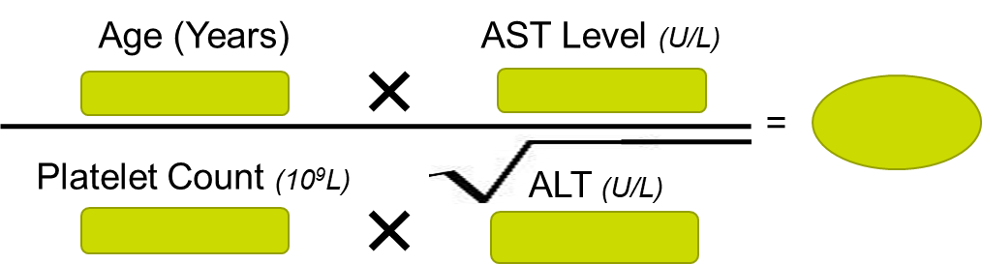

Fibrosis 4 (FIB-4) is easily accessible and can be easily calculated with a simple blood test and online calculators¹
FIB-4 =
Online Calculators
Available
FIB-4, fibrosis-4
1. Fibrosis-4 calculator. Available from: https://www.mdcalc.com/fibrosis-4-fib-4-index-liver-fibrosis. (Accessed June 2019); 2. Alkhouri N et al. Gastroenterol Hepatol (NY) 2012;8(10): 661–668.

Slide 36
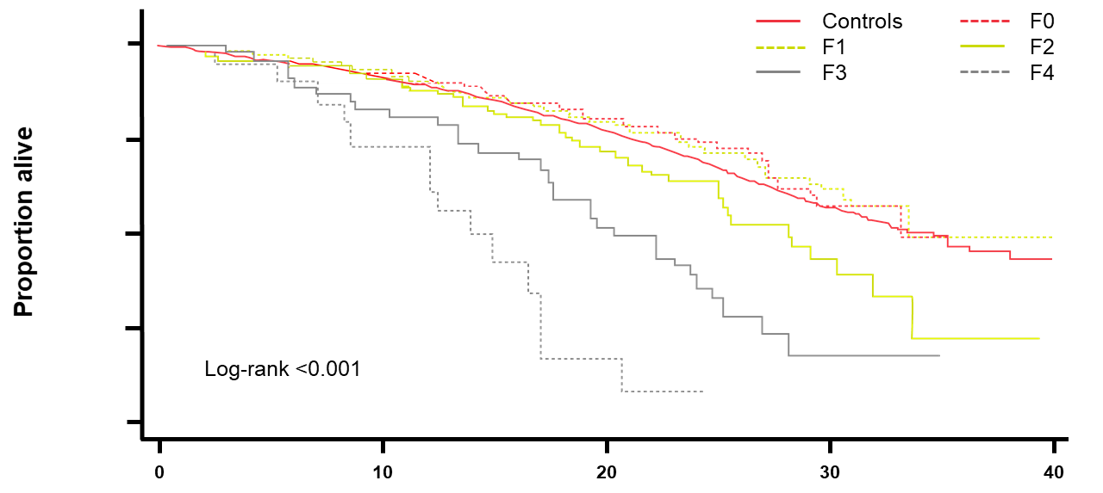

Fibrosis stage measured by
Transient Elastography is predictive of mortality
Cumulative probability of death is related to Transient Elastography score and is similar to the predictive value of liver biopsy^{1,2}
1.0
TE
Liver biopsy
LSM fibrosis classification:
LSM₁ (F0/1)
LSM₃ (F1/2)
LSM₄ (F2/3)
LSM₆ (F3/4)
LSM₇ (F4)
0.8
0.6
Overall survival
0.4
0.2
0.0
P <0.001
0
2
4
6
8
10
Follow-up (years)
Years of follow-up
Adapted from Boursier J et al. J Hepatol 2016;65(3):570–578
Adapted from Hagström H et al. J Hepatol 2017;67:1265 –1273
LSM, liver stiffness measurement; TE, transient elastrography
1. Boursier J et al. J Hepatol 2016;65(3):570–578; 2. Hagström H et al. J Hepatol 2017;67:1265 –1273.
Notes:
That’s just a few of the tests. All tests have limitations, for NITs, it’s the number of patients who fall into the “indeterminate” area…^{1,2}
References
Alkhouri N et al. Gastroenterol Hepatol (NY) 2012;8(10): 661–668.
Grandison GA and Angulo P. Clin Liver Dis 2012;16(3):567–585.

Slide 37
The use of sequential NITs could reduce the number of patients in the ‘indeterminate zone’^{1,2}
NIT #1
Absence of advanced fibrosis
Indeterminate
Presence of advanced fibrosis
NIT #2
Absence of advanced fibrosis
Indeterminate
Presence of advanced fibrosis
Adapted from Younossi ZM et al. Presented at: AASLD; November 9–13, 2018; San Francisco, United States; Abstract LB-10.
The sequential use of NITs maintains sensitivity and specificity, while enabling the classification of a larger proportion of patients¹
NIT, non-invasive test
1. Younossi ZM et al. Presented at: AASLD; November 9–13, 2018; San Francisco, United States; Abstract LB-10; 2. Newsome PN et al. Gut 2018;67(1):6–19.
Notes:
And one of the ways to address this is to use NITs sequentially…^{1,2}
References
Younossi ZM et al. Presented at: AASLD; November 9–13, 2018; San Francisco, United States; Abstract LB-10.
Newsome PN et al. Gut 2018;67(1):6–19.

Slide 38
Diagnosis: diagnostic flow-chart
Metabolic work-up must carefully assess all components of MetS
Obesity/T2DM or raised liver enzymes in patients with metabolic risk factors should prompt non-invasive screening to predict steatosis, NASH and fibrosis
Metabolic risk factors present
Ultrasound (steatosis biomarkers)*/
liver enzymes†
Steatosis present
Steatosis absent
Normal
liver enzymes
Abnormal
liver enzymes‡
Normal
liver enzymes
Serum fibrosis
markers§
Low risk‖
Medium/
high risk‖
Follow-up/
2 years
Specialist referral
Follow-up/
3–5 years
Liver enzymes,
fibrosis
biomarkers
Identify other chronic liver diseases
In-depth assessment of disease severity
Decision to perform liver biopsy
Initiate monitoring/therapy
Ultrasound/
liver enzymes
*Steatosis biomarkers: Fatty Liver Index, SteatoTest, NAFLD Fat score;
†Liver tests: ALT AST, GGT; ‡Any increase in ALT, AST or GGT;
§Serum fibrosis markers: NAFLD Fibrosis Score, FIB-4, Commercial tests (FibroTest, FibroMeter, ELF);
‖Low risk: indicative of no/mild fibrosis; medium/high risk: indicative of significant fibrosis or cirrhosis
EASL–EASD–EASO CPG NAFLD. J Hepatol 2016;64:1388–402
Notes:
ALT, alanine aminotransferase; AST, aspartate aminotransferase; ELF, enhanced liver fibrosis; GGT, gamma-glutamyl transpeptidase; MetS, metabolic syndrome; NASH, non-alcoholic steatohepatitis; T2DM, type 2 diabetes mellitus

Slide 39
For patients with Advanced Fibrosis, halting fibrosis is an important goal…^{1,2}
HALT or REVERSE
FIBROSIS
PREVENT
Progression to CIRRHOSIS
Fibrosis stage is associated with overall survival and
liver-related complications³
Fibrosis improvement is associated most strongly with resolution of NASH⁴
Preventing progression from advanced fibrosis to cirrhosis is a principle objective of management¹
NASH, nonalcoholic steatohepatitis
1. Filozof C et al. Hepatol Commun 2017; 1(7): 577–585; 2. FDA Noncirrhotic Nonalcoholic Steatohepatitis With Liver Fibrosis: Developing Drugs for Treatment Guidance for Industry. December 2018; 3. Angulo P et al. Gastroenterology 2015;149:389–397; 4. Brunt EM et al. Hepatology 2018;doi: 10.1002/hep.30418.

Slide 40
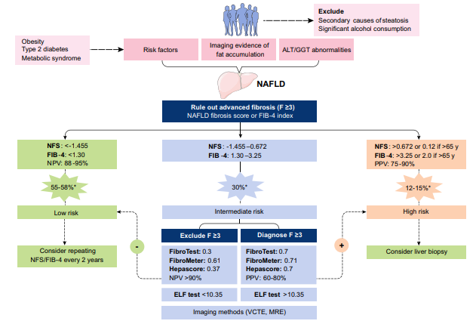
Potential algorithm for non-invasive assessment: prediction rules and blood-based biomarkers
*Estimated prevalence for low-, intermediate- and high-risk groups
Vilar-Gomez E, Chalasani N. J Hepatol 2018;68:305−15
Copyright © 2017 European Association for the Study of the Liver Terms and Conditions
Notes:
ALT, alanine aminotransferase; ELF, enhanced liver fibrosis; GGT, gamma-glutamyl transferase; MRE, magnetic resonance elastography; NFS, NAFLD fibrosis score; NPV, negative predictive value; PPV, positive predictive value; VCTE, vibration-controlled transient elastography
Citation for image: Vilar-Gomez and Chalasani J Hepatol 2018: 68:305–15

Slide 41
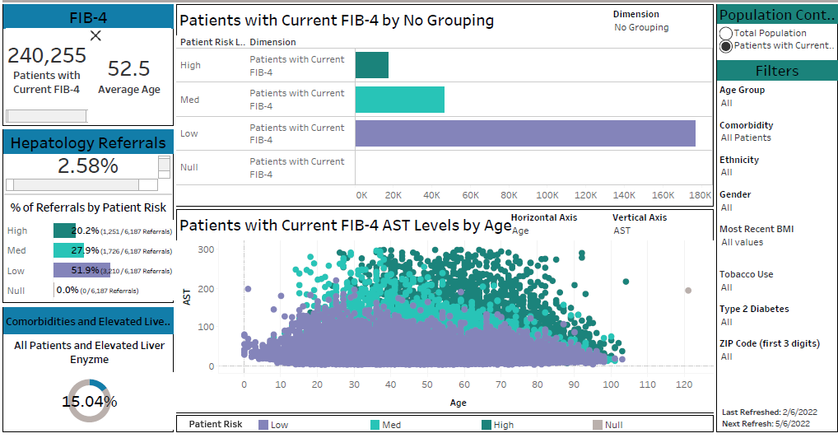
Real World Evidence for the Potential Magnitude of the Problem- Ochsner Health Data
Therapondos et al. ILC 2022

Slide 42
Ochsner Health data – June 21- Feb 22
633,267 patients met criteria
240,255 patients with Fib-4 (38%)
16,952- high risk
46,326- indeterminate risk- need further assessment
50% of hepatology referrals were low risk
Therapondos et al ILC 2022

Slide 43
Treatment
Notes:
There is a great deal of discussion around how best to identify these patients,^{1–3} so let’s take a closer look at this topic…
References
Alkhouri N et al. Gastroenterol Hepatol (NY) 2012;8(10): 661–668.
Grandison GA and Angulo P. Clin Liver Dis 2012;16(3):567–585.
Alkhouri N et al. Hepatology 2019; doi: 10.1002/hep4.1342.

Slide 44
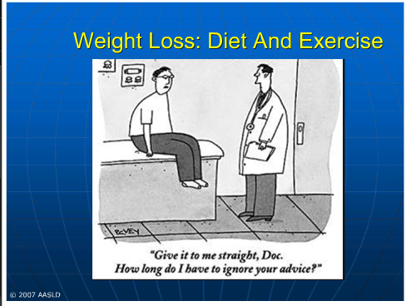

Slide 45
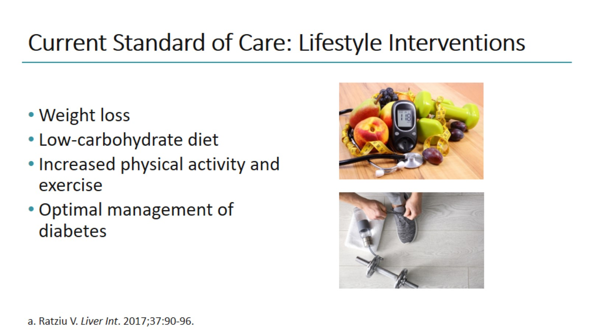
Current Standard of Care: Lifestyle Interventions

Slide 46
Components of a lifestyle approach to NAFLD
Energy restriction
Calorie restriction (500−1,000/day)
7−10% weight loss target
Long-term maintenance approach
Fructose intake
Avoid fructose-containing
food and drink
Daily alcohol intake
Strictly below 30 g men
and 20 g women
Coffee consumption
No liver-related limitations
Comprehensive
lifestyle approach
Macronutrient composition
Low-to-moderate fat
Moderate-to-high carbohydrate
Low-carbohydrate ketogenic diets or high protein
Physical activity
150−200 min/week moderate intensity
in 3−5 sessions
Resistance training to promote
musculoskeletal fitness and improve
metabolic factors
EASL–EASD–EASO CPG NAFLD. J Hepatol 2016;64:1388–402

Slide 47
Treatment: diet and lifestyle changes
Epidemiology suggests a close relationship between an unhealthy
lifestyle and NAFLD
Diet and lifestyle changes are mandatory in all patients
  Modest weight loss reduces liver fat, improves hepatic IR, and can result in NASH regression
  Weight loss of ≥7% is associated with histological improvement
EASL–EASD–EASO CPG NAFLD. J Hepatol 2016;64:1388–402
Notes:
IR, insulin resistance; NASH, non-alcoholic steatohepatitis

Slide 48
Treatment: Bariatric surgery
Option in patients unresponsive to lifestyle changes
Reduces weight and metabolic complications
  Stable results in the long term
  Bariatric surgery reduces liver fat and is likely to reduce NASH progression; prospective data have shown an improvement in all histological lesions of NASH, including fibrosis
EASL–EASD–EASO CPG NAFLD. J Hepatol 2016;64:1388–402
Notes:
HCC, hepatocellular carcinoma; LTx; liver transplantation; NASH, non-alcoholic steatohepatitis

Slide 49
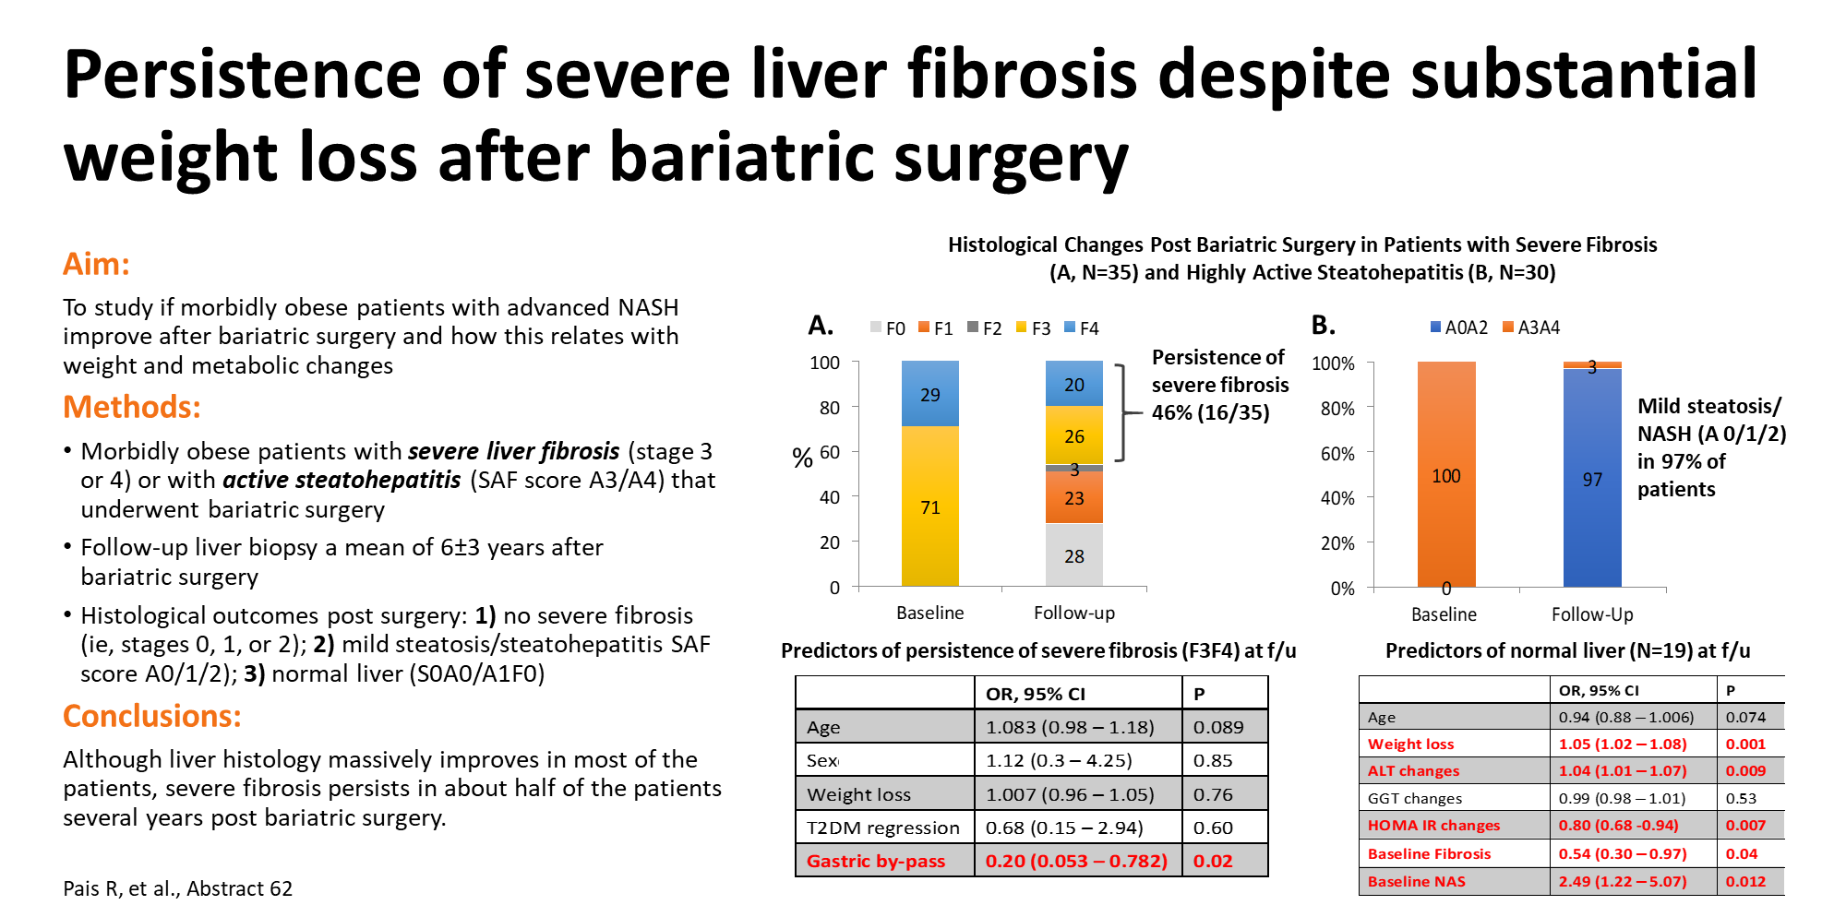
Notes:
62
PERSISTENCE OF SEVERE LIVER FIBROSIS DESPITE SUBSTANTIAL WEIGHT LOSS WITH BARIATRIC SURGERY
Dr. Raluca Pais¹, Dr. Judith Aron-Wisnewsky², Prof. Pierre Bedossa³, Prof. Jean-Michel Oppert⁴, Prof. Jean-Michel Siksik⁵, Laurent Genser², Dr. Frederic Charlotte⁵, Prof. Karine Clement, MD, PhD² and Prof. Vlad Ratziu⁴, (1)Assistance Publique Hôpitaux De Paris, Hôpital Pitié-Salpétrière – Sorbonne Université ; Institut of Cardiometabolism and Nutrition; Paris, France, (2)Inserm/Sorbonne Université Umrs 1269 Nutriomique, Service De Nutrition, Assistance Publique Hôpitaux De Paris, France, (3)Institute of Cellular Medicine, Newcastle University, Newcastle upon Tyne, United Kingdom, (4)Assistance Publique Hôpitaux De Paris, Hôpital Pitié-Salpétrière – Sorbonne Université ; Institut of Cardiometabolism and Nutrition; Paris, France, (5)Assistance Publique Hôpitaux De Paris, Hôpital Pitié-Salpétrière – Sorbonne Université; Paris, France
Background:
Bariatric surgery induces substantial hepatic and metabolic improvement in NASH patients although it is unclear if advanced NASH always improves several years post-surgery. Aim:To analyze improvement in hepatic histology and its relation with weight and metabolic changes in obese patients with advanced NASH that underwent bariatric surgery.
Methods:
868 patients underwent bariatric surgery with perioperative liver biopsy between 2004–2014. Central reading used the SAF score and the NASH-CRN fibrosis stage. Advanced NASH was defined as either severe fibrosis (SF, ie, F3 or F4) or high activity (HA, ie, SAF activity grade 3 or 4 with F0, 1 or 2). 181 of 868 pts had advanced NASH; among them, 65 pts (35 SF and 30 HA, 53 gastric by-pass, 12 sleeve) consented to a follow-up liver biopsy(fLB). Outcomes at fLB were: fibrosis response (pts with no SF), activity response (pts with no HA) and normal liver (S0A0/A1F0).
Results:
fLB was performed a mean of 6±3 years after surgery. At fLB there were 54% (19/35) SF responders, 97% (29/30) HA responders and 29% (19/65) pts with normal liver. 16 (45%) pts with baseline SF had persistent SF despite massive weight loss (-23%+/-9 kg), improvement in insulin resistance, normal ALT (in 63%), decrease in NAS (-3.12±2.3) and NASH resolution (in 67%). Compared to SF responders, they were older (56±8 vs 49±12, p=0.031), had less diabetes resolution (21% vs 50% p=0.09) and less often gastric by-pass (69% vs 100% p=0.014), shorter duration before fLB (4.2±2.2 vs 7.5±2.5 years, p<0.001) but similar weight-loss (23±9% vs 27±9%, p=0.19). Adjusting for age and sex, surgical procedures other than gastric bypass predicted SF at fLB independent of baseline BMI, weight loss or diabetes resolution.
No pts with HA progressed to SF, 70% had normal ALT, 87% NASH resolution, 53% normal liver and 71% diabetes resolution. Normal liver at fLB occurred in 19 pts (16 with HA and 3 with SF at baseline). They had similar age, follow-up time, baseline BMI but shorter diabetes duration and more weight loss post-surgery. Absence of SF at baseline was an independent predictor of a normal liver at fLB.
Conclusion:
Liver histology massively improves in most patients without severe fibrosis. However, severe fibrosis persists in about half of the patients several years post bariatric surgery. Gastric by-pass results in reversal of SF more often than other procedures and independently of metabolic improvement.
Disclosures:
Vlad Ratziu – Allergan: Consulting; Genfit: Consulting; Intercept: Consulting; Novartis: Consulting; Boehringer Ingelheim: Consulting; Novo Nordisk: Consulting; Galmed: Consulting; Pfizer: Consulting; Gilead: Grant/Research Support; Intercept: Grant/Research Support
The following people have nothing to disclose: Raluca Pais, Judith Aron-Wisnewsky, Pierre Bedossa, Jean-Michel Oppert, Jean-Michel Siksik, Laurent Genser, Frederic Charlotte, Karine Clement

Slide 50
Treatment: pharmacotherapy
Treatment should be indicated in:
  Progressive NASH
  Early-stage NASH with risk of fibrosis progression*
  Active NASH with high necroinflammatory activity
Treatment should reduce NASH-related mortality and progression to cirrhosis or HCC
  Resolution of NASH-defining lesions accepted as surrogate endpoint
Safety and tolerability are prerequisites
  Extensive comorbidities associated with significant polypharmacy and increased likelihood of DDIs
No drugs are approved for NASH
No specific therapy can be recommended
Any drug treatment is off label
Recommendations
Pharmacotherapy should be reserved for patients with NASH, particularly for those with significant fibrosis (stage F2 and higher). Patients with less severe disease, but at high risk of disease progression could also be candidates for treatment | B | 1
Grade of evidence
Grade of recommendation
*Age > 50 years, diabetes, MetS, increased ALT
EASL–EASD–EASO CPG NAFLD. J Hepatol 2016;64:1388–402
Notes:
ALT, alanine aminotransferase; DDI, drug-drug interaction; HCC, hepatocellular carcinoma; MetS, metabolic syndrome; NASH, non-alcoholic steatohepatitis

Slide 51
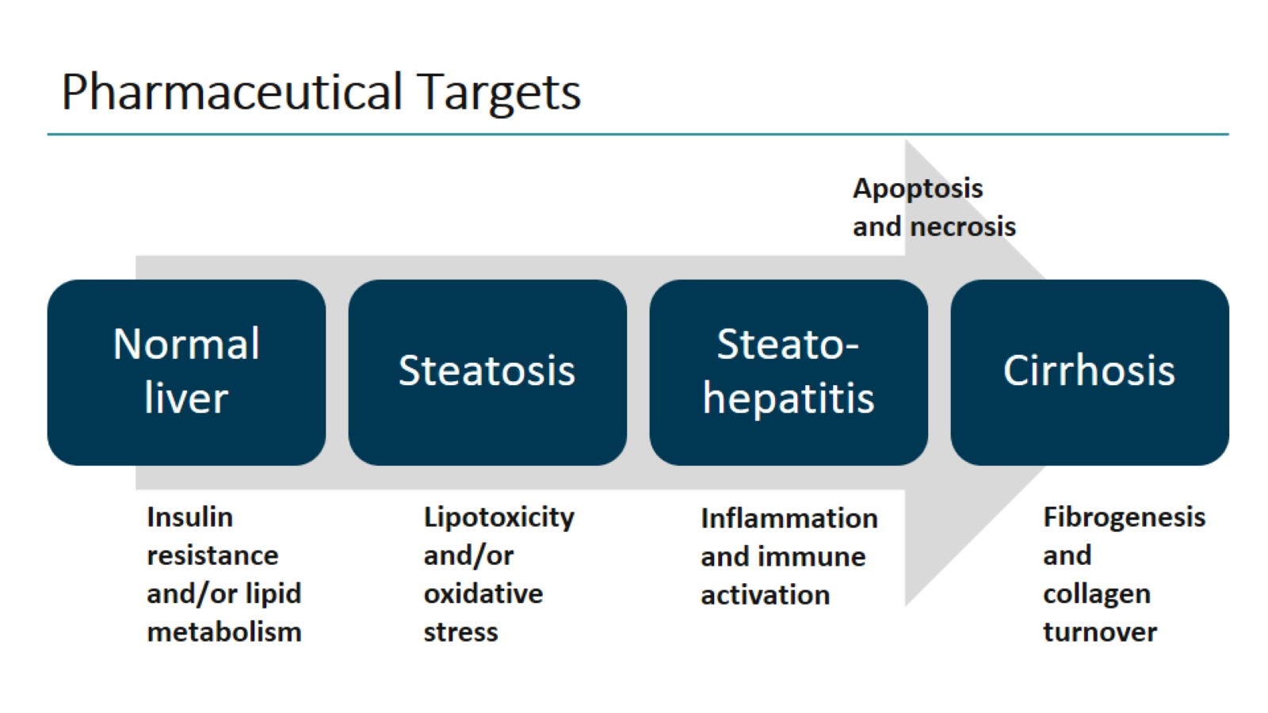
Pharmaceutical Targets

Slide 52
Treatment: pharmacotherapy
Insulin sensitizers
  Little evidence of histological efficacy with metformin
  PPARγ agonist pioglitazone better than placebo
    Improved all histological features except fibrosis
    Achieved resolution of NASH more often
Antioxidants
  Vitamin E may improve steatosis, inflammation and ballooning and
  resolve NASH in some patients
    Concerns about long-term safety exist
While no firm recommendations can be made, pioglitazone* or vitamin E† or their combination could be used for NASH
The optimal duration of therapy is unknown; in patients with increased ALT at baseline, treatment should be stopped if there is no reduction in aminotransferases after 6 months of therapy‡
*Most efficacy data, but off-label outside T2DM; †Better safety and tolerability than pioglitazone in the short-term;
‡No recommendations can be made in patients with normal baseline ALT
EASL–EASD–EASO CPG NAFLD. J Hepatol 2016;64:1388–402
Notes:
ALT, alanine aminotransferase; NASH, non-alcoholic steatohepatitis; PPAR, peroxisome proliferator-activated receptor; T2DM, type 2 diabetes mellitus

Slide 53
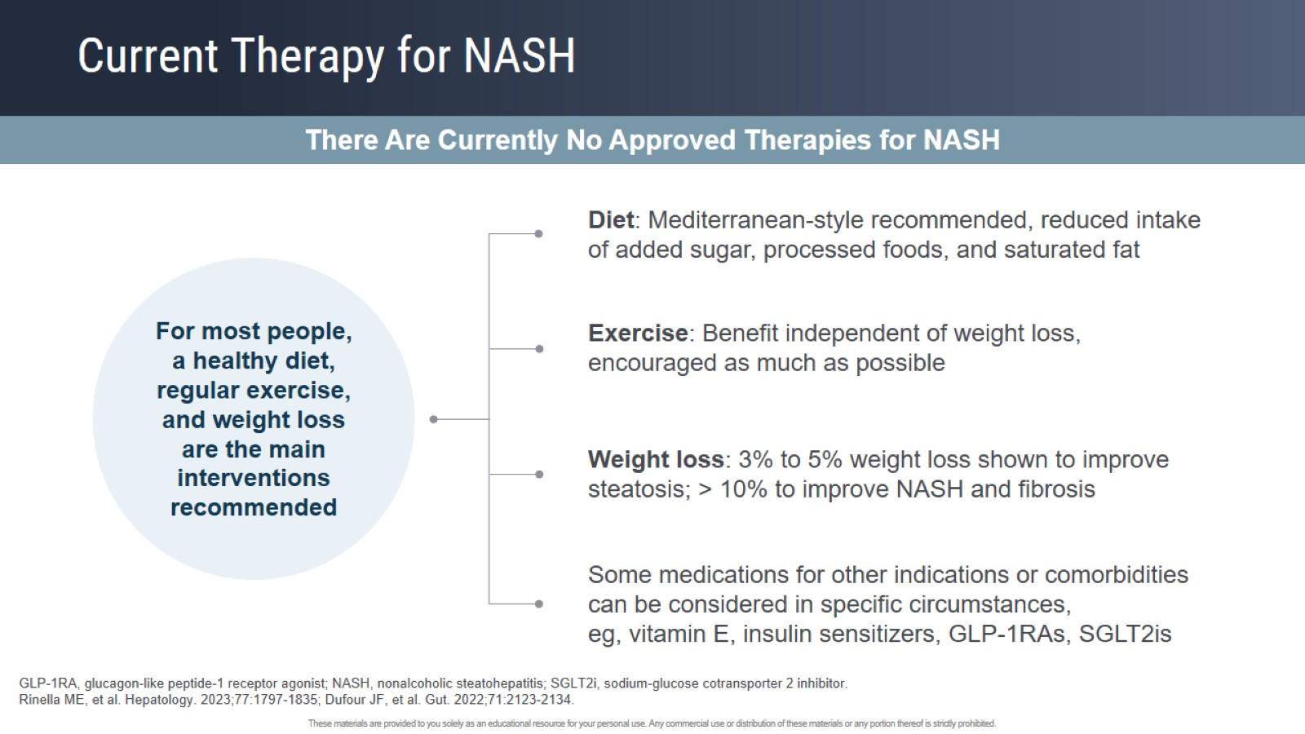
Current Therapy for NASH

Slide 54
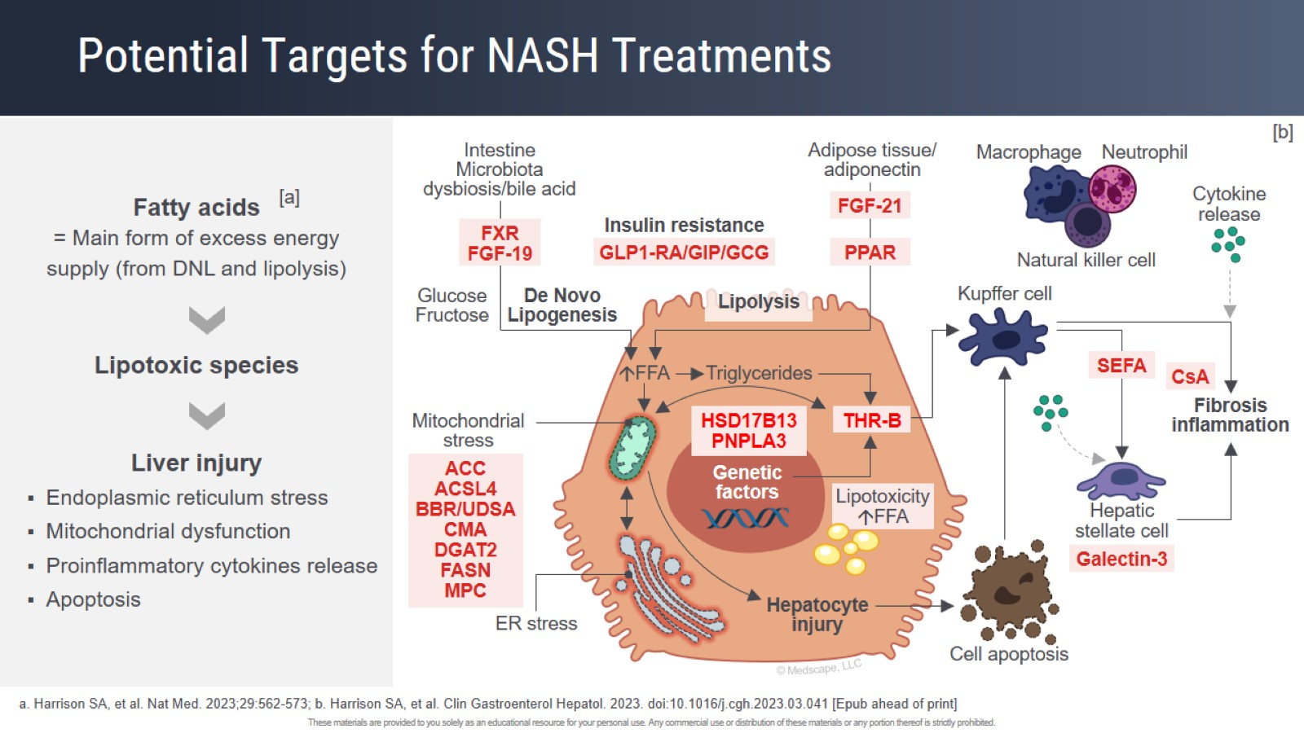
Potential Targets for NASH Treatments

Slide 55
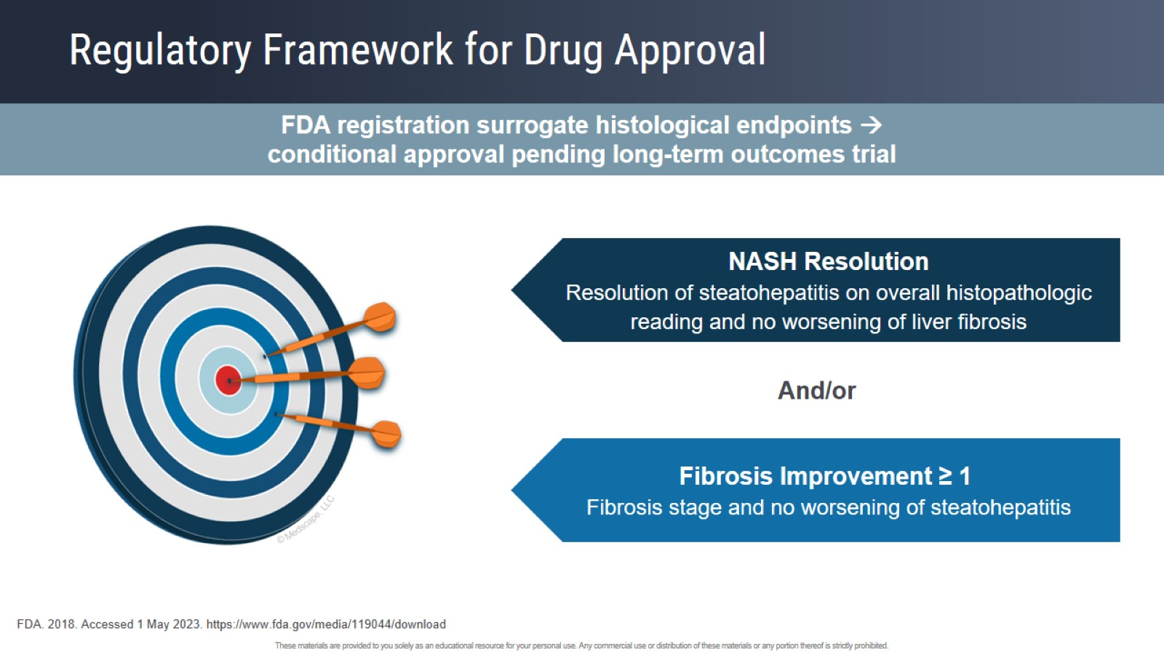
Regulatory Framework for Drug Approval

Slide 56
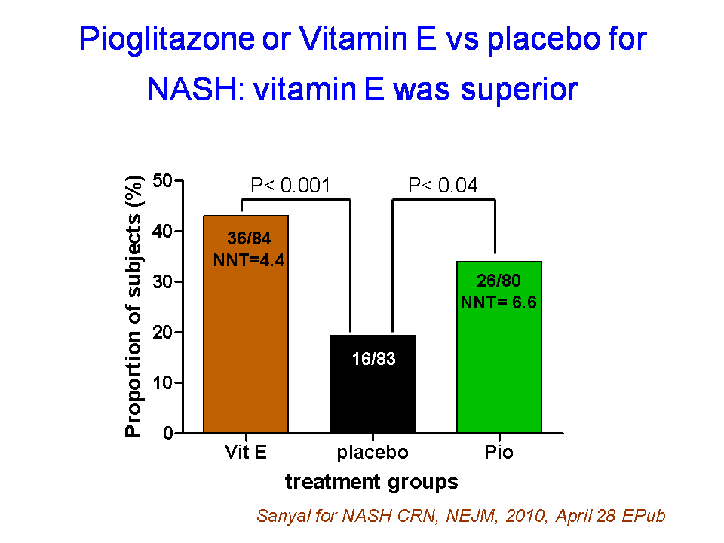

Slide 57
Pioglitazone trials- Sanyal (PIVENS) 2010 and Cusi (2016)
Histologic improvement in NASH but with weight gain and concerns about bone fractures/bladder ca and cardiovascular risk
FXR agonist- OCA- 2 trials (Mudaliar et al. 2013 + Neuschwander et al. FLINT trial 2015) - some encouraging results but pruritus was a significant AE (23%)

Slide 58
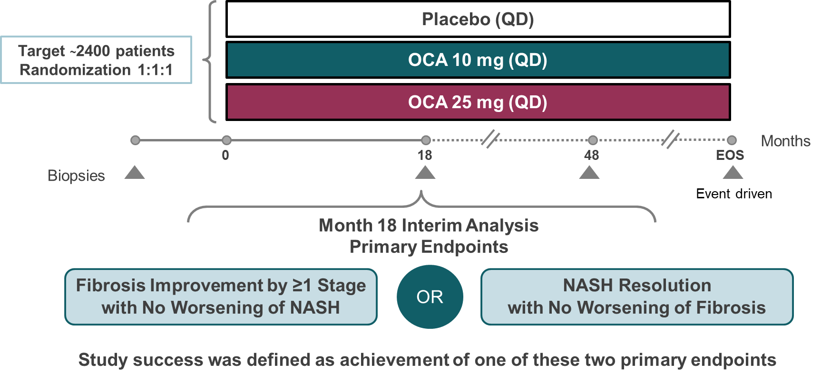
Positive results from REGENERATE: A phase 3 international, randomized, placebo-controlled study of obeticholic acid treatment for NASH
BACKGROUND & AIMS ​
OCA is a potent FXR agonist shown in preclinical models to have a direct antifibrotic effect in the liver¹
In the phase 2b FLINT study, OCA
25 mg for 72 weeks improved fibrosis and other histological features of NASH²
OCA is the only investigational drug to have received Breakthrough Therapy designation by the US FDA for the treatment of NASH patients with
liver fibrosis
This Month 18 interim analysis of REGENERATE evaluated OCA on liver histology in NASH patients with F2/F3 fibrosis
METHODS ​
1. Albanis A, et al. AASLD 2005 (Hepatology 2005;42:1040A);
2. Neuschwander-Tetri BA, et al. Lancet 2015;385:956−65.
Younossi Z, et al. ILC 2019; GS-06
Notes:
Abbreviations: FLINT, farnesoid X nuclear receptor ligand obeticholic acid for non-cirrhotic, non-alcoholic steatohepatitis; FXR, farnesoid X receptor; NASH, nonalcoholic steatohepatitis; OCA, obeticholic acid; QD, daily
Full abstract
Positive Results from REGENERATE: A Phase 3 International, Randomized, Placebo-Controlled Study Evaluating Obeticholic Acid Treatment for NASH
Zobair Younossi1, Vlad Ratziu2, Rohit Loomba3, Mary Rinella4, Quentin M. Anstee5, Zachary Goodman1, Pierre Bedossa6, Andreas Geier7, Susanne Beckebaum8, Philip Newsome9, David Sheridan10, James Trotter11, Whitfield Knapple12, Eric Lawitz13, Kris Kowdley14, Aldo Montano-Loza15, Jerome Boursier16, Philippe Mathurin17, Elisabetta Bugianesi18, Guiseppe Mazzella19, Antonio Olveira20, Helena Cortez-Pinto21, Isabel Graupera22, David Orr23, Lise Lotte Gluud24, Jean-Francois Dufour25, David Shapiro26, Jason Campagna26, Luna Zaru26, Leigh MacConell26, Reshma Shringarpure26, Stephen Harrison27, Arun Sanyal28 on behalf of the REGENERATE Study Investigators
1. Betty and Guy Beatty Center for Integrated Research, Inova Health System, Falls Church, United States; 2. Sorbonne Université, Hôpital Pitié – Salpêtrière, Paris, France; 3. University of California, San Diego, San Diego, United States; 4. Feinberg School of Medicine, Northwestern University, Chicago, United States; 5. Newcastle upon Tyne Hospitals NHS Foundation Trust, Newcastle Upon Tyne, United Kingdom; 6. Service d'Anatomie Pathologique, Hôpital Beaujon, Assistance Publique-Hôpitaux de Paris, Paris, France; 7. University of Wuerzburg, Wuerzburg, Germany; 8. St. Josef-Krankenhaus Kupferdreh, Essen, Germany; 9. University of Birmingham, Birmingham, United Kingdom; 10. Derriford Hospital, Plymouth, United Kingdom; 11. Baylor Health, Liver Consultants of Texas, Dallas, United States; 12. Arkansas Gastroenterology, North Little Rock, United States; 13. Texas Liver Institute, University of Texas Health San Antonio, San Antonio, United States; 14. Swedish Liver Center, Seattle, United States; 15. Division of Gastroenterology and Liver Unit, University of Alberta, Edmonton, Canada; 16. Angers University Hospital, Angers, France; 17. Hepato-gastroenterology, CHU Lille, Lille, France; 18. University of Turin, Turin, Italy; 19. University of Bologna, Bologna, Italy; 20. Hospital Universitario La Paz, Madrid, Spain; 21. Centro Hospitalar Lisboa, Lisbon, Portugal; 22. Hospital Clinic de Barcelona, Barcelona, Spain; 23. Auckland City Hospital, Auckland, New Zealand; 24. Copenhagen University Hospital Hvidovre, Hvidovre, Denmark; 25. University of Bern, Bern, Switzerland; 26. Intercept Pharmaceuticals, San Diego, United States; 27. Pinnacle Clinical Research Center, San Antonio, United States; 28. Virginia Commonwealth University, Richmond, United States
Background: Obeticholic acid (OCA), an FXR agonist, improved both fibrosis and histologic features of nonalcoholic steatohepatitis (NASH) in the Ph2 FLINT study. This Month 18 pre-specified interim analysis of the ongoing Ph3 REGENERATE study evaluated the effect of OCA on liver histology in patients (pts) with biopsy-confirmed NASH.
Methods: Pts with NASH and fibrosis stages F2-3 (ITT), and an exploratory group of F1 pts with metabolic syndrome, were randomized to placebo (PBO), OCA 10mg, or OCA 25mg QD. Primary endpoints were fibrosis improvement (≥1 stage) with no worsening of NASH, or NASH resolution with no worsening of liver fibrosis per liver biopsy. The safety population included all randomized and dosed pts (F1-3, N=1968). Clinical outcomes will be evaluated at the end-of-study.
Results: The ITT population included 931 pts (PBO [n=311], OCA 10mg [n=312] or OCA 25mg [n=308]), comprised of 44% F2 and 56% F3. Baseline characteristics were well-balanced across groups. Results in Table. The primary fibrosis endpoint was met by 11.9% PBO, 17.6% OCA 10mg (p=0.0446 vs PBO), and 23.1% OCA 25mg (p=0.0002 vs PBO) pts (ITT). The primary NASH endpoint was not statistically significant (ITT); however, in a pre-specified analysis that included F1-F3 pts (N=1218), more OCA 25mg pts achieved NASH resolution. Significantly more pts
on OCA 25mg showed improvements in hepatocellular ballooning (p=0.0011 vs PBO) and lobular inflammation (p=0.0322 vs PBO). Dose-dependent reductions in ALT, AST and GGT were observed. Pruritus was the most common AE (19% PBO, 28% OCA 10mg, 51% OCA 25mg) and was predominantly mild to moderate in severity (severe pruritus: <1% PBO, <1% OCA 10mg, 5% OCA 25mg). More OCA 25mg pts discontinued due to pruritus (<1% PBO, <1% OCA 10mg, 9% OCA 25mg; protocol mandated discontinuation of treatment with severe pruritus). SAEs occurred in 11% PBO, 11% OCA 10mg and 14% OCA 25mg pts. Increases in LDLc with OCA were observed by Week 4, but approached baseline by Month 18 (OCA 25mg: LS mean change Wk4 +22.6 mg/dL, M18 +4.0 mg/dL). Cardiovascular SAEs were similar across groups (2% PBO, 1% OCA 10 mg, 2% OCA 25mg). Cholelithiasis or cholecystitis were reported in 1% PBO, 1% OCA 10mg and 3% OCA 25mg pts. Hepatic disorder SAEs were uncommon but occurred more frequently in OCA 25mg pts (<0.01%). Three deaths occurred; none were considered treatment-related (PBO n=2; OCA 25mg n=1).
Conclusion: Treatment with OCA 25mg improved liver fibrosis, key histologic features of steatohepatitis and liver biochemistry, demonstrating consistent efficacy with an overall AE profile similar to previous studies.

Slide 59
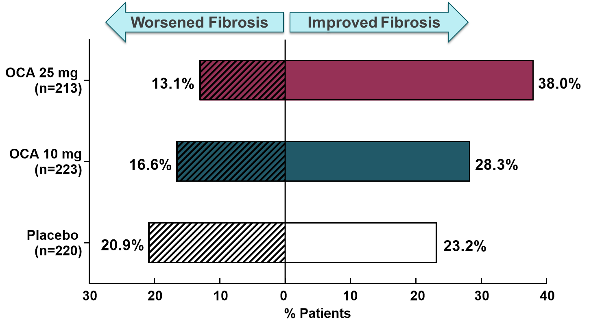
Positive results from REGENERATE: A phase 3 international, randomized, placebo-controlled study of obeticholic acid treatment for NASH
RESULTS ​
OCA 25 mg QD met the primary endpoint of improvement in liver fibrosis with no worsening of NASH (p=0.0002* vs. placebo)
  The antifibrotic effect of OCA was dose dependent and consistent across endpoints and key subgroups
Although the additional primary endpoint of NASH resolution with no worsening of fibrosis was not met, OCA improved NASH disease activity based on key histological parameters including NAFLD activity score, hepatocyte ballooning and lobular inflammation
Primary endpoint (ITT): fibrosis improvement by ≥1 stage with no worsening of NASH
Primary endpoint (ITT): NASH resolution
with no worsening of fibrosis
Fibrosis improvement or worsening by ≥1 stage
(per protocol with post-baseline biopsy)
*Statistically significant in accordance with the statistical analysis plan agreed with the FDA. All other p values are nominal.
Younossi Z, et al. ILC 2019; GS-06
Notes:
Abbreviations: ITT, intention-to-treat; NAFLD, nonalcoholic fatty liver disease; NASH, nonalcoholic steatohepatitis; OCA, obeticholic acid; QD, daily
Full abstract
Positive Results from REGENERATE: A Phase 3 International, Randomized, Placebo-Controlled Study Evaluating Obeticholic Acid Treatment for NASH
Zobair Younossi1, Vlad Ratziu2, Rohit Loomba3, Mary Rinella4, Quentin M. Anstee5, Zachary Goodman1, Pierre Bedossa6, Andreas Geier7, Susanne Beckebaum8, Philip Newsome9, David Sheridan10, James Trotter11, Whitfield Knapple12, Eric Lawitz13, Kris Kowdley14, Aldo Montano-Loza15, Jerome Boursier16, Philippe Mathurin17, Elisabetta Bugianesi18, Guiseppe Mazzella19, Antonio Olveira20, Helena Cortez-Pinto21, Isabel Graupera22, David Orr23, Lise Lotte Gluud24, Jean-Francois Dufour25, David Shapiro26, Jason Campagna26, Luna Zaru26, Leigh MacConell26, Reshma Shringarpure26, Stephen Harrison27, Arun Sanyal28 on behalf of the REGENERATE Study Investigators
1. Betty and Guy Beatty Center for Integrated Research, Inova Health System, Falls Church, United States; 2. Sorbonne Université, Hôpital Pitié – Salpêtrière, Paris, France; 3. University of California, San Diego, San Diego, United States; 4. Feinberg School of Medicine, Northwestern University, Chicago, United States; 5. Newcastle upon Tyne Hospitals NHS Foundation Trust, Newcastle Upon Tyne, United Kingdom; 6. Service d'Anatomie Pathologique, Hôpital Beaujon, Assistance Publique-Hôpitaux de Paris, Paris, France; 7. University of Wuerzburg, Wuerzburg, Germany; 8. St. Josef-Krankenhaus Kupferdreh, Essen, Germany; 9. University of Birmingham, Birmingham, United Kingdom; 10. Derriford Hospital, Plymouth, United Kingdom; 11. Baylor Health, Liver Consultants of Texas, Dallas, United States; 12. Arkansas Gastroenterology, North Little Rock, United States; 13. Texas Liver Institute, University of Texas Health San Antonio, San Antonio, United States; 14. Swedish Liver Center, Seattle, United States; 15. Division of Gastroenterology and Liver Unit, University of Alberta, Edmonton, Canada; 16. Angers University Hospital, Angers, France; 17. Hepato-gastroenterology, CHU Lille, Lille, France; 18. University of Turin, Turin, Italy; 19. University of Bologna, Bologna, Italy; 20. Hospital Universitario La Paz, Madrid, Spain; 21. Centro Hospitalar Lisboa, Lisbon, Portugal; 22. Hospital Clinic de Barcelona, Barcelona, Spain; 23. Auckland City Hospital, Auckland, New Zealand; 24. Copenhagen University Hospital Hvidovre, Hvidovre, Denmark; 25. University of Bern, Bern, Switzerland; 26. Intercept Pharmaceuticals, San Diego, United States; 27. Pinnacle Clinical Research Center, San Antonio, United States; 28. Virginia Commonwealth University, Richmond, United States
Background: Obeticholic acid (OCA), an FXR agonist, improved both fibrosis and histologic features of nonalcoholic steatohepatitis (NASH) in the Ph2 FLINT study. This Month 18 pre-specified interim analysis of the ongoing Ph3 REGENERATE study evaluated the effect of OCA on liver histology in patients (pts) with biopsy-confirmed NASH.
Methods: Pts with NASH and fibrosis stages F2-3 (ITT), and an exploratory group of F1 pts with metabolic syndrome, were randomized to placebo (PBO), OCA 10mg, or OCA 25mg QD. Primary endpoints were fibrosis improvement (≥1 stage) with no worsening of NASH, or NASH resolution with no worsening of liver fibrosis per liver biopsy. The safety population included all randomized and dosed pts (F1-3, N=1968). Clinical outcomes will be evaluated at the end-of-study.
Results: The ITT population included 931 pts (PBO [n=311], OCA 10mg [n=312] or OCA 25mg [n=308]), comprised of 44% F2 and 56% F3. Baseline characteristics were well-balanced across groups. Results in Table. The primary fibrosis endpoint was met by 11.9% PBO, 17.6% OCA 10mg (p=0.0446 vs PBO), and 23.1% OCA 25mg (p=0.0002 vs PBO) pts (ITT). The primary NASH endpoint was not statistically significant (ITT); however, in a pre-specified analysis that included F1-F3 pts (N=1218), more OCA 25mg pts achieved NASH resolution. Significantly more pts
on OCA 25mg showed improvements in hepatocellular ballooning (p=0.0011 vs PBO) and lobular inflammation (p=0.0322 vs PBO). Dose-dependent reductions in ALT, AST and GGT were observed. Pruritus was the most common AE (19% PBO, 28% OCA 10mg, 51% OCA 25mg) and was predominantly mild to moderate in severity (severe pruritus: <1% PBO, <1% OCA 10mg, 5% OCA 25mg). More OCA 25mg pts discontinued due to pruritus (<1% PBO, <1% OCA 10mg, 9% OCA 25mg; protocol mandated discontinuation of treatment with severe pruritus). SAEs occurred in 11% PBO, 11% OCA 10mg and 14% OCA 25mg pts. Increases in LDLc with OCA were observed by Week 4, but approached baseline by Month 18 (OCA 25mg: LS mean change Wk4 +22.6 mg/dL, M18 +4.0 mg/dL). Cardiovascular SAEs were similar across groups (2% PBO, 1% OCA 10 mg, 2% OCA 25mg). Cholelithiasis or cholecystitis were reported in 1% PBO, 1% OCA 10mg and 3% OCA 25mg pts. Hepatic disorder SAEs were uncommon but occurred more frequently in OCA 25mg pts (<0.01%). Three deaths occurred; none were considered treatment-related (PBO n=2; OCA 25mg n=1).
Conclusion: Treatment with OCA 25mg improved liver fibrosis, key histologic features of steatohepatitis and liver biochemistry, demonstrating consistent efficacy with an overall AE profile similar to previous studies.

Slide 60
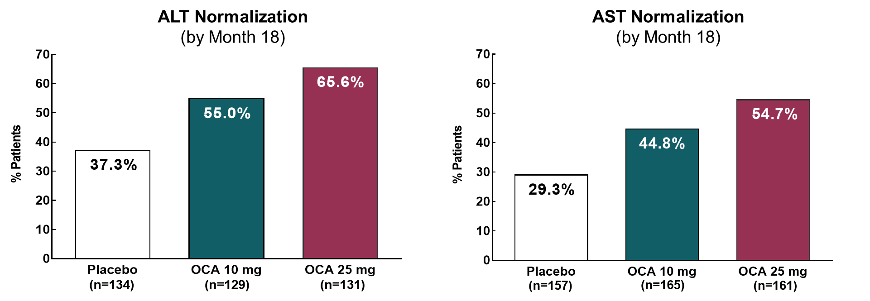
Positive results from REGENERATE: A phase 3 international, randomized, placebo-controlled study of obeticholic acid treatment for NASH
Normalization of aminotransferases
in patients with elevated baseline levels
RESULTS (Cont.) ​
OCA rapidly decreased ALT, AST and GGT levels, which are routinely monitored by clinicians
AEs were mostly mild to moderate in severity and the most common were consistent with the known profile of OCA
CONCLUSION ​ REGENERATE is the first successful phase 3 study in NASH. These results are highly relevant because fibrosis is a strong predictor of liver-related morbidity and mortality in NASH.¹ The REGENERATE study is ongoing to confirm benefit on clinical outcomes
1. Dulai PS, et al. Hepatology 2017;65:1557–65.
Younossi Z, et al. ILC 2019; GS-06
Notes:
Abbreviations: AE, adverse event; ALT, alanine aminotransferase; AST, aspartate aminotransferase; GGT, γ-glutamyl transferase; NASH, Nonalcoholic steatohepatitis; OCA, obeticholic acid
Full abstract
Positive Results from REGENERATE: A Phase 3 International, Randomized, Placebo-Controlled Study Evaluating Obeticholic Acid Treatment for NASH
Zobair Younossi1, Vlad Ratziu2, Rohit Loomba3, Mary Rinella4, Quentin M. Anstee5, Zachary Goodman1, Pierre Bedossa6, Andreas Geier7, Susanne Beckebaum8, Philip Newsome9, David Sheridan10, James Trotter11, Whitfield Knapple12, Eric Lawitz13, Kris Kowdley14, Aldo Montano-Loza15, Jerome Boursier16, Philippe Mathurin17, Elisabetta Bugianesi18, Guiseppe Mazzella19, Antonio Olveira20, Helena Cortez-Pinto21, Isabel Graupera22, David Orr23, Lise Lotte Gluud24, Jean-Francois Dufour25, David Shapiro26, Jason Campagna26, Luna Zaru26, Leigh MacConell26, Reshma Shringarpure26, Stephen Harrison27, Arun Sanyal28 on behalf of the REGENERATE Study Investigators
1. Betty and Guy Beatty Center for Integrated Research, Inova Health System, Falls Church, United States; 2. Sorbonne Université, Hôpital Pitié – Salpêtrière, Paris, France; 3. University of California, San Diego, San Diego, United States; 4. Feinberg School of Medicine, Northwestern University, Chicago, United States; 5. Newcastle upon Tyne Hospitals NHS Foundation Trust, Newcastle Upon Tyne, United Kingdom; 6. Service d'Anatomie Pathologique, Hôpital Beaujon, Assistance Publique-Hôpitaux de Paris, Paris, France; 7. University of Wuerzburg, Wuerzburg, Germany; 8. St. Josef-Krankenhaus Kupferdreh, Essen, Germany; 9. University of Birmingham, Birmingham, United Kingdom; 10. Derriford Hospital, Plymouth, United Kingdom; 11. Baylor Health, Liver Consultants of Texas, Dallas, United States; 12. Arkansas Gastroenterology, North Little Rock, United States; 13. Texas Liver Institute, University of Texas Health San Antonio, San Antonio, United States; 14. Swedish Liver Center, Seattle, United States; 15. Division of Gastroenterology and Liver Unit, University of Alberta, Edmonton, Canada; 16. Angers University Hospital, Angers, France; 17. Hepato-gastroenterology, CHU Lille, Lille, France; 18. University of Turin, Turin, Italy; 19. University of Bologna, Bologna, Italy; 20. Hospital Universitario La Paz, Madrid, Spain; 21. Centro Hospitalar Lisboa, Lisbon, Portugal; 22. Hospital Clinic de Barcelona, Barcelona, Spain; 23. Auckland City Hospital, Auckland, New Zealand; 24. Copenhagen University Hospital Hvidovre, Hvidovre, Denmark; 25. University of Bern, Bern, Switzerland; 26. Intercept Pharmaceuticals, San Diego, United States; 27. Pinnacle Clinical Research Center, San Antonio, United States; 28. Virginia Commonwealth University, Richmond, United States
Background: Obeticholic acid (OCA), an FXR agonist, improved both fibrosis and histologic features of nonalcoholic steatohepatitis (NASH) in the Ph2 FLINT study. This Month 18 pre-specified interim analysis of the ongoing Ph3 REGENERATE study evaluated the effect of OCA on liver histology in patients (pts) with biopsy-confirmed NASH.
Methods: Pts with NASH and fibrosis stages F2-3 (ITT), and an exploratory group of F1 pts with metabolic syndrome, were randomized to placebo (PBO), OCA 10mg, or OCA 25mg QD. Primary endpoints were fibrosis improvement (≥1 stage) with no worsening of NASH, or NASH resolution with no worsening of liver fibrosis per liver biopsy. The safety population included all randomized and dosed pts (F1-3, N=1968). Clinical outcomes will be evaluated at the end-of-study.
Results: The ITT population included 931 pts (PBO [n=311], OCA 10mg [n=312] or OCA 25mg [n=308]), comprised of 44% F2 and 56% F3. Baseline characteristics were well-balanced across groups. Results in Table. The primary fibrosis endpoint was met by 11.9% PBO, 17.6% OCA 10mg (p=0.0446 vs PBO), and 23.1% OCA 25mg (p=0.0002 vs PBO) pts (ITT). The primary NASH endpoint was not statistically significant (ITT); however, in a pre-specified analysis that included F1-F3 pts (N=1218), more OCA 25mg pts achieved NASH resolution. Significantly more pts
on OCA 25mg showed improvements in hepatocellular ballooning (p=0.0011 vs PBO) and lobular inflammation (p=0.0322 vs PBO). Dose-dependent reductions in ALT, AST and GGT were observed. Pruritus was the most common AE (19% PBO, 28% OCA 10mg, 51% OCA 25mg) and was predominantly mild to moderate in severity (severe pruritus: <1% PBO, <1% OCA 10mg, 5% OCA 25mg). More OCA 25mg pts discontinued due to pruritus (<1% PBO, <1% OCA 10mg, 9% OCA 25mg; protocol mandated discontinuation of treatment with severe pruritus). SAEs occurred in 11% PBO, 11% OCA 10mg and 14% OCA 25mg pts. Increases in LDLc with OCA were observed by Week 4, but approached baseline by Month 18 (OCA 25mg: LS mean change Wk4 +22.6 mg/dL, M18 +4.0 mg/dL). Cardiovascular SAEs were similar across groups (2% PBO, 1% OCA 10 mg, 2% OCA 25mg). Cholelithiasis or cholecystitis were reported in 1% PBO, 1% OCA 10mg and 3% OCA 25mg pts. Hepatic disorder SAEs were uncommon but occurred more frequently in OCA 25mg pts (<0.01%). Three deaths occurred; none were considered treatment-related (PBO n=2; OCA 25mg n=1).
Conclusion: Treatment with OCA 25mg improved liver fibrosis, key histologic features of steatohepatitis and liver biochemistry, demonstrating consistent efficacy with an overall AE profile similar to previous studies.

Slide 61
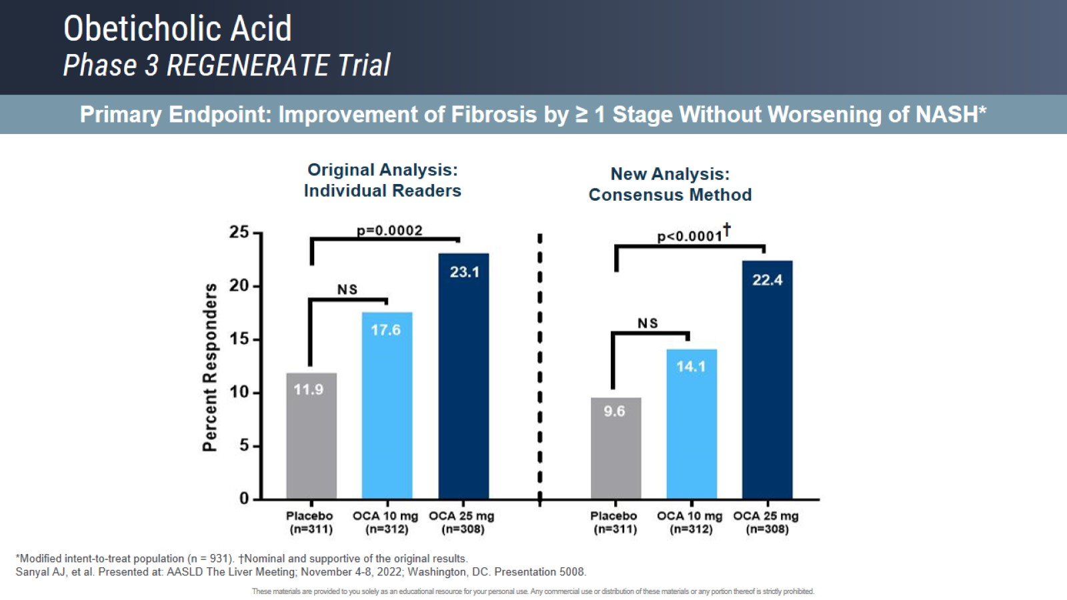
Obeticholic Acid
Phase 3 REGENERATE Trial

Slide 62
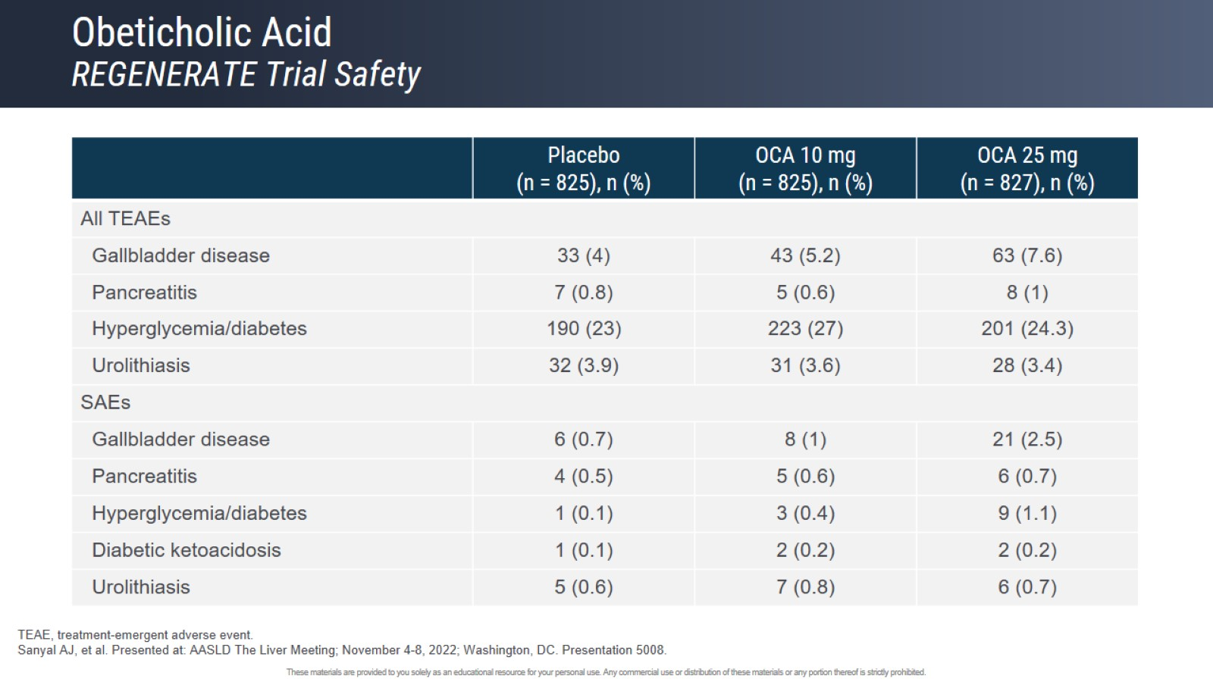
Obeticholic Acid
REGENERATE Trial Safety

Slide 63
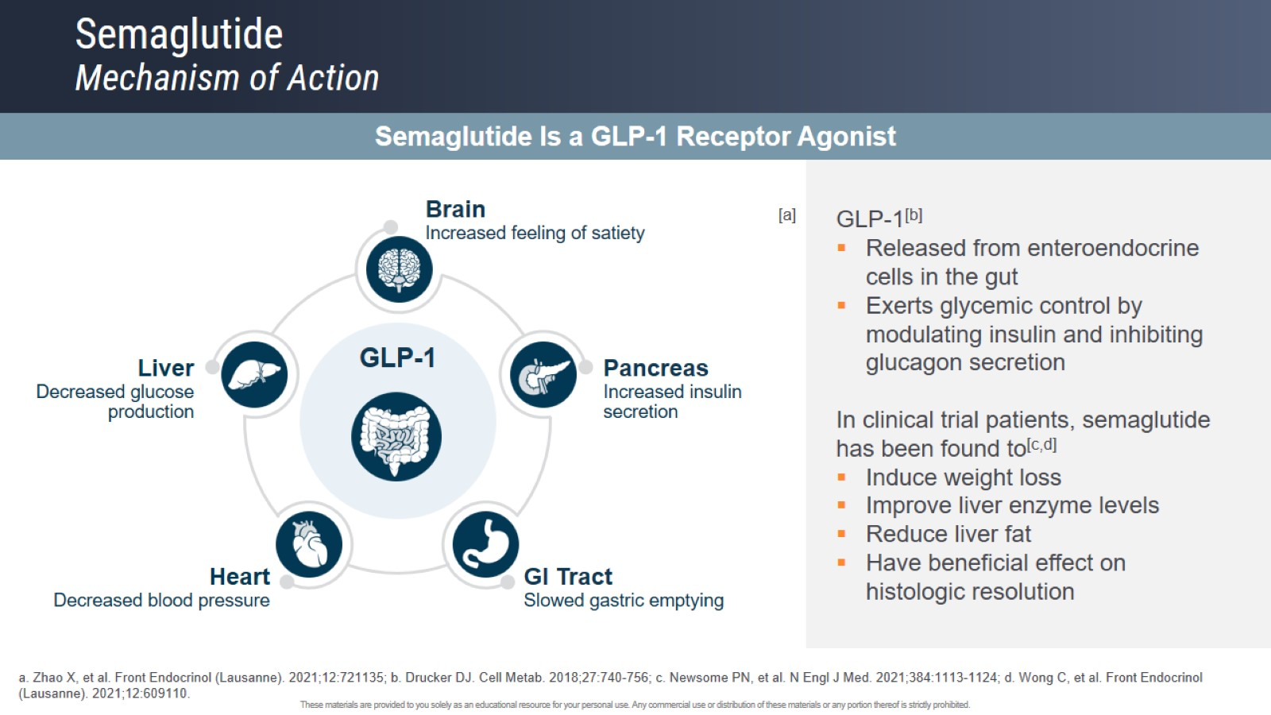
Semaglutide
Mechanism of Action

Slide 64
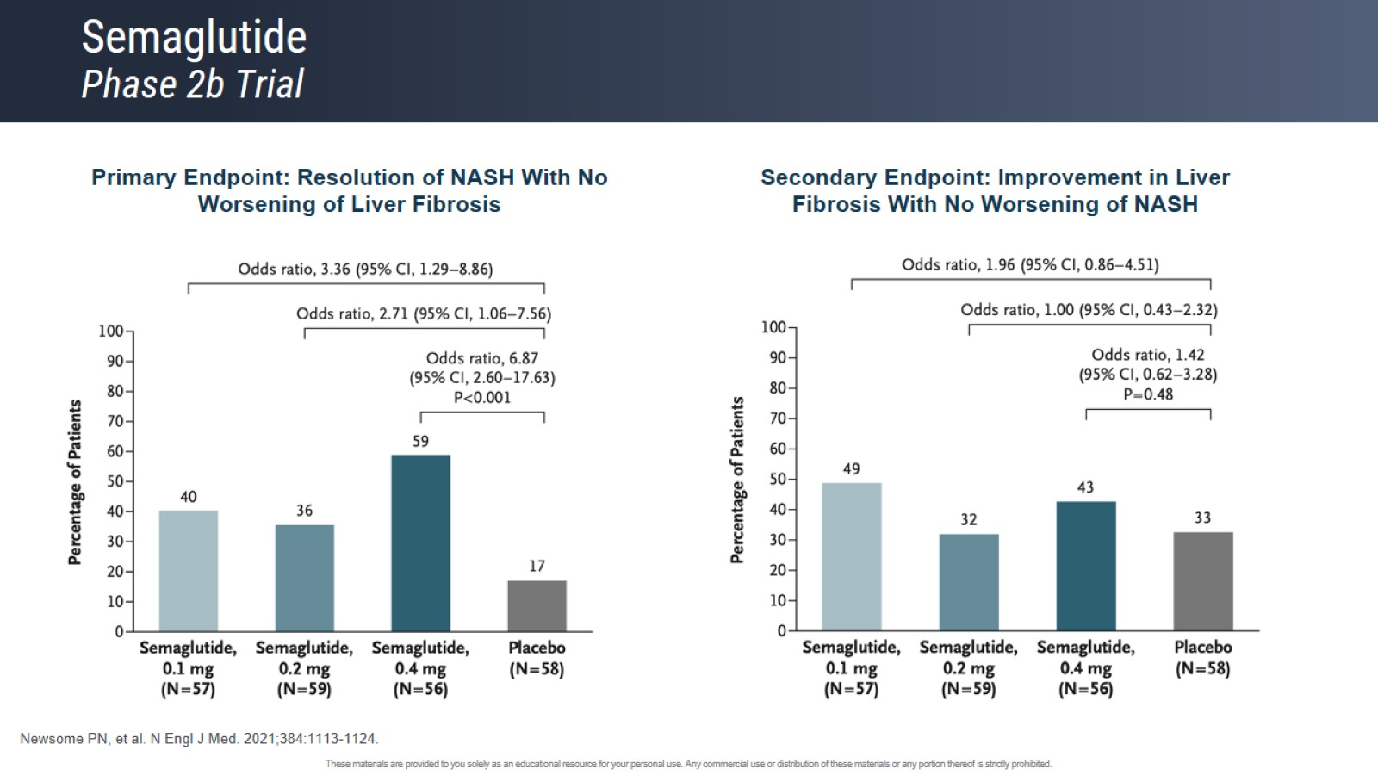
Semaglutide
Phase 2b Trial

Slide 65
Primary Results From MAESTRO-NASH:
A Pivotal Phase 3 52-week Serial Liver Biopsy Study in 966 Patients With NASH & Fibrosis
Stephen A. Harrison,¹ Pierre Bedossa,² Cynthia D. Guy,³ Jörn M. Schattenberg,⁴ Rohit Loomba,⁵ Rebecca Taub,⁶ Dominic Labriola,⁶ Sam E. Moussa,⁷ Guy W. Neff,⁸ Arun J. Sanyal,⁹ Mazen Noureddin,¹⁰ Meena Bansal,¹¹ Naim Alkhouri,¹² Vlad Ratziu¹³
¹University of Oxford, Oxford, UK & Pinnacle Clinical Research, San Antonio, TX, USA; ²Translational & Clinical Research Institute, Faculty of Medical Sciences, Newcastle University, Newcastle upon Tyne, UK; ³Duke University Medical Center, Durham, NC, USA; ⁴University Medical Center, Mainz, Germany; ⁵University of California San Diego, La Jolla, CA, USA;
⁶Madrigal Pharmaceuticals, Conshohocken, PA, USA; ⁷University of Arizona for Medical Sciences, Tucson, AZ, USA; ⁸Covenant Metabolic Specialists, Sarasota, FL, USA;
⁹Virginia Commonwealth University, Richmond, VA, USA; ¹⁰Houston Research Institute, Houston, TX, USA; ¹¹Mt Sinai, New York, NY, USA; ¹²Arizona Liver Health, Tucson, AZ, USA;
¹³Pitie–Salpetriere Hospital, Institute of Cardiometabolism & Nutrition, Sorbonne Universite, Paris, France.
Presented at The International Liver Congress; 21-24 June 2023; Vienna, Austria.

Slide 66
MAESTRO-NASH Trial Design
KEY ELIGIBILITY CRITERIA
Presence of ≥3 metabolic risk factors
NASH on biopsy: NAS ≥4
(with ≥1 in each component)
Fibrosis stage F1B, F2, or F3
≥8% hepatic fat by MRI-PDFF
NASH resolution (ballooning score=0, inflammation score=0/1, & ≥2-point reduction in NAS) with no worsening of fibrosis
≥1-stage improvement in fibrosis with no worsening of NAS
DUAL PRIMARY ENDPOINT
AT WEEK 52
LDL-C, low-density lipoprotein cholesterol; MRI-PDFF, magnetic resonance imaging-proton density fat fraction; NAS, nonalcoholic fatty liver disease activity score; NASH, nonalcoholic steatohepatitis.

Slide 67
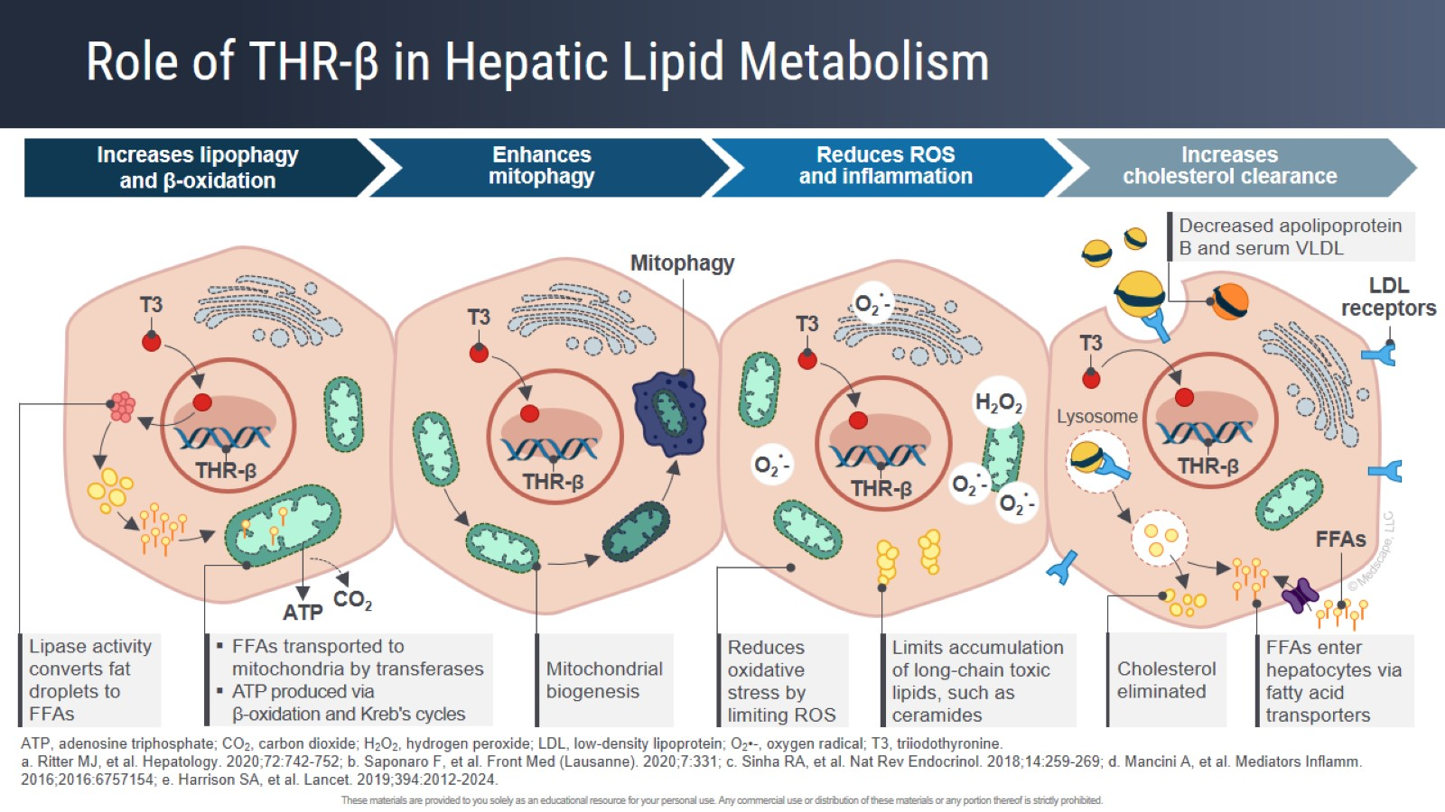
Role of THR-β in Hepatic Lipid Metabolism

Slide 68
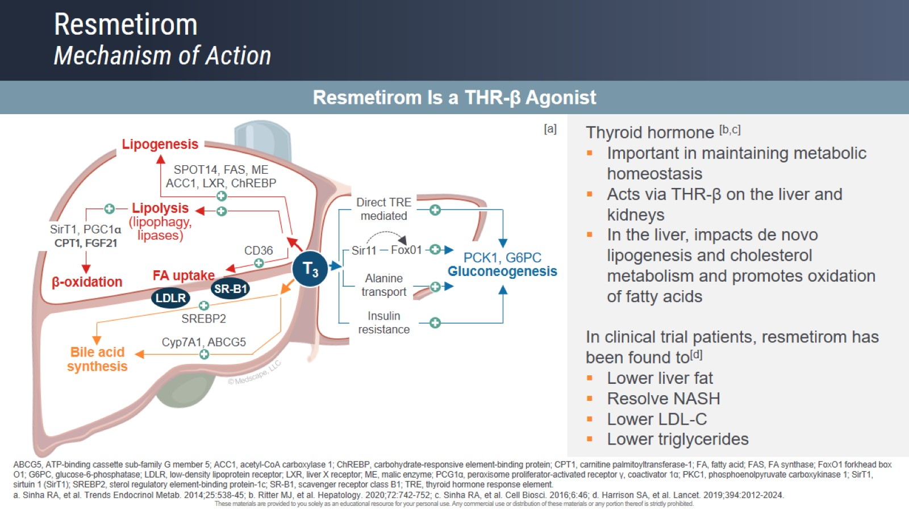
Resmetirom
Mechanism of Action

Slide 69
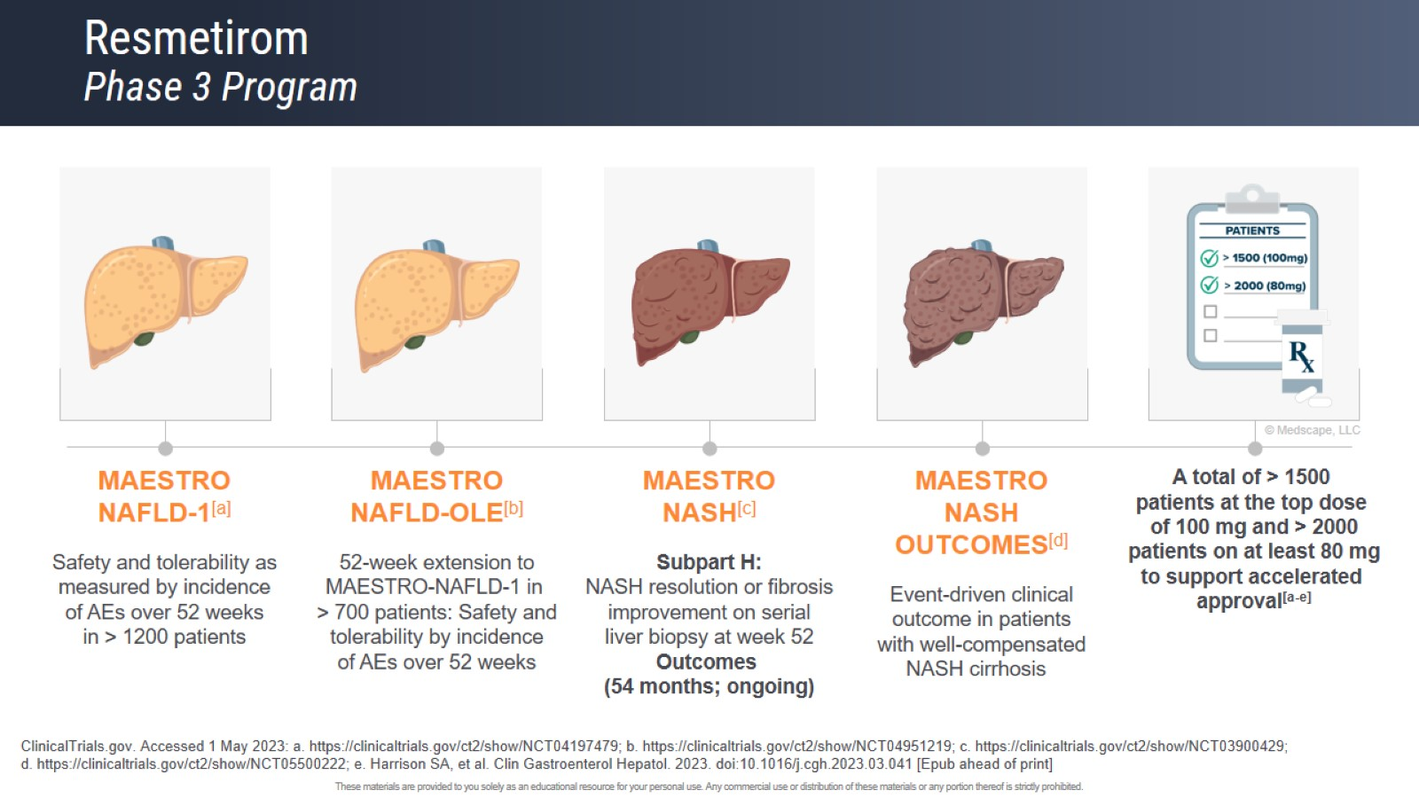
Resmetirom
Phase 3 Program

Slide 70
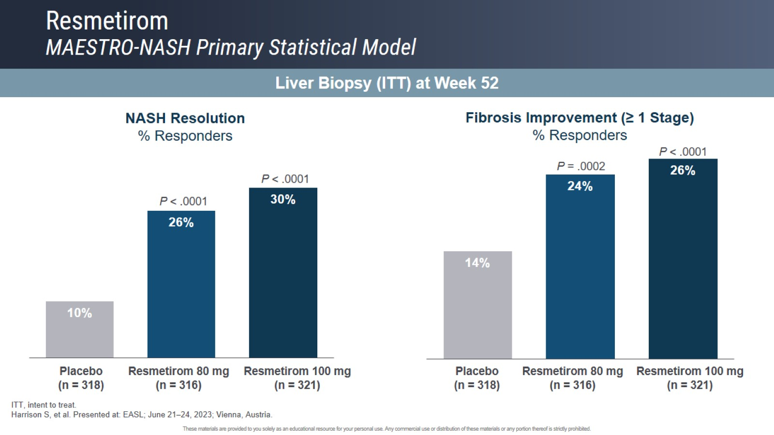
Resmetirom
MAESTRO-NASH Primary Statistical Model

Slide 71
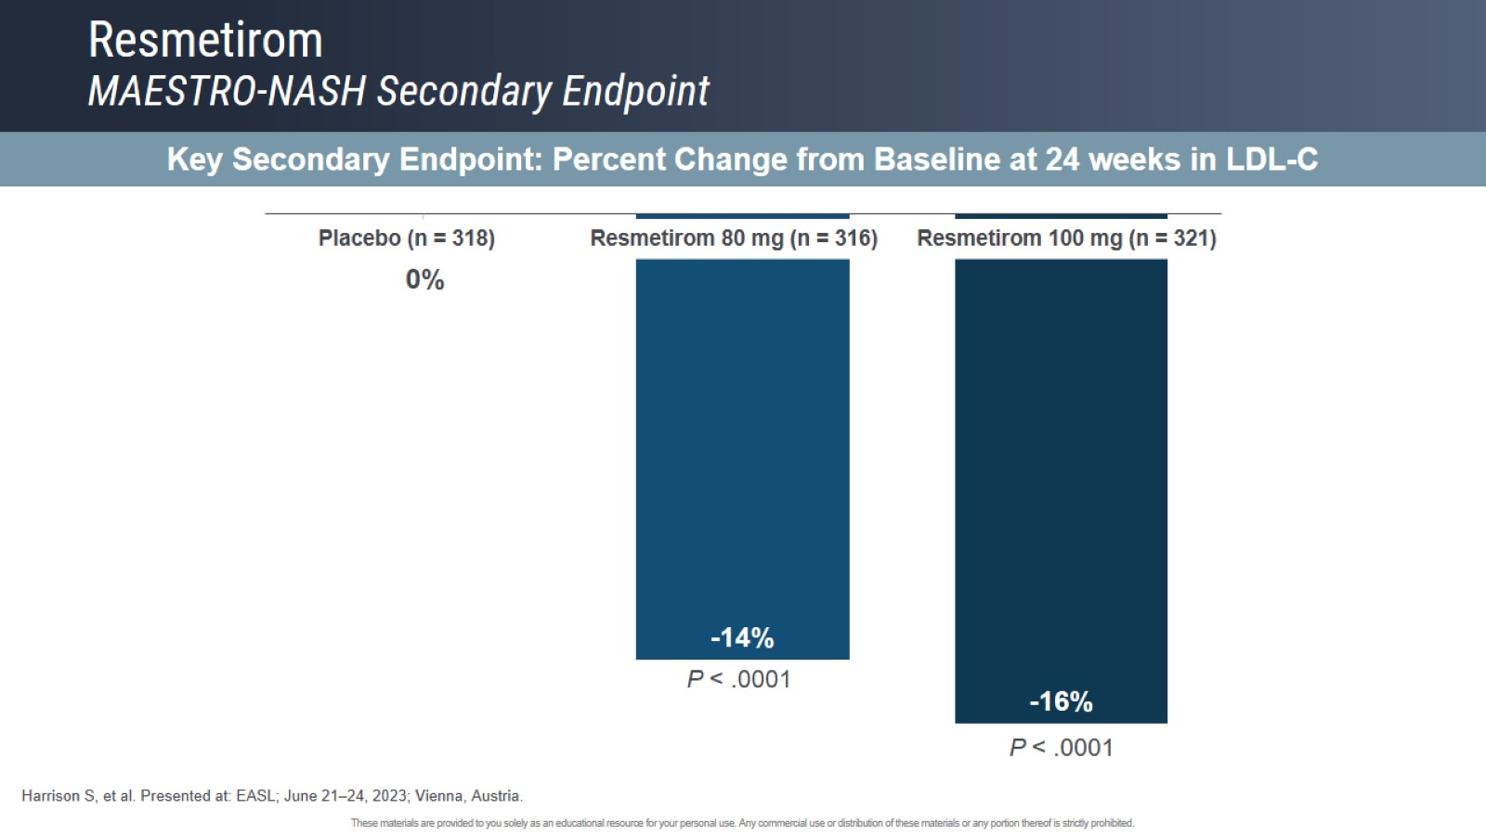
Resmetirom
MAESTRO-NASH Secondary Endpoint

Slide 72
Key Subgroups: Primary Endpoints
NASH Resolution
Fibrosis Improvement
T2D, Type 2 Diabetes; NAS, NAFLD Activity Score
% difference from placebo
% difference from placebo

Slide 73
Weight Loss or Concomitant Drug Therapies
GLP therapy, 14%; thyroxine, 13%; and statins, ~50% of patients in each arm; small differences relate to the small size of subgroups (>=5% weight loss n=47, 80 mg; n=57, 100mg; n=36, placebo)
NASH Resolution
Fibrosis Improvement
>=
>=
% difference from placebo
% difference from placebo
WL, weight loss; GLP, Glucagon-like peptide-1 receptor agonist

Slide 74
Percent Change from Baseline in Lipids/Lipoproteins (Weeks 24 & 52)
LDL-c
ApoB
TG BL >150
Lp(a) BL >10
ApoCIII
Non-HDL-c
Key secondary endpoint met (LDL-C lowering)
Significant effect of resmetirom 80 & 100 mg on multiple atherogenic lipids/lipoproteins at Week 24 and 52
ApoB, apolipoprotein B; TG, triglycerides; ApoCIII, apolipoprotein CIII; BL, baseline; LDL-C, low-density lipoprotein cholesterol; Lp(a), lipoprotein (a); non-HDL-C, non-high-density lipoprotein cholesterol; PBO, placebo

Slide 75
Change from Baseline in MRI-PDFF & FibroScan CAP
Significant effect of resmetirom 80 & 100 mg on both MRI-PDFF & FibroScan CAP
Significant effect of resmetirom to reduce liver and spleen volume as assessed on serial MRI-PDFF
  Liver volume corrected MRI-PDFF reduction is a mean of 60% at the 100 mg dose
MRI-PDFF
FibroScan CAP
Liver Volume
Spleen Volume
Change from baseline
CAP, controlled attenuation parameter; CFB, change from baseline; MRI-PDFF, magnetic resonance imaging-proton density fat fraction; NASH, nonalcoholic steatohepatitis; PBO, placebo.

Slide 76
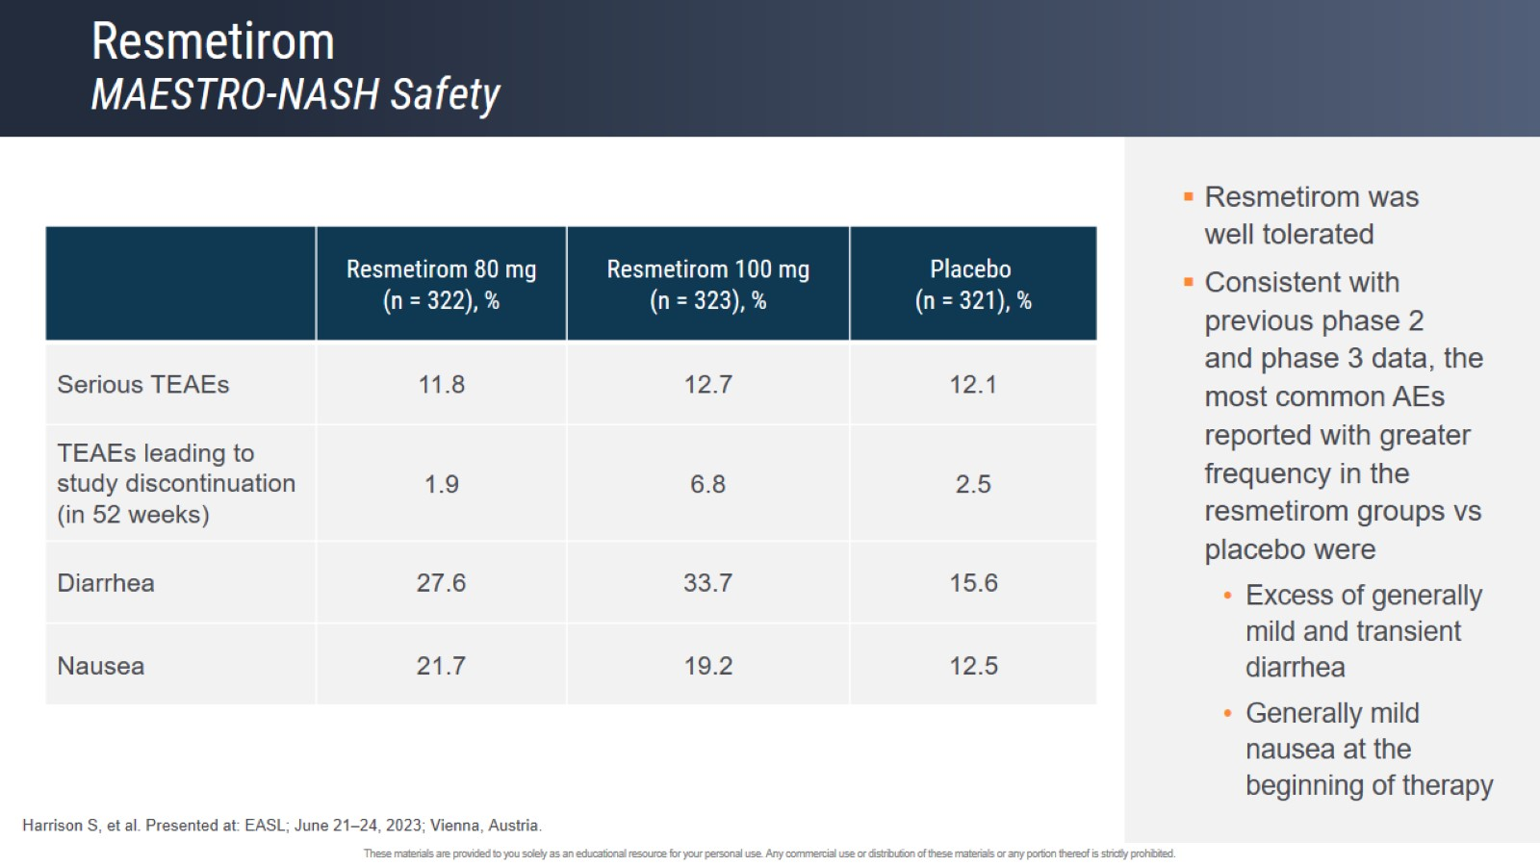
Resmetirom
MAESTRO-NASH Safety

Slide 77
Safety Overview
n (%) | Resmetirom 80mg (n=322) | Resmetirom 100mg (n=323) | Placebo (n=321)
≥1 TEAEs | 296 (91.9) | 296 (91.6) | 269 (92.2)
Grade 1 (mild) | 71 (22.0) | 65 (20.1) | 77 (24.0)
Grade 2 (moderate) | 180 (55.9) | 183 (56.7) | 167 (52.0)
≥ Grade 3 (severe) | 45 (14.0) | 48 (14.9) | 52 (16.2)
≥1 drug-related TEAEs | 122 (37.9) | 134 (41.5) | 86 (26.8)
≥1 serious TEAEs | 38 (11.8) | 41 (12.7) | 39 (12.1)
≥1 drug-related serious TEAEs | 2 (0.6) | 0 | 1 (0.3)
TEAEs leading to study discontinuation (in 52 Weeks) | 6 (1.9) | 22 (6.8) | 8 (2.5)
Fatal TEAE | 1 (0.3) | 1 (0.3) | 1 (0.3)
3-pt MACE* (adjudicated) | 1 (0.3) | 1 (0.3) | 1 (0.3)
Other cardiovascular events (adjudicated) | 0 | 1 (0.3) | 3 (0.9)
Study discontinuations in the 100 mg arm were increased relative to placebo only during the first 12 weeks and were similar in all treatment groups for the remaining period of the first 52 weeks; after 52 weeks, placebo discontinuations were higher than drug treatment arms
  Most AE discontinuations in the 100 mg arm were GI-related
No DILI events (adjudicated)
*Nonfatal stroke, nonfatal myocardial infarction, & cardiovascular death.
MACE, major adverse cardiovascular event; TEAE, treatment-emergent adverse event.

Slide 78
TEAEs Reported in >5% of Patients Overall
n (%) | Resmetirom 80mg (n=322) | Resmetirom 100mg (n=323) | Placebo (n=321)
Diarrhea | 89 (27.6) | 109 (33.7) | 50 (15.6)
COVID-19 | 78 (24.2) | 56 (17.3) | 68 (21.2)
Nausea | 70 (21.7) | 62 (19.2) | 40 (12.5)
Arthralgia | 46 (14.3) | 34 (10.5) | 40 (12.5)
Back pain | 36 (11.2) | 27 (8.4) | 38 (11.8)
Urinary tract infection | 33 (10.2) | 26 (8.0) | 29 (9.0)
Fatigue | 32 (9.9) | 26 (8.0) | 27 (8.4)
Pruritus | 26 (8.1) | 37 (11.5) | 22 (6.9)
Abdominal pain upper | 25 (7.8) | 27 (8.4) | 29 (9.0)
Headache | 30 (9.3) | 24 (7.4) | 27 (8.4)
Vomiting | 28 (8.7) | 35 (10.8) | 17 (5.3)
Type 2 diabetes | 25 (7.8) | 27 (8.4) | 25 (7.8)
Abdominal pain | 27 (8.4) | 30 (9.3) | 18 (5.6)
Constipation | 21 (6.5) | 27 (8.4) | 18 (5.6)
Muscle spasms | 14 (4.3) | 22 (6.8) | 21 (6.5)
Hypertension | 16 (5.0) | 13 (4.0) | 25 (7.8)
Dizziness | 21 (6.5) | 19 (5.9) | 11 (3.4)

Slide 79
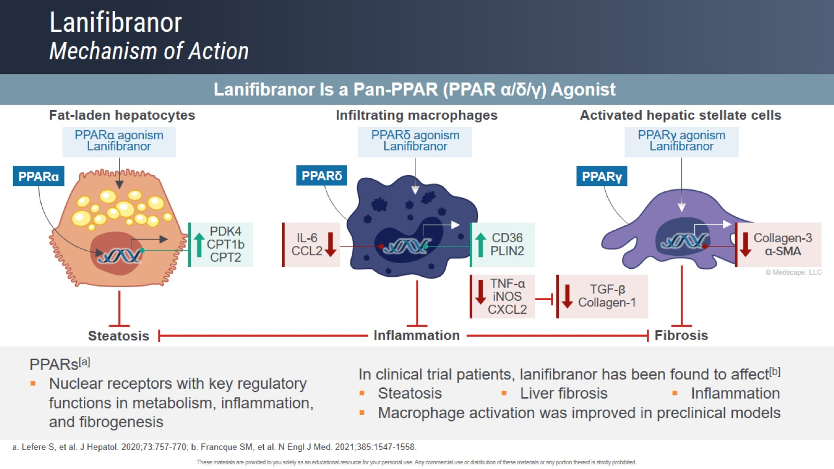
Lanifibranor
Mechanism of Action

Slide 80
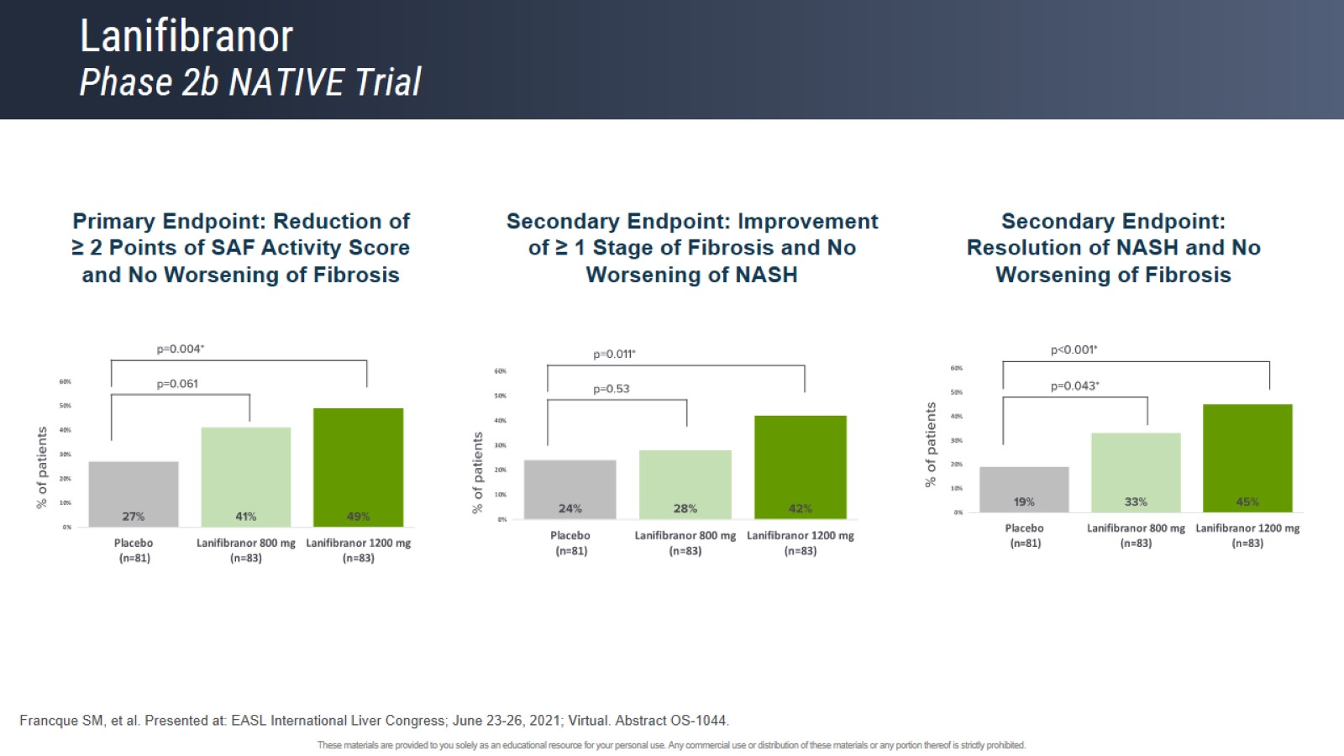
Lanifibranor
Phase 2b NATIVE Trial

Slide 81
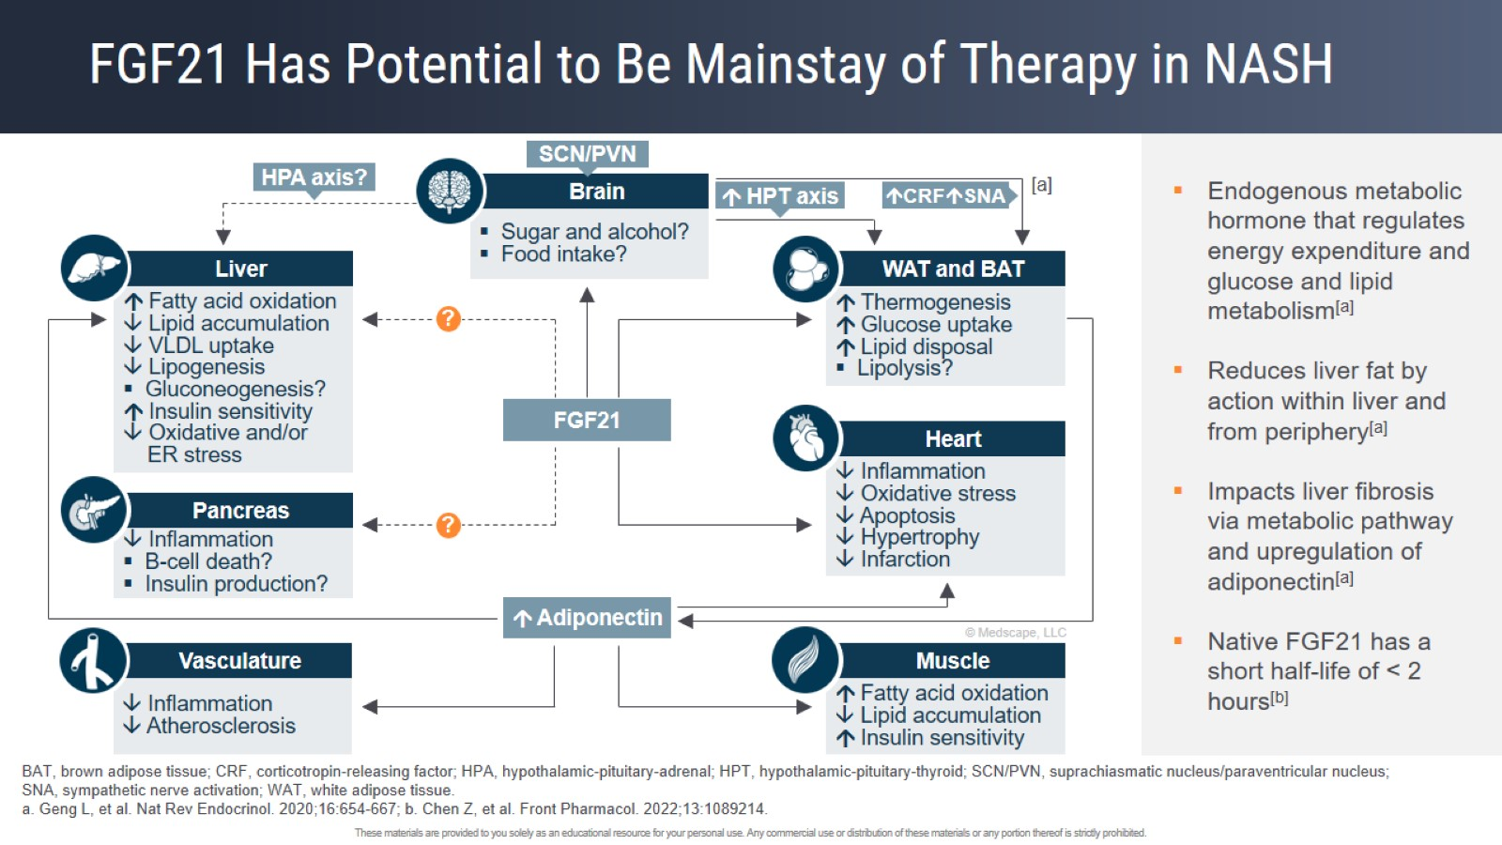
FGF21 Has Potential to Be Mainstay of Therapy in NASH

Slide 82

Efruxifermin
Phase 2b HARMONY Trial

Slide 83

Pegozafermin
Phase 2b ENLIVEN Trial

Slide 84
SUMMARY
Identify NAFLD in high risk recipients esp DM patients
Identify advanced fibrosis with NIT +/liver biopsy (in a few cases)
Intensify lifestyle modification/bariatric surgery
?future pharmacotherapy

